Slide 1
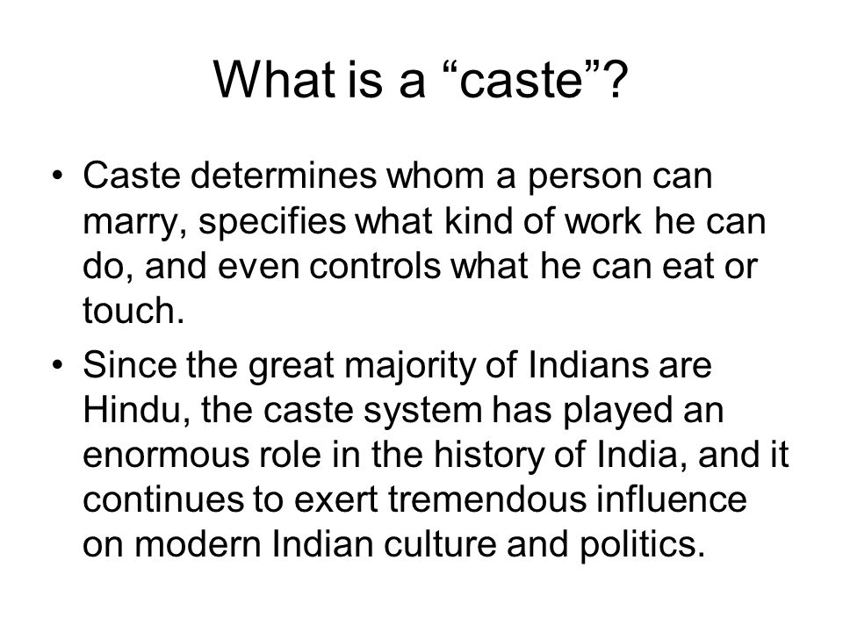
caste

Slide 2
caste
Birth determines the caste. Mostly developed in ancient times but is still present in India. It is a particular characteristic of Indian society & without understanding the caste system Indian Society is not fully understood. The word caste comes from 'Casta' a portugese word & it means difference in birth a race. It is based on 'Varna system ? means colour syst. They are mainly Four Brahmin, Kshastriyas, Vaishya & Sudra. But of course these have many sub-castes

Slide 3
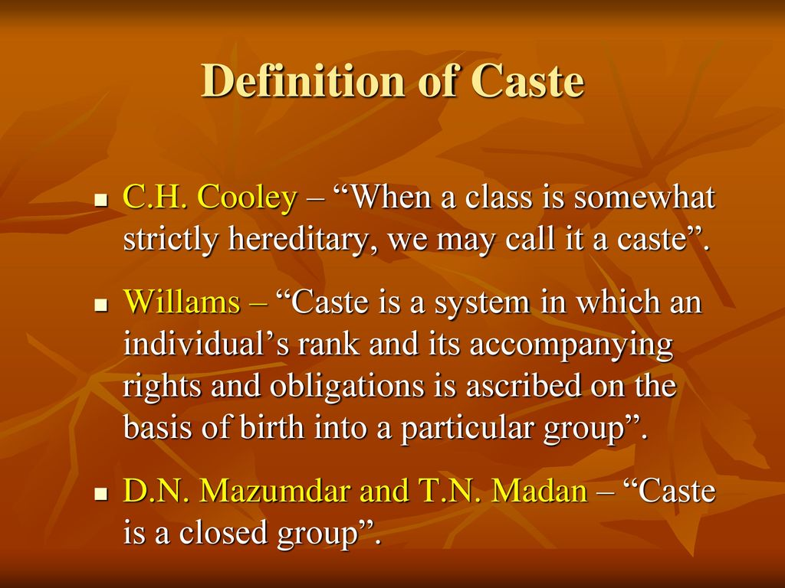
Definitions of caste

Slide 4
Definitions of caste
According to Herbert Kisley – "Class is a collection of families or group of families bearing a common name which usually denotes or is associated with specific occupation, claiming descent from a mythical ancestor, human or divine, professing to follow the same heredity callings & regarded by those who are competent to give an opinion as forming a single homogenous communities.“
Ketekar – in his book "History of caste in India' –'Caste is a social group having two characteristics
(a) membership is confined to those who are born of
members & includes all persons no born.
(b) the members are forbidden by an inexorable social law
to marry outside the group.

Slide 5
Characteristics of the Caste System
Based on birth, or birth is the determinant factor of caste system. Once born in a caste he has to remain the same. Status, position prestige is fixed according to his caste. i.e. A scribed. The castes are divided into sub-caste.
Endogamy & exogamy – In a caste syst. There is restriction on marriage. Westermarck- "Restriction on marriage Endogamy & Exogamy are the essence of the caste system. "Endogamy their one's own caste or sub-caste. Exogamy –same caste but not same clean i.e. Gotra.
Social Hierarchy is found in caste syst. Brahmin is high & sudra have the inferior position & prestige. Prof. Bhurey – Sanskritisation in this the lower caste people can initiate the upper caste. De-Sanskritisation – Upper caste can initiate the lower caste.

Slide 6
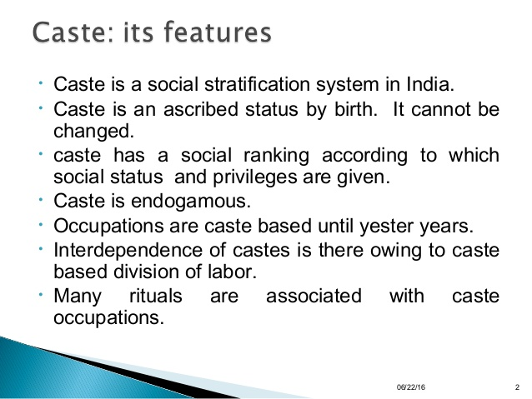

Slide 7
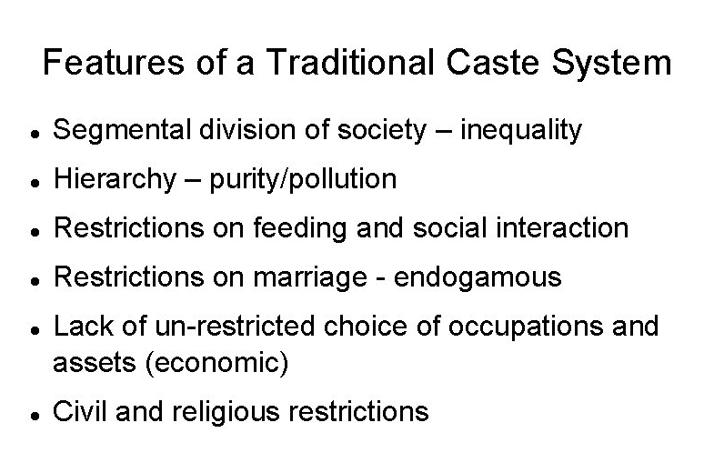

Slide 8
Characteristics of the Caste System
Occupational restriction & hereditary occupation – your occupation is fixed by your caste. A black smith son will always be a black smith.
Economic disparity – The higher caste people are generally economically better off & the lower caste people work harder & yet they get little benefit i.e. they are poorer.

Slide 9
Characteristics of the Caste System
Prof. Ghuray - According to him
Segmental division of society i.e. society is divided into diff. castes. Earlier there were 4 but now over 3000 & work education etc, are associated with it. Role, prestige etc, is fixed according to his caste. Every caste has moral obligation. All people are morally obliged to their own castes & sub-castes i.e. there are certain rules & regulations which one has to follow & are punished if they don't. They are not so much to that society or community but more to his caste.
Social Hierarchy – In caste system, Hierarchy is found & the Brahmin are it the highest level & the Indra's are the lowest and therefore are the untouchables & even unseables. Sanskritisation is Ghuray's concept – i.e. this can initiate the higher caste & therefore change their position.

Slide 10
Characteristics of the Caste System
Prof. Ghuray - According to him
Restriction on food – In the caste system there is restriction in the food too. The members of the higher caste can't take food from the lower caste. Kalahari- fruits can be eaten by the higher caste from anyone & nothing will happen. Pakka Khana – from the Kshtriya & Vaishya. Tried in ghee etc. Kachna Bhajan – rice or Kheer – This can be taken only from his own caste. All these are the 3 types of food & this is in ref. to the Brahmin, the highest class. There is no restriction in water too. Only the kahar can give them water & they can drink from no other caste generally the maids are Ramani Kahar, & because of this they feel somewhat proud cause they are not so backward so that their touched food may not be eaten.

Slide 11
Characteristics of the Caste System
Prof. Ghuray - According to him
Restriction regarding marriage & social inter course – One should not marry within one's own clan. There is restriction even in social relationship & Bihari may marry a Bihari only & a Bengali a Bengali only.
Occupational Restriction – In a caste syst. There is hereditary in occupation

Slide 12
Theories regarding the origin of C.S.
Traditional Theory – Vedas, mainly Rig Veda, Maha Bharat, Geeta, Upanishad, Manu Smuriti. It says caste syst. Originated from the of body Bramha i.e. from the month came Brahmin, Keshahiya, arms, Vaishyas – thighs & Shudras from feet. And the place was given to the hierarchy of organs in the body. Varna, status & position is fixed according to this. Therefore 1st come Brahmins then Kshatriyas then Vaishayas & last Sudras. The month for preaching, learn, ceremonial performation, the arms – protections, thighs – to cultivate or business feet – helps the whole body therefore the duty of the Sundras is to serve all the others. Manu – C.S. has developed due to Auolay & pratilog.

Slide 13
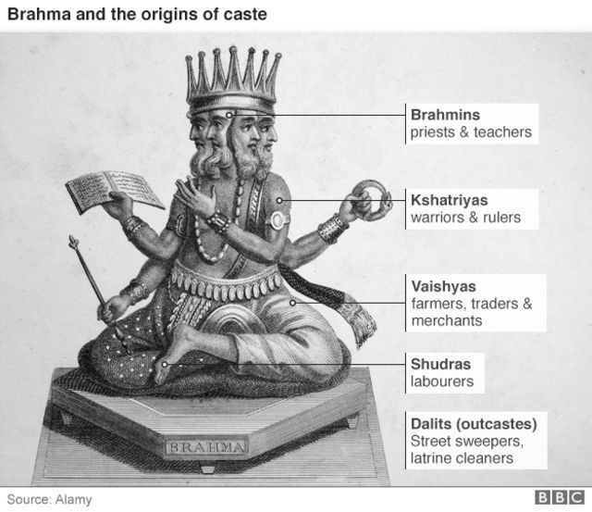
Traditional Theory

Slide 14
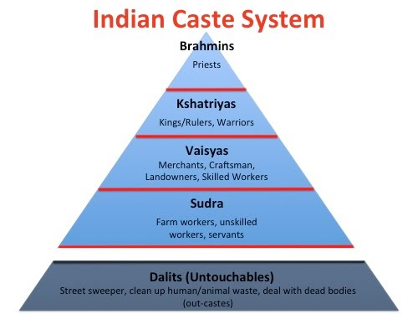
Indian caste system

Slide 15
Religious theory
Given by Hocart' C.S. Originated due to religious factor a due to performance of various religious rites. In India religion plays an imp. place. Everything is based on this religion. He gave – pure work i.e. to perform religious work. Those who do Yagya they are Brahmins, the ones who gather flower – messages – impure work – those who sacrificed the low caste (Dasas).

Slide 16
Political theory
– Abbe Dubois, - C.S. originated due to the supremacy of Brahmins – the Brahmanism, theory. To maintain their superiority diff. castes & sub-castes came into being Ghuray – 'Caste is the Brahmin child of the Indo-Arjun culture, cradled in the Ganges & Yamuna & then transferred in other parts of the country'.

Slide 17
Occupational Theory
By Nesfield- C.S. is based on occup.The hierarchy is according to occupation.The higher the occupation the higher the position & status in societies. If the according is considered good in a place that caste is high but it may necessarily be higher in another place.In general C.S.originated from the Varmas & then in marriage but these varmas of Anolog & Pralilog & sub-caste were formed.

