Slide 1

ENTREPRENEURSHIP DEVELOPMENT INSTITUTION OF INDIA (EDII)
BY: BHARADIYA VAISHNAVI SATISH
M. A. F. D. S. Y.

Slide 2
Content :
Introduction
International Centres
Timeline
Mission and Beliefs
Sponsors
Governing Board
Departments at EDII
Courses
Projects
Regional Offices
Functions
Objectives

Slide 3
Introduction
Autonomous and not- for- profit institution
Established – Societies Registration Act on April 20, 1983.
Head Quarter – Ahmedabad, Gujarat
EDII has helped set up 12 state level exclusive Entrepreneurship Development Centres and Institutions.
EDII established a Centre for Research in Entrepreneurship Education and Development (CREED)

Slide 4
INTERNATIONAL CENTRES
EDII has 4 existing International Centres located in –
Myanmar
Laos
Vietnam
Cambodia
Upcoming centres of EDII would be in- Rwanda , Uzbekistan , Zambia , Namibia and in Mauritius.

Slide 5
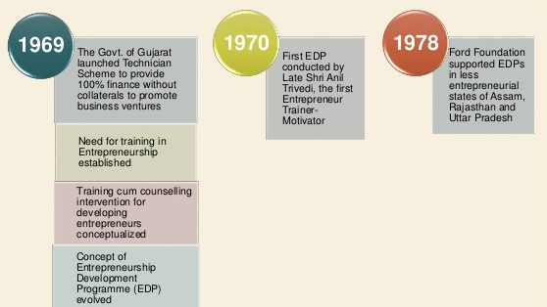
TIMELINE

Slide 6
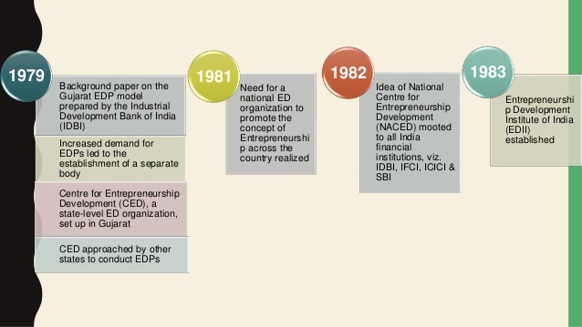
TIMELINE

Slide 7
MISSION AND BELIEFS
MISSION:
To become catalyst in facilitating emergence of competent first generation entrepreneurs and transition of existing SMEs into growth-oriented enterprises through entrepreneurship education, training, research and institution building.
BELIEFS:
EDI has been spearheading entrepreneurship movement throughout the nation with a belief that entrepreneurs need not necessarily be born, but can be developed through well-conceived and wel-directed activities.

Slide 8
SPONSORS
IDBI BANK
ICICI BANK
IFCI LIMITED
SBI
GOVT. OF GUJARAT

Slide 9
DEPARTMENTS AT EDII
ENTRERENEURSHIP EDUCATION
POLICY ADVOCACY, KNOWLEDGE AND RESEARCH
PROJECTS
BUSINESS DEVELOPMENT SERVICES & NATIONAL OUTREACH
DEVELOPING ECONOMY ENGAGEMENT

Slide 10
COURSES
Doctoral level prog.- FPM
PGDM – BE
PGDM – Developing Studies
Open Learning Programme in Entrepreneurship

Slide 11
PROJECTS
Ongoing major projects:
DST – NIMAT
Accenture – Skills to succeed 2020 goals
Start up Village Entrepreneurship Programme
Tourism Corporation of Gujarat Ltd
Udyamita – MOSDE
Food Processing Project
Karnali Project

Slide 12
REGIONAL OFFICES
North : Lucknow
North East : Guwahati
East : Bhubaneshwar
South : Bengaluru
Thrissur
Central : Bhopal

Slide 13
FUNCTIONS
Promoting micro enterprises at rural areas.
Participating in institutional building efforts.
Inculcating spirit of ‘Entrepreneurship’ in youth.
Developing new knowledge and insights on entrepreneurship theory.
Improving managerial capabilities.
Collaborating with other organizations.

Slide 14
OBJECTIVES
Augment supply of new entrepreneurs.
Enterprise creation and employment generation.
Increase competitiveness of Indian SME’s.
Act as repository of knowledge in the area of women entrepreneurship.
Create a group of trained social entrepreneurs.

Slide 15
THANK YOU

