Slide 1
Mesopotamia

Slide 2
Turkey costume
Turkish salvar are traditional baggy trousers. Men may add the traditional loose coat called a jubba, over the salvar. Mustafa Kemal pasha changed the dress coad in turkey in the 1920’s as
Part of his revolutions. However, men & women still wear the salvar in many areas of turkey indifferent to social status.

Slide 3
Female Dress(costume)
The traditional clothing for women of Turkey includes the şalvar which is usually worn with upper garments of varying styles and lengths. The traditional şalvar suits are a part of Turkey's culture back to the Ottoman era. The şalvars are of varying degrees of bagginess and are gathered at the ankle. Bright colours and flowered prints are favoured by rural women. The total female ensemble includes the
1.Salvar
2.Gömlek (chemise), and
3. Entari (robe).

Slide 4
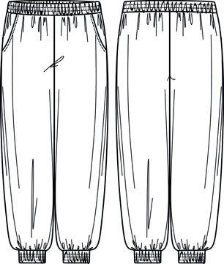
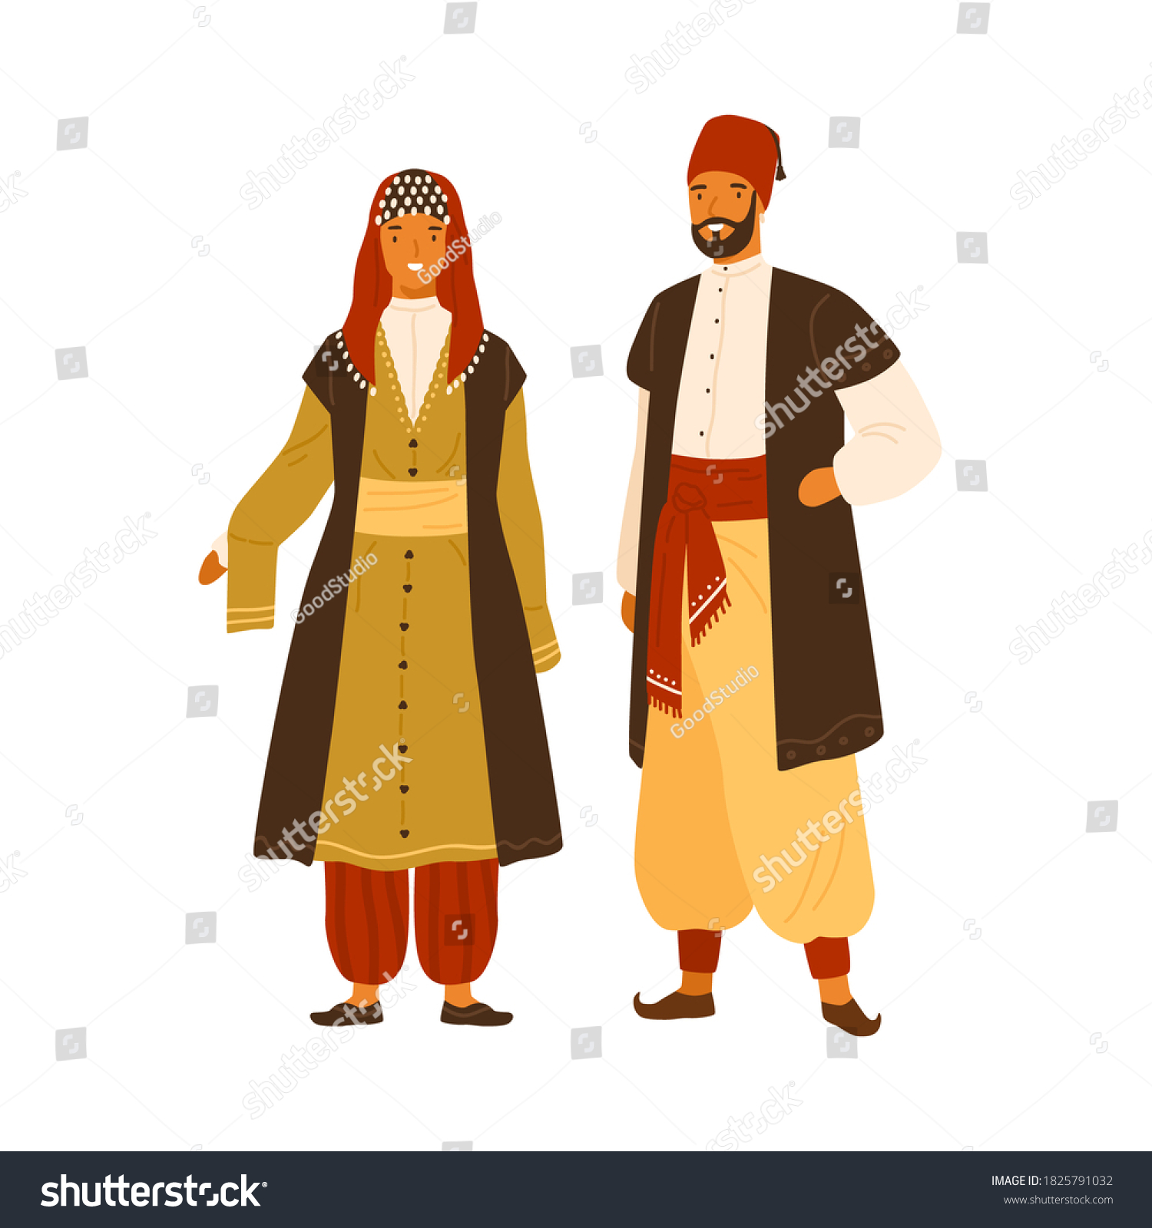
1.SALVAR

Slide 5
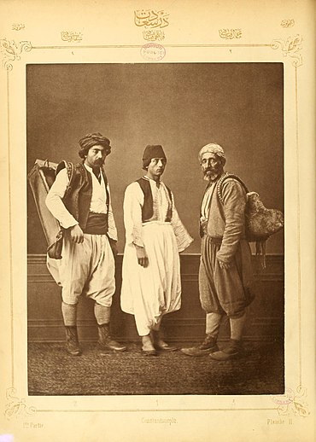

Slide 6
GOLMEK (chemise)
A type of undergarment worn close to the skin in order to protect outer garments, though the term chemise is now most commonly associated with being a women’s garment. during this period, it was also used to describe an item of men’s underclothing. Women wore a shift or chemise under their gown or robe; while men wore a chemise with their trousers , and covered the chemise with garments such as doublets, robes, etc.

Slide 7
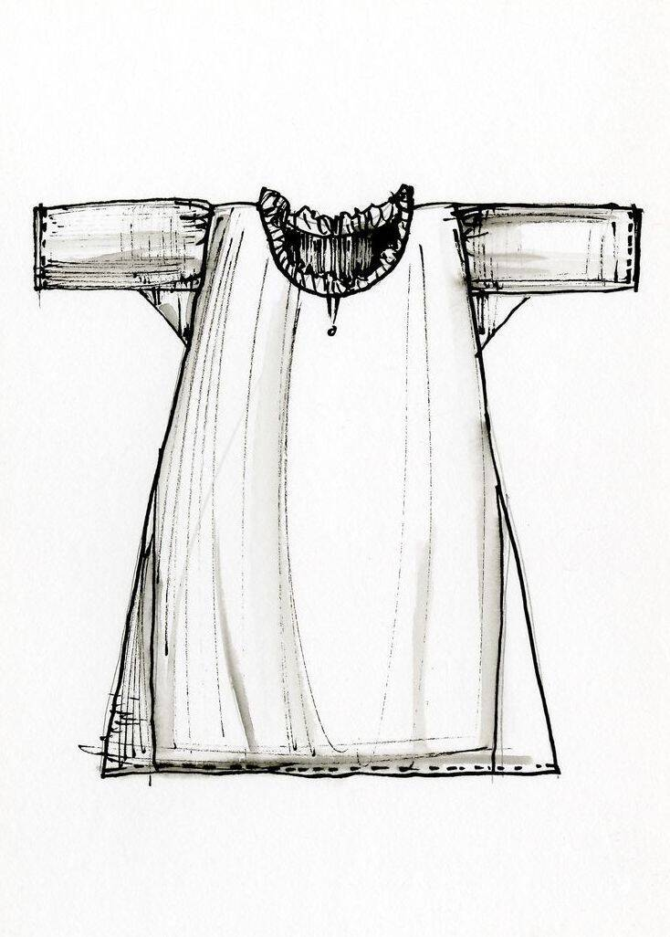

Slide 8
Entari, Or Robe
The entari, or robe, was the primary garment of indoor dress for women in the Ottoman Empire for several centuries. Worn over an undershirt (gömlek) and baggy trousers (şalvar), the entari was open down the front, held closed by a belt or sash. While the proportions of the garment changed over time
.

Slide 9
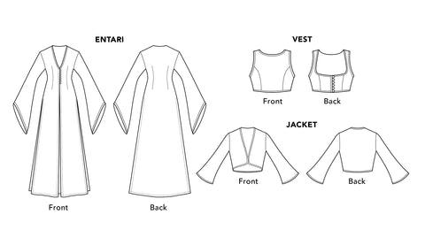

Slide 10
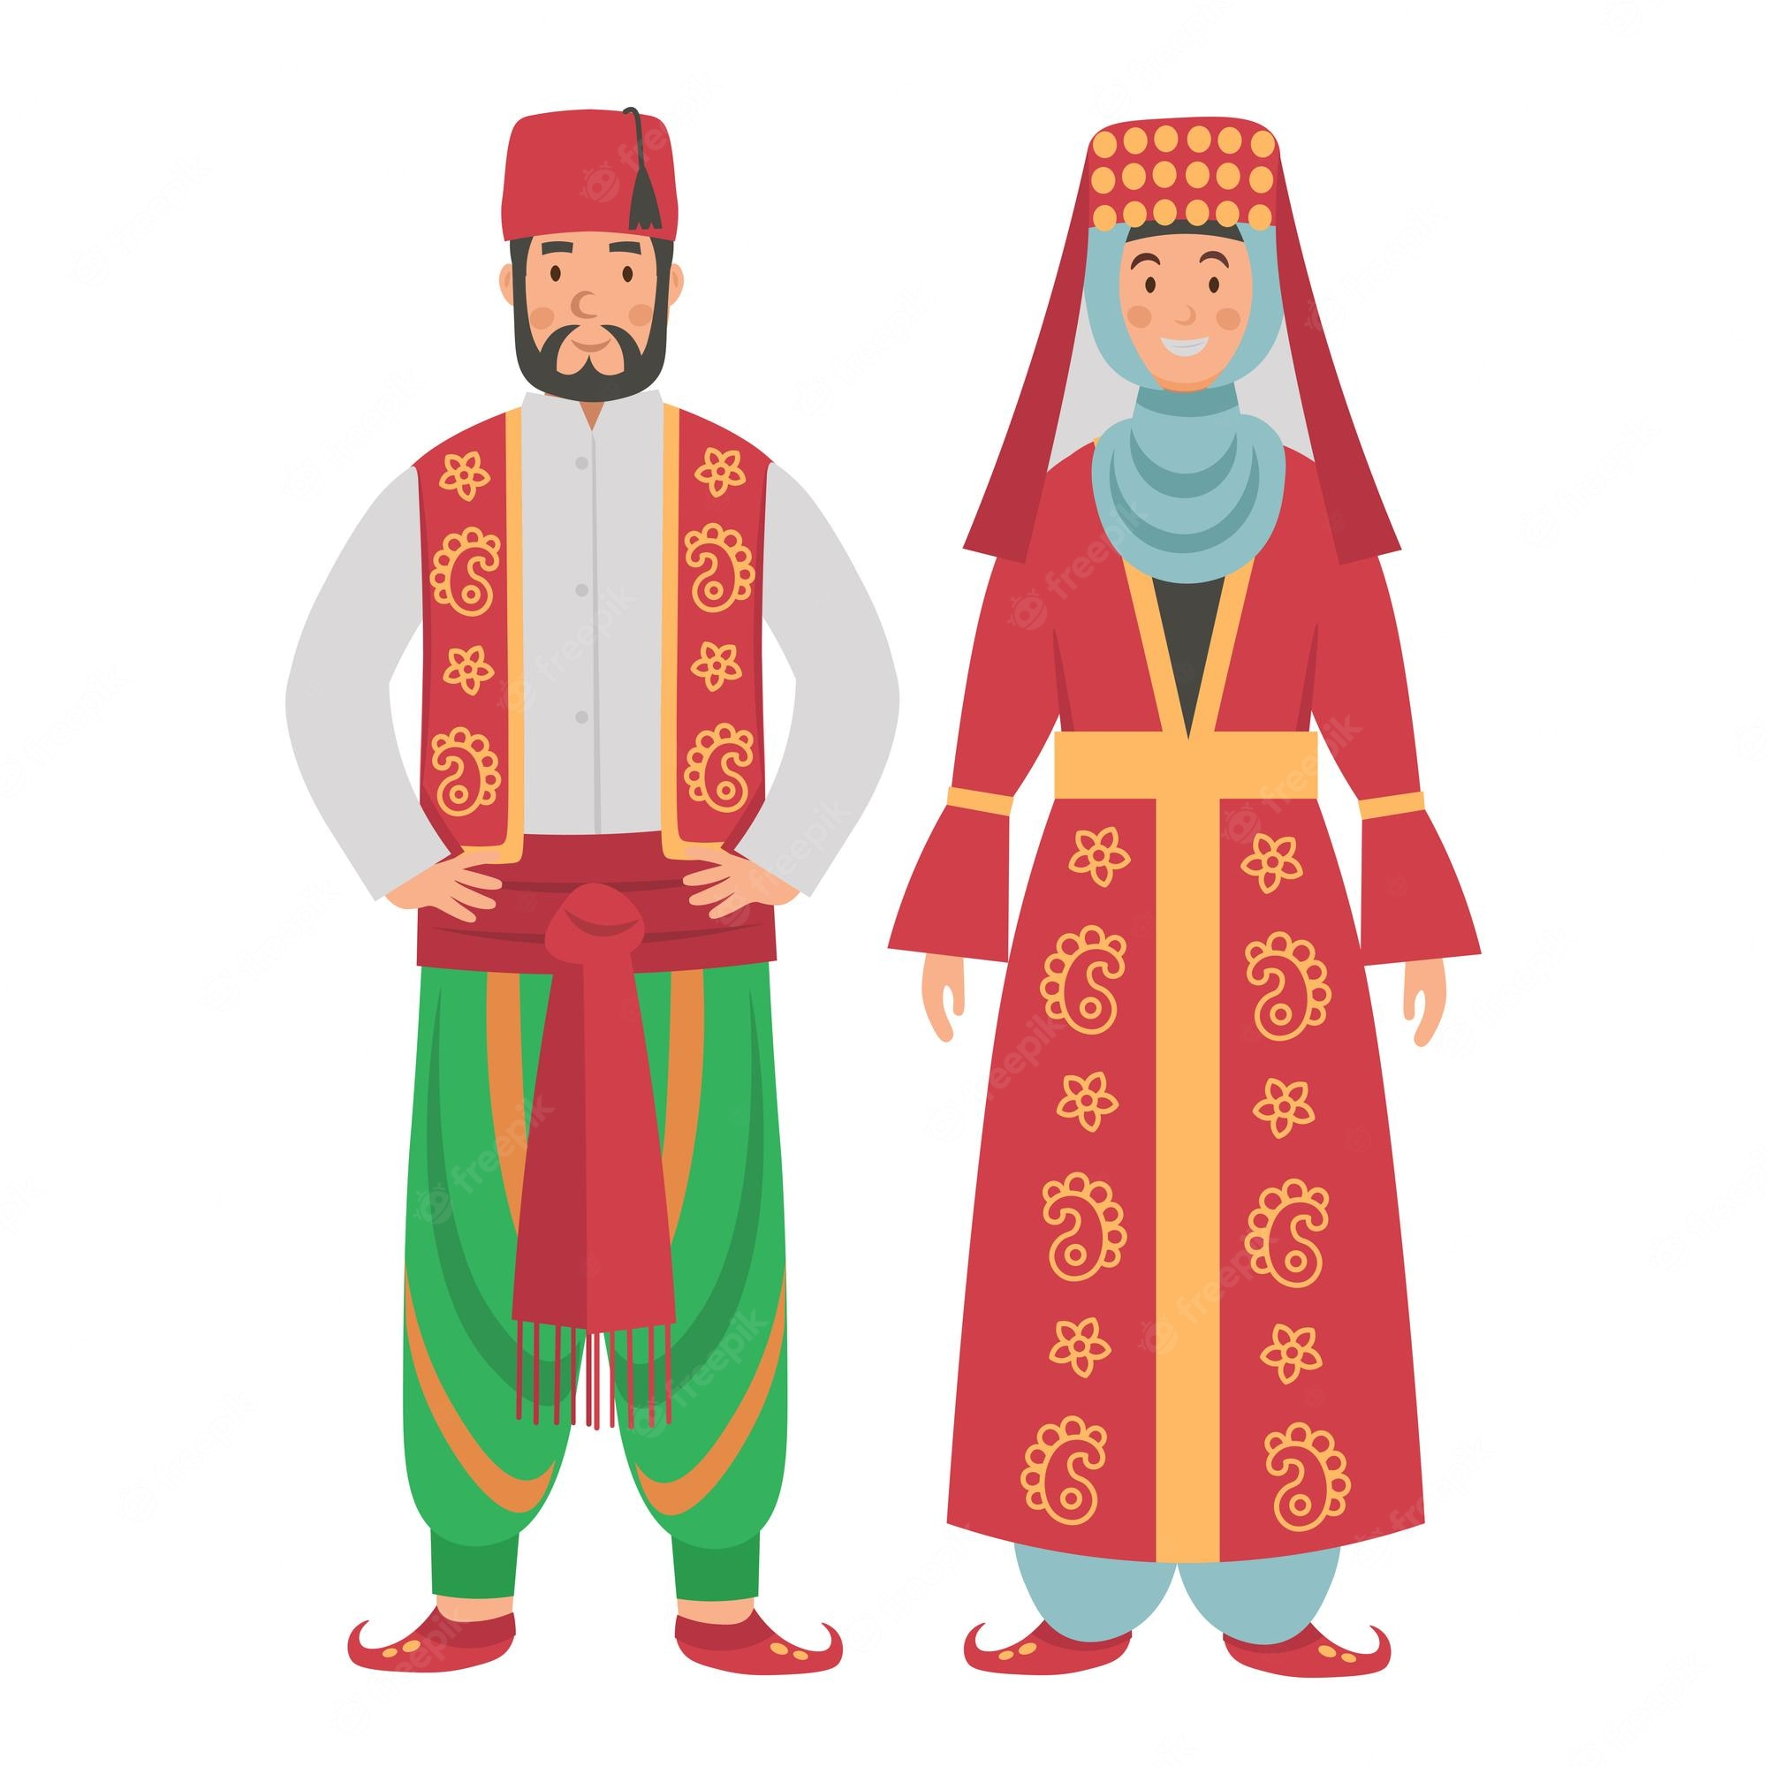

Slide 11
Forms of Turkish Traditional Dress
Characteristic features of Turkish traditional dress include the layering of garments, distinctive surface or woven-in decoration on the fabrics, and a geometric cut. Wool, silk, and cotton, fibers are commonly used for apparel. Separate garments are layered to accommodate the need for adjustments according to climate; to create storage areas for coins and other small items in fabric folds; and to create asystem for holding garments onto the body. Careful cutting exposes portions of garments underneath the top layers. Surface design is achieved by embroidering, dyeing, or weaving.

Slide 12
Male Dress(costume)
1.Salvar
2.Yelek(vest)
3.Cebken(jaket)

Slide 13
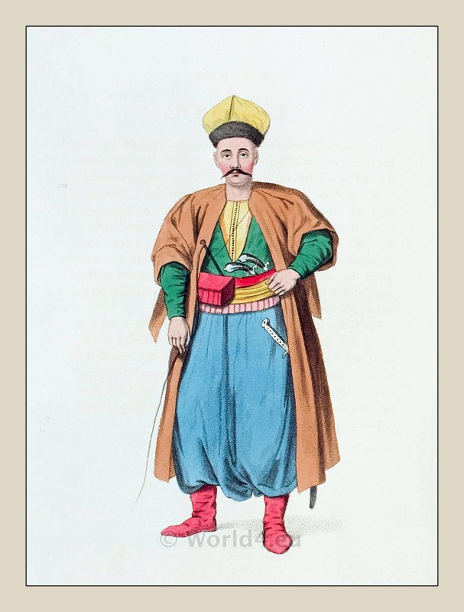
Salvar

Slide 14
2.Yelenk(vest)
A yelek is the bodice or waistcoat of Ottoman origin, traditionally worn by women & men. The yelek is typically a sleeveless and collarless garment and usually has small pockets on the sides. Traditional yeleks are generally embroidered and made out of silk cloth as well as velvet and leather. During the Ottoman era, the yelek was a hip-length jacket or vest worn for warmth by both sexes. It could have long sleeves, short sleeves, or no sleeves, and often had a small standing collar.

Slide 16
3.Cebken(jacket)
In this period men wore outer items such as 'mintan an entari or kaftan (a long robe), 'kalpak’ on the head; 'çarık', (boots), 'çedik', 'Yemeni' on the feet.
The administrators and the wealthy wore caftans with fur lining and embroidery, whereas the middle class wore 'cübbe' (a mid-length robe) and 'hırka' (a short robe or tunic), and the poor wore collarless 'yelek' (vest).

Slide 17
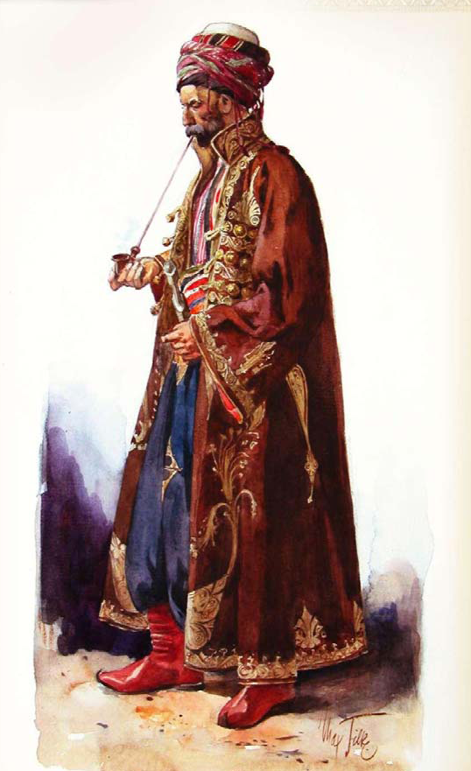
Presentation title

Slide 18

PRESENTED BY
DEEPA NILAWAR

