Slide 1
Byzantine middle age clothing
​

Slide 2


300 to 1400AD
A
Introduction
Men's clothing
Women's clothing
Accessories
Summary

Slide 3
Introduction
.

Slide 4
Men's clothing

Slide 5
Men's costume
In Byzantium didn't change too much over the centuries. It consisted of the tunica, the cloak and shoes or boots. The shapes of the garments were consistent throughout the classes, only the quality of the fabric and trimming distinguished them.

Slide 6
The change from ancient to Byzantine costume began (c.400) with the end of the Roman Empire. The social and financial status as well the profession, the age and sex were the main factor for costumes during Byzantine period. Costume was the identity for the two main parts of Byzantine society,
The higher class with aristocrats, provincial officials (public and military)
The poor citizens, servants, monks, soldiers and farmers.

Slide 7
Tunica
was the basic article of clothing in Byzantium. For the lower classes, it was the everyday working garment. For the upper classes, it was the underlayment for some of the richest clothing in history. The tunica was a derivation of the ancient Roman tunica talaris, or tunic to the ankles. They were trim in the sleeve and mostly loose in the body. The more active wearer would gird it up to the shins or knees with a thin belt. The sleeve length would change according to the class of the wearer and the weather.
The primary fabric for a tunica was undyed linen orundyed wool. Both would be in a plain weave.

Slide 8
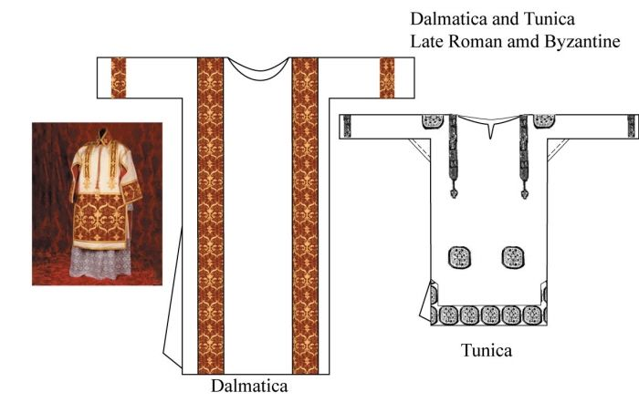

Slide 9
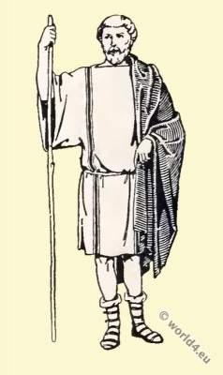

Slide 10
Dalmatica
was the over robe worn by the upper classes and on special occasions, by the commonpeople. An early (6th -10th cent.) type of dalmatic is characterized by the one worn by Emperor Justinian in theRavenna mosaics. It has long tight sleeves and comes down to the knees. This would be worn over a tunicor shirt and was usually belted.
Emperor Justinian and his consequence. Mosaic from St Apolinarius in Ravenna.
Dalmatica
was the over robe worn by the upper classes and on special occasions, by the common people. type of dalmatic is a long unbelted robe with wide sleeves was reserved as an outer garment for ruler & high ranking dignitaries .colourful lengthways stripes called clavi, decorated the front & back as well as the hem of the sleeves. It has long tight sleeves and comes down to the knees. This would be worn over a tunic or shirt.

Slide 11
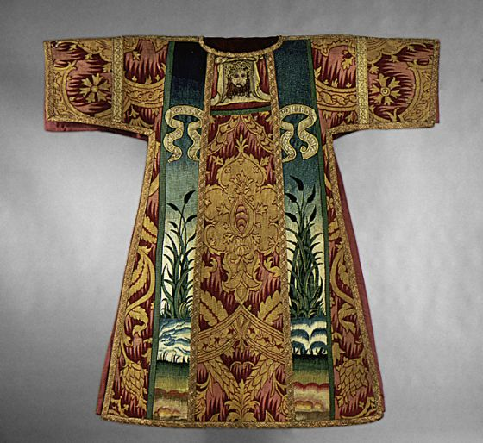

Slide 12
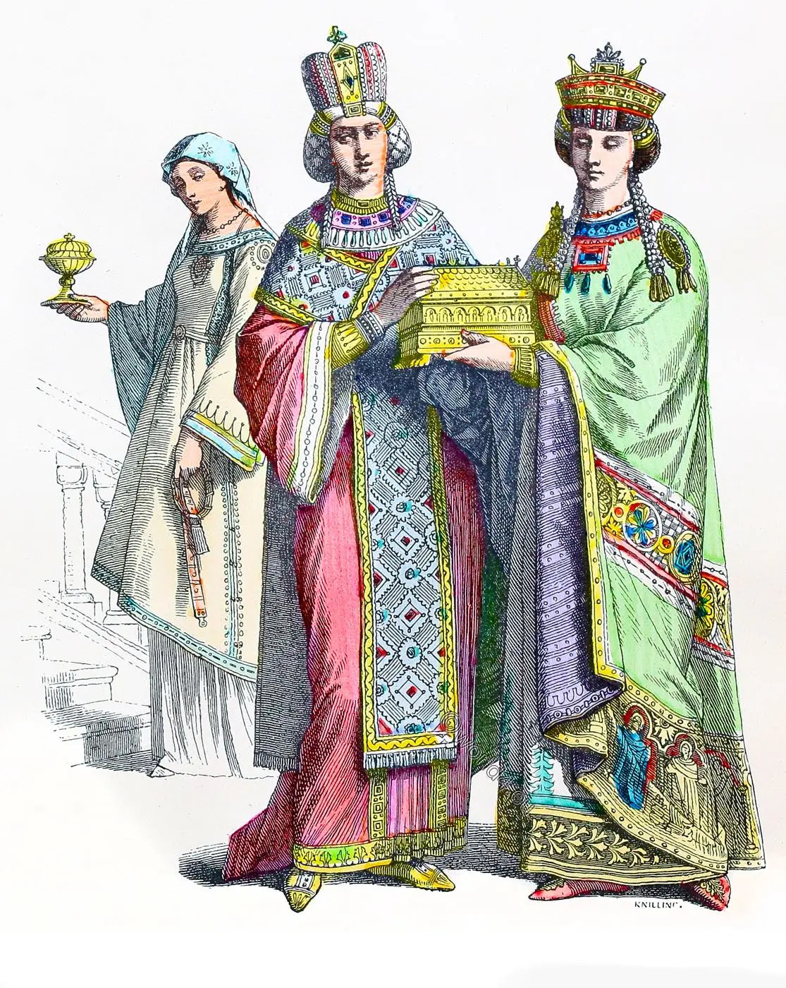

Slide 13
Cloaks:
The semi circular or rectangular cloak seemed to have been the most popular. Cloaks would be pinned on the right shoulder for ease movement. The length usually fell to about the hips or floor and on each straight side there might be a tablion. The tablion was a decorative spot sometimes used to show the rank of the wearer by the type of embroidery and jewels that were used.

Slide 14
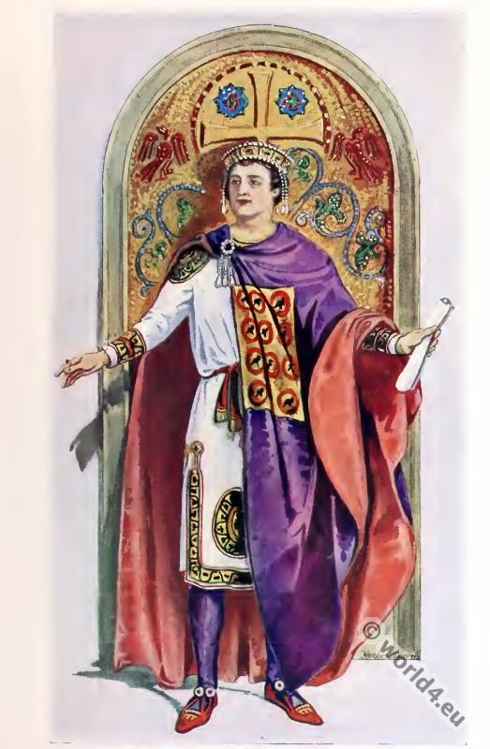

Slide 15
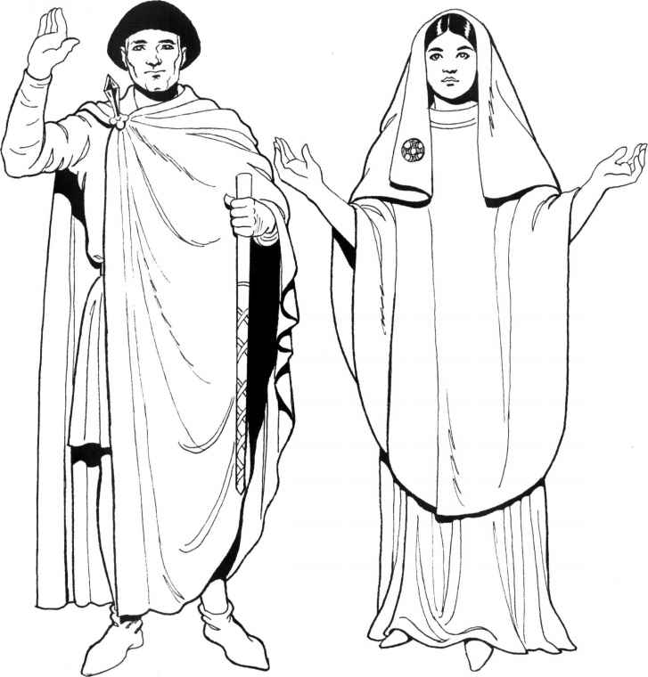

Slide 16
Paenula
Is a robe which was put on over the head was adopted by the church & become the chasuble.

Slide 17
Women's clothing

Slide 18
Women's costume
in Byzantium didn't change too much over the centuries either. It basically consisted of the tunica, the stola, and shoes. The lower classes still wore basically Roman clothes. These had lots of drape and movement, so the ladies could get on with their work. The upper class women wore the more stiff, jewelled garments

Slide 19
Tunica:
These were the basic underclothes for every class and every time period. It would only vary in material by class of the wearer. It was long and had tight sleeves that were trim to the body. The neck would be cut either in a boat style or in a regular round configuration. This garment could be of fine wool, as in Roman times, or of linen or silk. Generally it was the sole garment of the lower classes. It could be plain or have trimming. The trimming would be around the foot of the garment, the neck, and the wrists. Clavi would also be seen, in varying lengths.

Slide 20
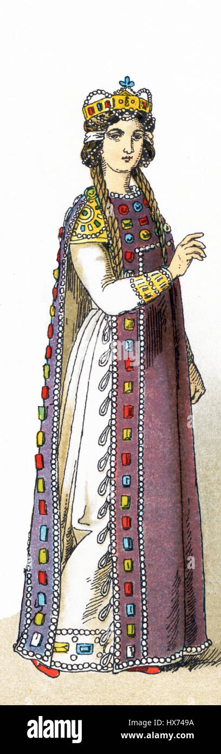

Slide 21
Stola
the stola was wide and had no separate sleeves. A sleeved effect was gotten from the excess width of the stola being belted at the waist and bloused over the belt.it is the outer garment, & reached to the floor.

Slide 22
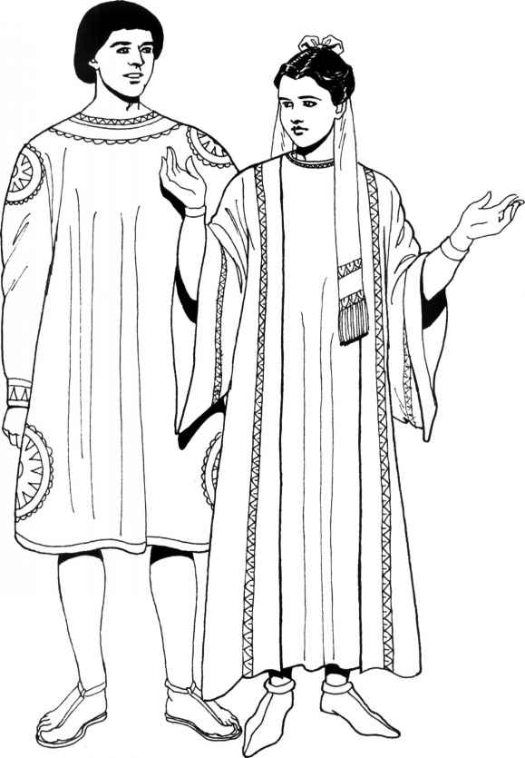

Slide 23
Cloaks:
Cloaks were semicircular from the early centuries.The straightedge was worn over the head like a scarf. Sometimes, though they would be pinned in the center with a big brooch or they wouldn't fasten at all.

Slide 24
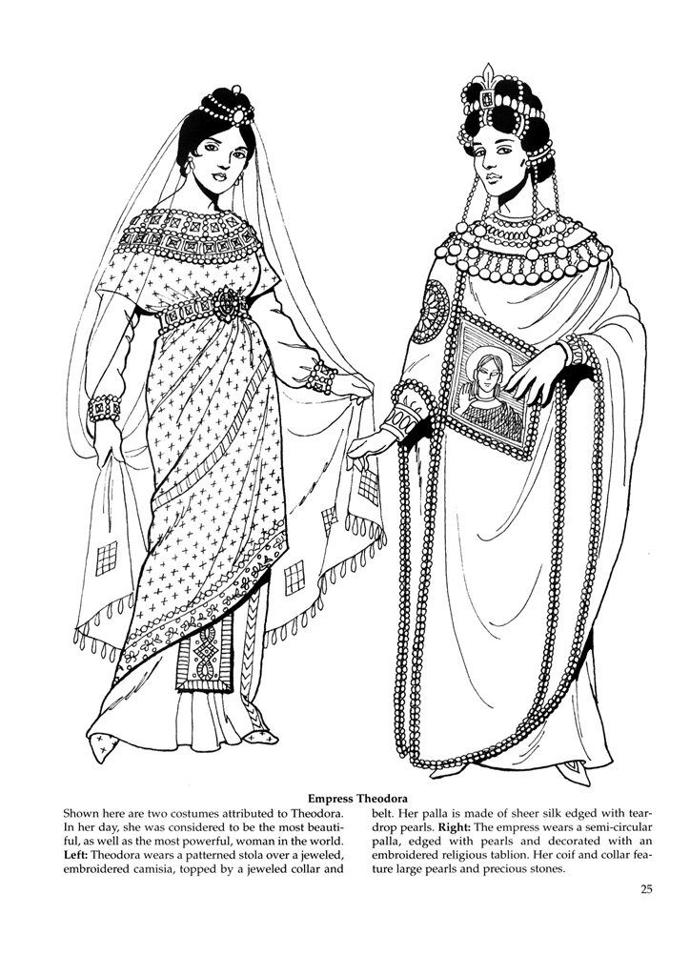

Slide 25
Thank you
Thank you

