Slide 1
Course No. 6 : English Literature III (Victorian)
The Victorian Period 1830-1901
Unit I : Background
1) The Age of the Novel
2) Early Victorian Verse
3) Early Victorian Nonfictional Prose
4) The Oxford movement
5) Late Victorian Fiction
6)The Pre-Raphelites
7) Victorian Drama
8) The Decadent movement

Slide 2
A Time of Change
London becomes most important city in Europe
Population of London expands from two million to six million
Shift from ownership of land to modern urban economy
Impact of industrialism
Increase in wealth
World’s foremost imperial power
Victorian people suffered from anxiety, a sense of being displaced persons in an age of technological advances.

Slide 3
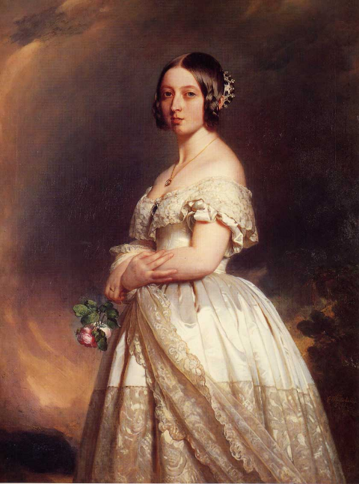
Queen Victoria and the Victorian Temper
Ruled England from 1837-1901
Exemplifies Victorian qualities: earnestness, moral responsibility, domestic propriety
The Victorian Period was an age of transition
An age characterized by energy and high moral purpose

Slide 4
The Early Victorian Period 1830-1848
In 1830, the Liverpool and Manchester Railway opened, the first public railway line in the world.
By 1850, railway lines connected England’s major cities
By 1900 , England had 15,195 lines of railroad and an underground rail system beneath London.
The train transformed England’s landscape, supported the growth of commerce, and shrank the distance between cities.

Slide 5
Troubles1830’s and 1840’s
&
The Reform Bill of 1832
Unemployment
Poverty
Rioting
Slums in large cities
Working conditions for women and children were terrible
Transformed English class structure
Extended the right to vote to all males owning property
Second Reform Bill passed in 1867
Extended right to vote to working class

Slide 6
Impact on Victorian Literature
The novelists of the 1840’s and the 1850’s responded to the industrial and political scene:
  Charles Kingsley - The Water Babies
  Elizabeth Gaskell – North and South;
  Life of Charlotte Bronte
  Benjamin Disraeli - Sybil

Slide 7
The Mid-Victorian Period
1848-1870
A time of prosperity
A time of improvement
A time of stability
A time of optimism
The Crystal Palace was erected to display the exhibits of modern industry and science at the 1851 Great Exhibition
One of the first buildings constructed according to modern architectural principles
The building symbolized the triumphs of Victorian industry

Slide 8
Religious Debate
Evangelical movement emphasized spiritual transformation of the individual by conversion and a moral Christian life.
Their view of life was identical with Dissenters.
The High Church emphasized the importance of tradition, ritual, and authority
The Oxford Movement led by Newman
The Broad Church was open to modern ideas.

Slide 9
Utilitarianism & Challenges to Religious Belief
Derived from the ideas of Jeremy Bentham and his disciple James Mill, the father of John Stuart Mill
Rationalist test of value
The greatest good for the greatest number
Utilitarianism failed to recognize people’s spiritual needs
Science
  Huxley
  Darwin- the Origin of Species and The Descent of Man
Higher Criticism
  Examination of the Bible as a mere text of history
  Source studies
  Geology
  Astronomy

Slide 10
The Late Victorian Period1870-1901
Decay of Victorian values
British imperialism
Boer War
Irish question
Bismarck's Germany became a rival power
United States became a rival power
Economic depression led to mass immigration
Socialism

Slide 11
The 1890’s
Breakdown of Victorian values
Mood of melancholy
Aesthetic movement
The beginning of the modern movement in literature
Aubrey Beardsley’s drawings
Prose of George Moore and Max Beerbohm
Poetry of Ernest Dowson

Slide 12
The Role of Women
The Woman Question
Changing conditions of women’s work created by the Industrial Revolution
The Factory Acts (1802-78) – regulations of the conditions of labor in mines and factories
The Custody Act (1839) – gave a mother the right to petition the court for access to her minor children and custody of children under seven and later sixteen.
The Divorce and Matrimonial Causes Act – established a civil divorce court
Married Women’s Property Acts

Slide 13
Educational Opportunities Working Conditions & for Women
First women’s college established in 1848 in London.
By the end of Victoria’s reign, women could take degrees at twelve university colleges.
  Bad working conditions and underemployment drove thousands of women into prostitution.
  The only occupation at which an unmarried middle-class woman could earn a living and maintain some claim to gentility was that of a governess.

Slide 14
Literacy, Publication, Reading
By the end of the century, literacy was almost universal.
Compulsory national education required to the age of ten.
Due to technological advances, an explosion of things to read, including newspapers, periodicals, and books.
Growth of the periodical
Novels and short fiction were published in serial form.
The reading public expected literature to illuminate social problems.

Slide 15
The Victorian Novel
The novel was the dominant form in Victorian literature.
Victorian novels seek to represent a large and comprehensive social world, with a variety of classes & realistic approach.
Major theme is the place of the individual in society, the aspiration of the hero or heroine for love or social position.
The protagonist’s search is symbolic of the human condition.
For the first time, women were major writers: the Brontes, Elizabeth Gaskell, George Eliot.
The Victorian novel was a principal form of entertainment.

Slide 16
Victorian Poetry
Poets sought new ways of telling stories in verse
It shows the strong influence of the Romantics, but can’t sustain the poise the Romantics felt in the power of the imagination.
Victorian poets often rewrite Romantic poems with a sense of belatedness.
Dramatic monologue – the idea of creating a lyric poem in the voice of a speaker ironically distinct from the poet is the great achievement of Victorian poetry.
Victorian poetry is pictorial; poets use detail to construct visual images that represent the emotion or situation the poem concerns.
Conflict t between private poetic self and public social role.

