Slide 1

THE LOST CHILD
Mulk raj anand

Slide 2
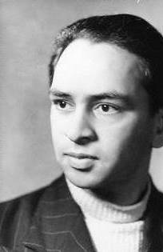
Mulk Raj Anand: Introduction
Born on 12/12/1905 in Peshawar; Died on 28/09/2004 in Pune.
Prominent Indian Author of novels, short stories, and essays in English.
Known for realistic and sympathetic portrayal of India.
Hailed as founder of Indian English Novel.
Notable works include ‘Untouchable’ (1935), ‘Coolie’ (1936) and ‘Two Leaves and a Bud’ (1937)
Studied at Khalsa College, Amritsar and moved to University College London and Cambridge University. Awarded Ph.D. in Philosophy in 1929.
Awarded International Peace Prize (1953), Padma Bhushan (1967) and Sahitya Akademi Award (1971)
Autobiographical Novel ‘Seven Ages of Men’ planned in seven volumes, but completed four volumes.

Slide 3
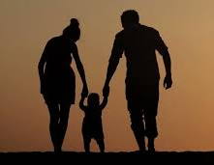

Theme
https://www.graphic.com.
Universality of a child’s nature for everything.
Curious nature of a child.
Aspiration, demands and realization of a child.
A strong bond of love between a Child and parents.
True value of parents.
www.flitto.com/content/1484

Slide 4
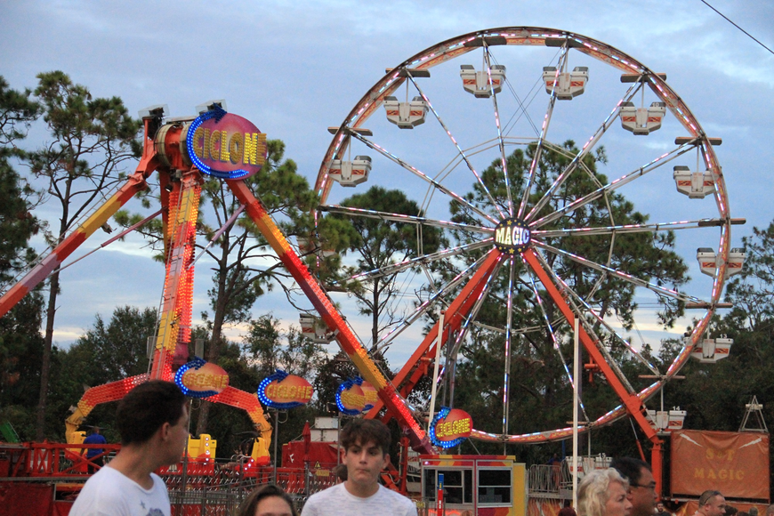
The Lost Child
IT was the festival of spring. From the wintry shades of narrow lanes and alleys emerged a gaily clad humanity. Some walked, some rode on horses, others sat, being carried in bamboo and bullock carts. One little boy ran between his father’s legs, brimming over with life and laughter.
Glossary:
1. wintry shades of narrow lanes and alleys: in the winter season, the narrow lanes were full of shade.
2.Emerged: came out
3.Brimming over: to be full of something
The story is set in the spring season.
The winter has passed, all the people came out of their houses.
They were cheerful as the chilling cold weather had ended.
A little child, with his parents, goes to a fair.
He is happy and excited.

Slide 5
“Come, child, come,” called his parents, as he lagged behind, fascinated by the toys in the shops that lined the way.
He hurried towards his parents, his feet obedient to their call, his eyes still lingering on the receding toys. As he came to where they had stopped to wait for him, he could not suppress the desire of his heart, even though he well knew the old, cold stare of refusal in their eyes.
“I want that toy,” he pleaded.
The child was unable to control his desire any longer. He said that he wanted to buy the toy.
His father looked at him red-eyed, in his familiar tyrant’s way.
His mother, melted by the free spirit of the day was tender and, giving him her finger to hold, said, “Look, child, what is before you!”
Glossary:
1. Lagged behind: was left behind 2. Fascinated by: attracted to 3. Lingering: lasting for a long time 4. Receding: left behind as he walked ahead 5. Suppress: put an end to 6. Tyrant: a cruel and oppressive ruler
The Child’s first demand
The little child was attracted to the toys.
His parents called him as he was left behind.
The child ran towards the parents, but his eyes were fixed on the toys in the shop.
He wanted to buy the toy.
His father looked at him red-eyed.
The child was familiar to his father’s reaction.
His mother became emotional.

Slide 6
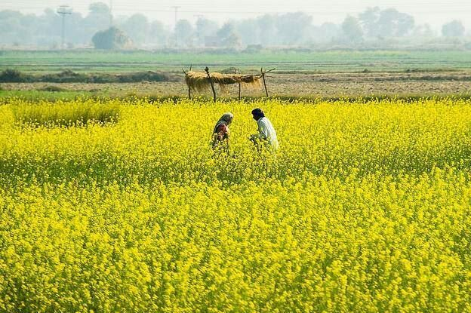
It was a flowering mustard-field, pale like melting gold as it swept across miles and miles of even land. A group of dragonflies were bustling about on their gaudy purple wings, intercepting the flight of a lone black bee or butterfly in search of sweetness from the flowers. The child followed them in the air with his gaze, till one of them would still its wings and rest, and he would try to catch it. But it would go fluttering, flapping, up into the air, when he had almost caught it in his hands. Then his mother gave a cautionary call: “Come, child, come, come on to the footpath.”
He ran towards his parents gaily and walked abreast of them for a while, being, however, soon left behind, attracted by the little insects and worms along the footpath that were teeming out from their hiding places to enjoy the sunshine.
“Come, child, come!” his parents called from the shade of a grove where they had seated themselves on the edge of a well. He ran towards them.
The emotional mother asked the child to look at a flowering mustard-field, bustling dragonflies, black bees and butterflies.
The child followed them to catch, but unable to catch it.
His mother called him as they started walking.
The child joined his parents, but again stopped to see the insects coming out of the soil.
He was left behind and again called by his parents.

Slide 7
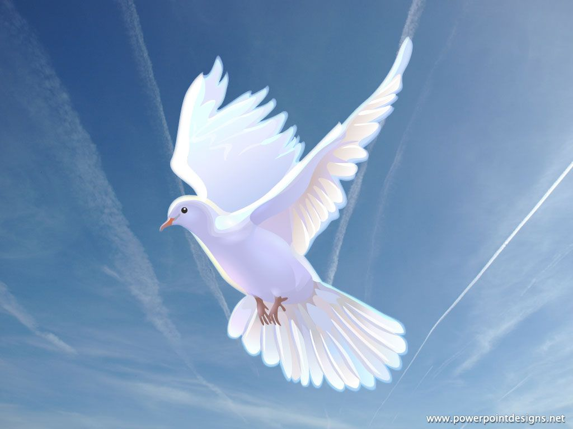
A shower of young flowers fell upon the child as he entered the grove, and, forgetting his parents, he began to gather the raining petals in his hands. But lo! he heard the cooing of doves and ran towards his parents, shouting, “The dove! The dove!” The raining petals dropped from his forgotten hands.
“Come, child, come!” they called to the child, who had now gone running in wild capers round the banyan tree, and gathering him up they took the narrow, winding footpath which led to the fair through the mustard fields.
As they neared the village the child could see many other footpaths full of throngs, converging to the whirlpool of the fair, and felt at once repelled and fascinated by the confusion of the world he was entering.
Glossary:
Grove: a small wood or group of trees
Capers: a playful skipping movement
Throngs: huge crowds
Converging: gathering
The child joined his parents in the grove.
He was welcomed by a shower of flowers.
He started collecting the raining petals.
Just then he heard the cooing of the doves
He started chasing the birds and dropped the petals.
The parents again called the child.
They started marching towards the fair through the mustard fields.
As they neared the village, the child experienced a huge crowd from all direction.
The child was initially confused but felt attracted later.
Dove

Slide 8
A sweetmeat seller hawked, “gulab-jaman, rasagulla, burfi, jalebi,” at the corner of the entrance and a crowd pressed round his counter at the foot of an architecture of many coloured sweets, decorated with leaves of silver and gold. The child stared open-eyed and his mouth watered for the burfi that was his favourite sweet. “I want that burfi,” he slowly murmured. But he half knew as he begged that his plea would not be heeded because his
parents would say he was greedy. So without waiting for an answer he moved on.
A flower-seller hawked, “A garland of gulmohur, a garland of gulmohur!” The child seemed irresistibly drawn. He went towards the basket where the flowers lay heaped and half murmured, “I want that garland.” But he well knew his parents would refuse to buy him those flowers because they would say that they were cheap. So, without waiting for an answer, he moved on.
Glossary:
Heeded: paid attention to
At the entrance of the fair, a sweetmeat seller set up his shop.
He was selling various sweets.
The sweets were displayed at various heights and decorated with leaves of silver and gold.
The child’s mouth watered for the burfi.
He wanted the burfi, but he knew that his parents would not allow him.
Next, he saw a flower-seller selling garland of gulmohur.
The boy wanted one of the garlands and went towards the basket of flowers.
The boy knew very well that his demands were not be fulfilled by the parents.
They would refuse to buy the floweres saying they were cheap.
So, the boy moved on in the fair.

Slide 9
A man stood holding a pole with yellow, red, green and purple balloons flying from it. The child was simply carried away by the rainbow glory of their silken colours and he was filled with an overwhelming desire to possess them all. But he well knew his parents would never buy him the balloons because they would say he was too old to play with such toys. So he walked on further.
A snake-charmer stood playing a flute to a snake which coiled itself in a basket, its head raised in a graceful bend like the neck of a swan, while the music stole into its invisible ears like the gentle rippling of an invisible waterfall. The child went towards the snake-charmer. But, knowing his parents had forbidden him to hear such coarse music as the snake-charmer played, he proceeded farther.
Glossary:
Overwhelming: a very strong emotion
Forbidden: not allowed
Coarse: unpleasant
The boy saw the balloon seller selling balloons of different colours.
The boy was attracted to shiny colours of balloon and wanted all of them.
He knew that his parents would not buy the balloons because he was too old to play with the balloons.
He moved on and came across a snake-charmer. He was playing a flute to a snake
The snake coiled itself in a basket.
Its head raised in a graceful bend like the neck of a swan.
The child went towards the snake-charmer.
But moved on immediately because his parents had forbidden him to hear coarse music.

Slide 10
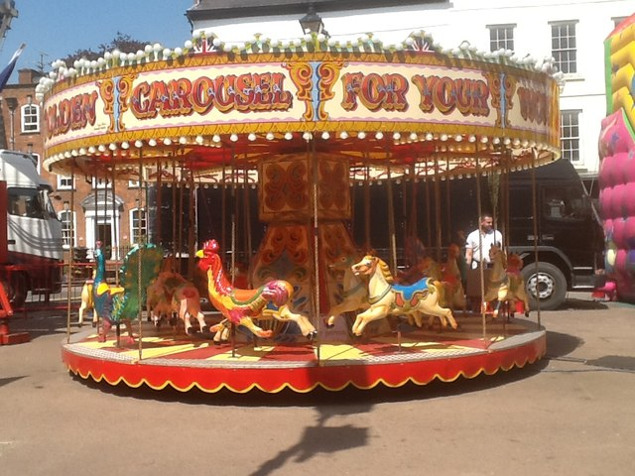
There was a roundabout in full swing. Men, women and children, carried away in a whirling motion, shrieked and cried with dizzy laughter. The child watched them intently and then he made a bold request: “I want to go on the roundabout, please, Father, Mother.”
There was no reply. He turned to look at his parents. They were not there, ahead of him. He turned to look on either side. They were not there. He looked behind. There was no sign of them.
A full, deep cry rose within his dry throat and with a sudden jerk of his body he ran from where he stood, crying in real fear, “Mother, Father.” Tears rolled down from his eyes, hot and fierce; his flushed face was convulsed with fear. Panic-stricken, he ran to one side first, then to the other, hither and thither in all directions, knowing not where to go. “Mother, Father,” he wailed. His yellow turban came untied and his clothes became muddy.
Glossary
Hither and thither: here and there
The boy saw a roundabout in full swing.
The people carried away in a whirling motion.
They were enjoying the swing.
The child wanted to go on the roundabout.
He turned to look at his parents and found that they were nowhere around.
The boy cried loudly, jerked his body and ran here and there calling out for his parents. He was full of fear and tears started rolling down his cheeks.

Slide 11
Having run to and fro in a rage of running for a while, he stood defeated, his cries suppressed into sobs. At little distances on the green grass he could see, through his filmy eyes, men and women talking. He tried to look intently among the patches of bright yellow clothes, but there was no sign of his father and mother among these people, who seemed to laugh and talk just for the sake of laughing and talking.
He ran quickly again, this time to a shrine to which people seemed to be crowding. Every little inch of space here was congested with men, but he ran through people’s legs, his little sob lingering: “Mother, Father!” Near the entrance to the temple, however, the crowd became very thick: men jostled each other, heavy men, with flashing, murderous eyes and hefty shoulders. The poor child struggled to thrust a way between their feet but, knocked to and fro by their brutal movements, he might have been trampled underfoot, had he not shrieked at the highest pitch of his voice, “Father, Mother!” A man in the surging crowd heard his cry and, stooping with great difficulty, lifted him up in his arms.
Glossary:
Intently: carefully Congested: full of
Hefty: large and heavy Thrust: push
Knocked: hit Brutal: harsh
Trampled: crushed Surging: powerful
After some time he gave up. The loud cries turned into mild sobs.
He saw some people standing and talking. The laughter and talks of the people were meaningless for the child.
He was simply searching for his parents.
The boy ran towards a temple which was crowded with people.
He ran through the legs of men, calling out for his parents.
The strong men in crowd was pushing each other as he neared the entrance of the temple.
The boy got scared and could have been crushed under the feet of the men.
His cries have been heard by a man in the crowd. He lifted the child.

Slide 12
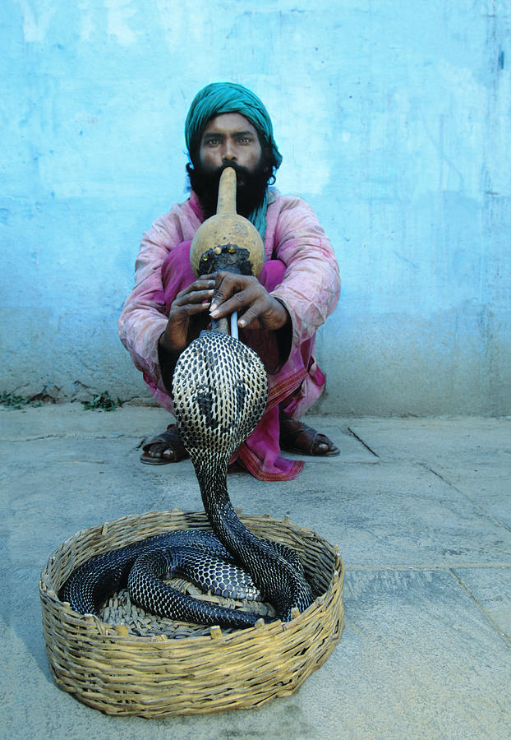
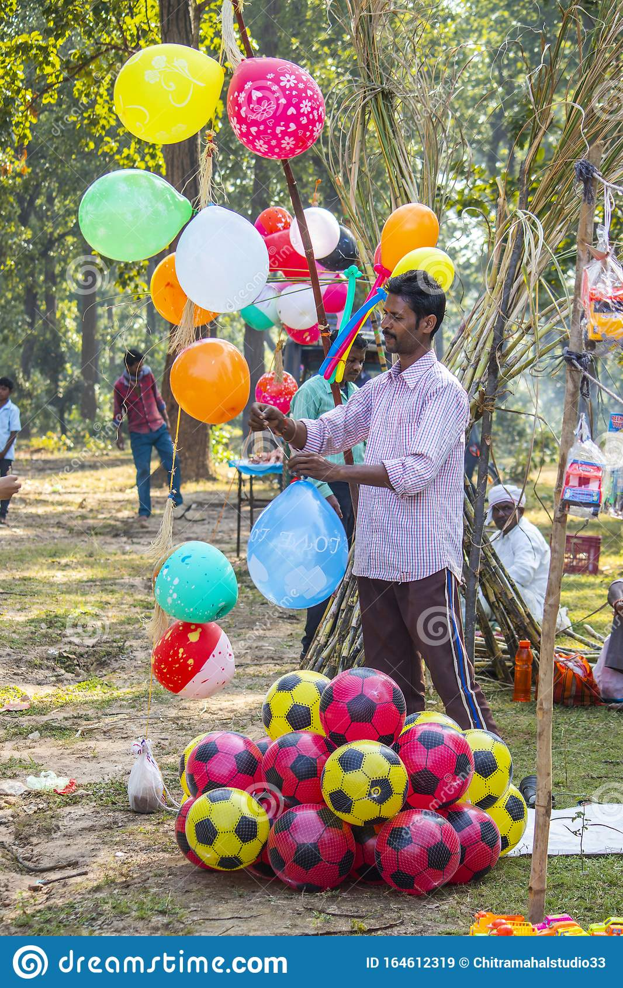
“How did you get here, child? Whose baby are you?” the man asked as he steered clear of the mass. The child wept more bitterly than ever now and only cried, “I want my mother, I want my father!”
The man tried to soothe him by taking him to the roundabout. “Will you have a ride on the horse?” he gently asked as he approached the ring. The child’s throat tore into a thousand shrill sobs and he only shouted, “I want my mother, I want my father!”
The man headed towards the place where the snake-charmer still played on the flute to the swaying cobra. “Listen to that nice music, child!” he pleaded. But the child shut his ears with
his fingers and shouted his double-pitched strain: “I want my mother, I want my father!” The man took him near the balloons, thinking the bright colours of the balloons would distract the
child’s attention and quieten him. “Would you like a rainbow coloured balloon?” he persuasively asked. The child turned his eyes from the flying balloons and just sobbed, “I want my mother, I want my father!”
Glossary:
Soothe: relax
The man got the child out of the crowd.
The child was crying and asking for his parents.
The man took him to the roundabout, the snake-charmer and the balloons.
The child denied everything and asked for his parents, “I want my mother, I want my father!”

Slide 13
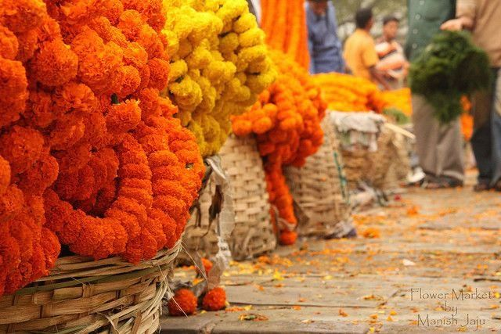
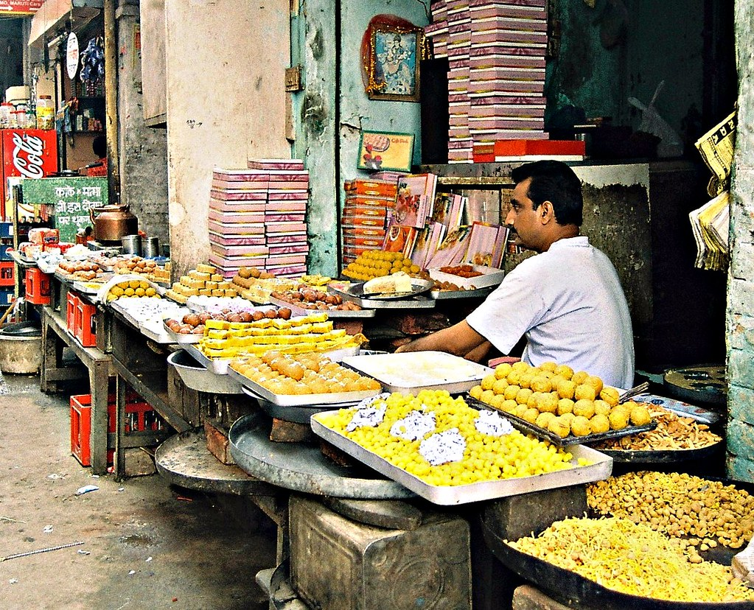
The man, still trying to make the child happy, bore him to the gate where the flower-seller sat. “Look! Can you smell those nice flowers, child! Would you like a garland to put round your neck?”
The child turned his nose away from the basket and reiterated his sob, “I want my mother, I want my father!”
Thinking to humour his disconsolate charge by a gift of sweets, the man took him to the counter of the sweet shop. “What sweets would you like, child?” he asked. The child turned his face from the sweet shop and only sobbed, “I want my mother, I want my father!”
Glossary:
Bore: carried
Reiterated: repeated
Disconsolate: very unhappy and unable to be comforted
Charge: a person or thing entrusted to the care of someone
Further, the man carried the child to the flower-seller and asked whether the child wanted the garland.
The child refused to smell the flowers that he wanted buy earlier.
The man took him to the sweet meat seller and offered to buy sweets.
Still, the child did not want his favourite sweet but wanted his parents.

Slide 14
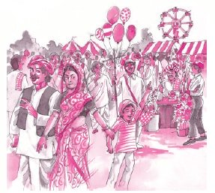
Summing up:
‘The Lost Child’ is the story of a small child who gets lost in a fair.
He had gone with his parents to the fair but loses them when he gets attracted to roundabout swing.
The story highlights the bond of love and affection that the child shares with his parents.
Before losing them he had been demanding different things like toys, sweets, balloons, flowers, swings, etc.
Once he loses them, he is picked up by a stranger.
The stranger tries to quieten the child by offering him all these things that he had demanded from his parents.
But the child does not want them any more now.
He wants his parents only.
https://www.youtube.com/watch?v=4xT18bQAX1w

Slide 15
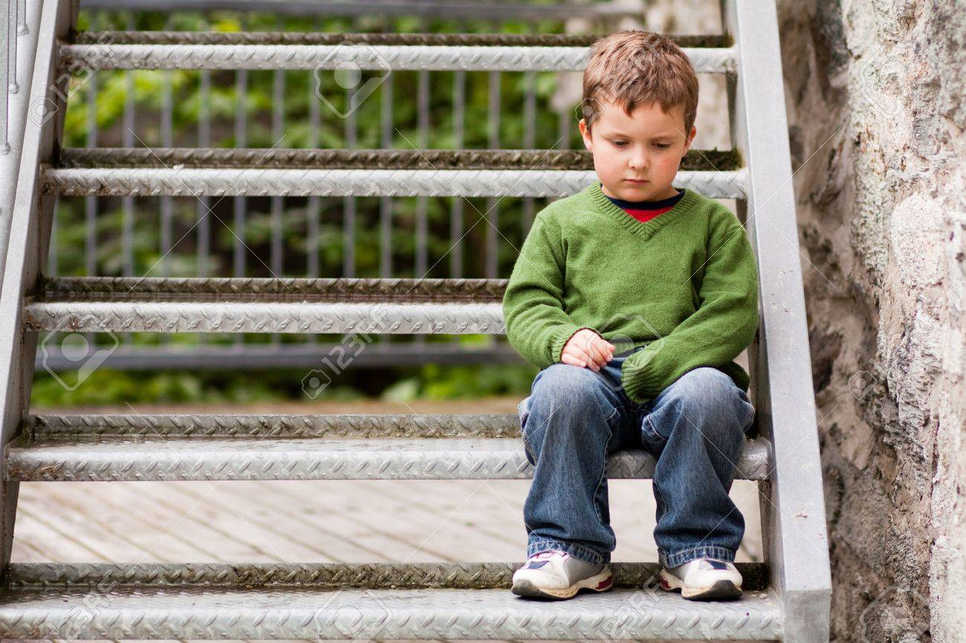
Thank
You

