Slide 1
Principle of Design

Slide 2
Introduction
Fashion designers learn the basic principles for designing items to go on the human body. Principles are guiding rules and fundamental ideas that anyone working in a field should know. In fashion design, there are several important principles, and they apply to both the garment's basic structure and its decoration. Let's look more at each of them.
Principles of Design:
The principles of design suggest how a designer can best arrange the various elements of a page layout in connection to the overall design and to each other. The important principles are:
1 Proportion.
2 Balance.
3 harmony
4 Rhythm.
5 Emphasis.

Slide 3
proportion
Proportion, sometimes also referred to as scale, relates to how well the size of the parts of a garment work together
. Most clothing is made to flatter someone's shape. Proportions vary for many body types, and designers need to understand how to make clothing look good for different shapes.
Think of the difference between a suit made for a tall man or a dress made for a petite woman. These fashions have very different proportions but a good design should be able to make each of them feel more proportionate

Slide 4
Proportion in fashion design
The principle that holds that the size of various components of a garment or fashion accessory must look good together.
... PROPORTION can be defined as a pleasing relationship between the garment and its different parts
Proportion is one of the most important principles of design, especially when applied to a garment. it relates to such as collar ,pocket, placket,hemline etc are designed in such a way that it is proportionate to one another

Slide 5
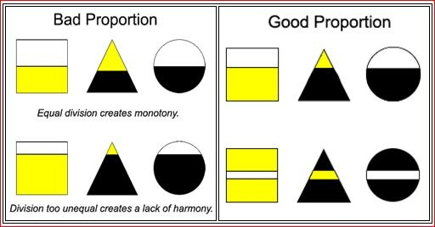
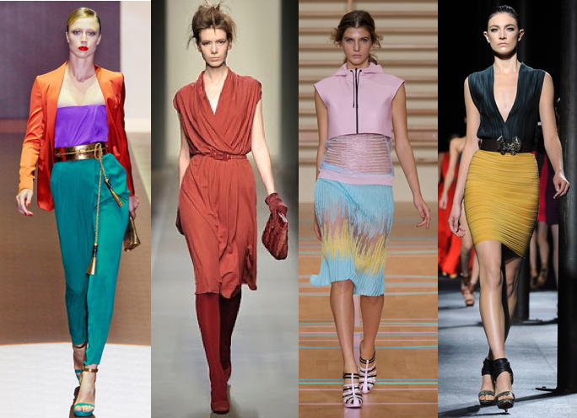

Slide 6
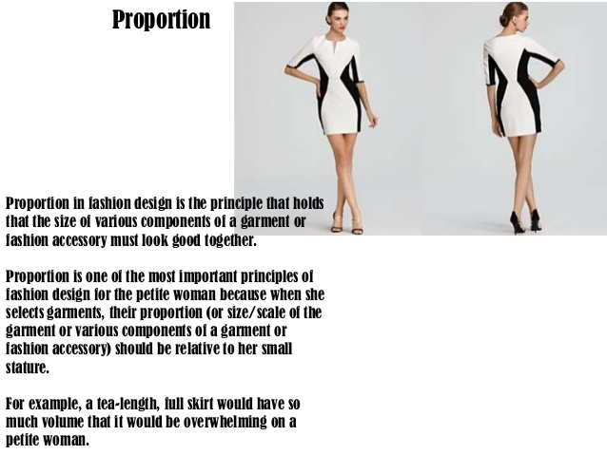

Slide 7
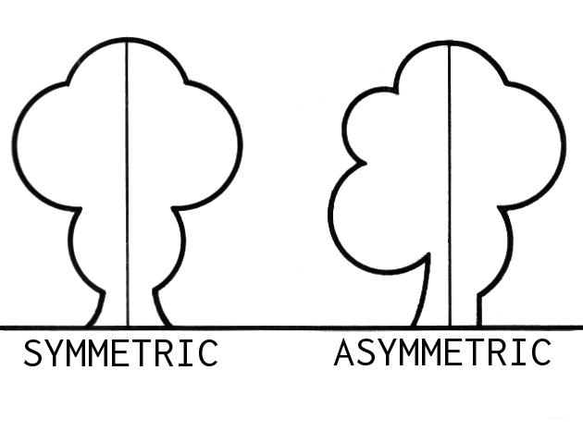
Balance
. Balance in fashion design can be achieved with the use of features, such as seams, hemlines, and necklines

Slide 8
The principles of design describe the ways that artists use the elements of art in a work of art. Balance is the distribution of the visual weight of objects, colors, texture, and space. If the design was a scale, these elements should be balanced to make a design feel stable.
symmetrical balance,
asymmetrical balance.
.

Slide 9
Symmetrical balance
Symmetrical balance occurs when equal weights are on equal sides of a composition, balanced around a fulcrum or axis in the center
.
•

Slide 10
Asymmetrical balance
Informal balance is asymmetrical, with parts placed unequally from the center
• Formal (symmetrical) balance is the most common, with identical details arranged the same distance from the center.

Slide 11
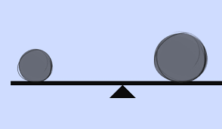
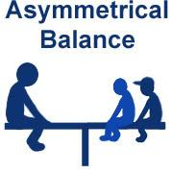

Slide 12
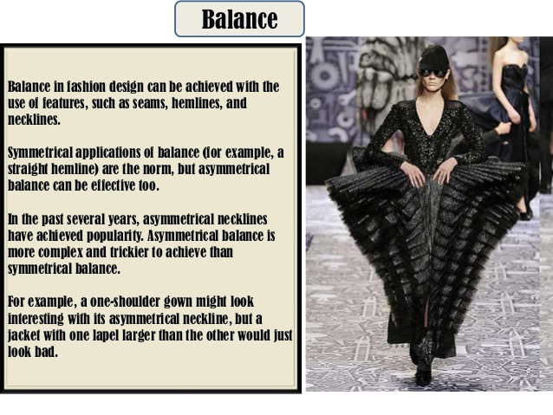
Symmetric balance

Slide 13
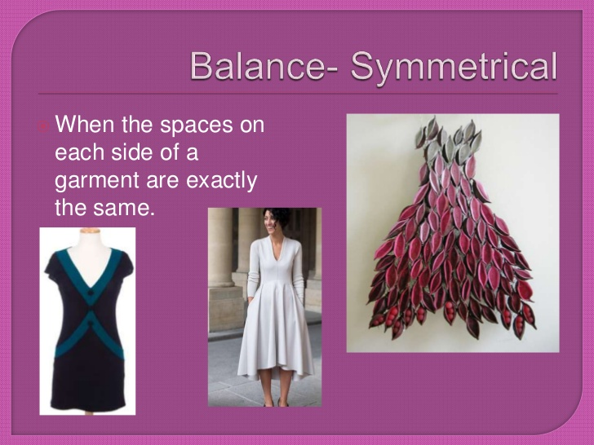

Slide 14
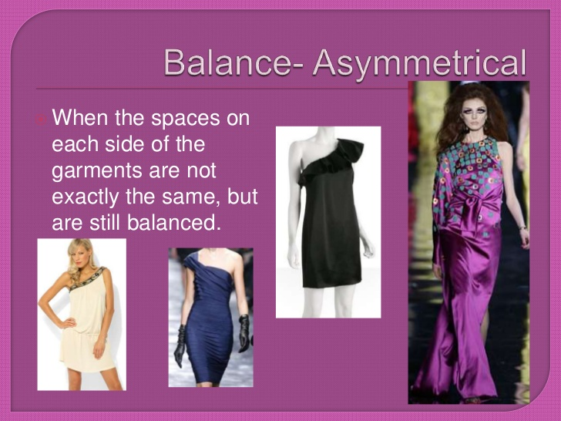
Asymmetrical balance

Slide 15
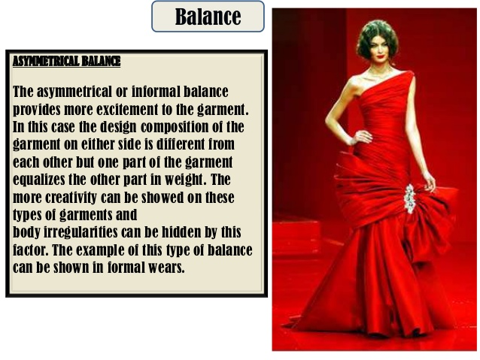

Slide 16
Harmony
Harmony can be described as sameness, the belonging of one thing with another.
The repetition of design elements like colour ,texture, shape,and form is one of the easiest way to achive harmony to create a composition.

Slide 17
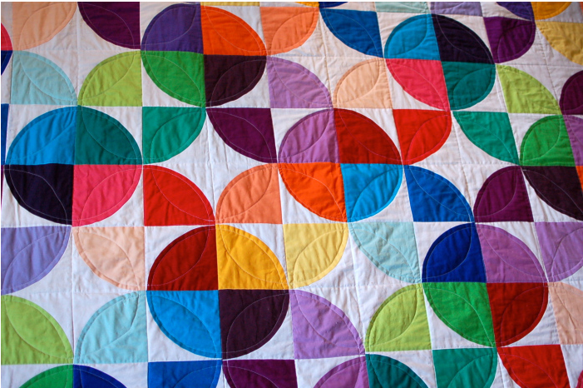
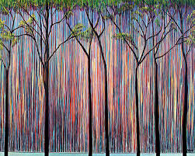

Slide 18
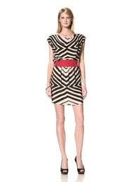
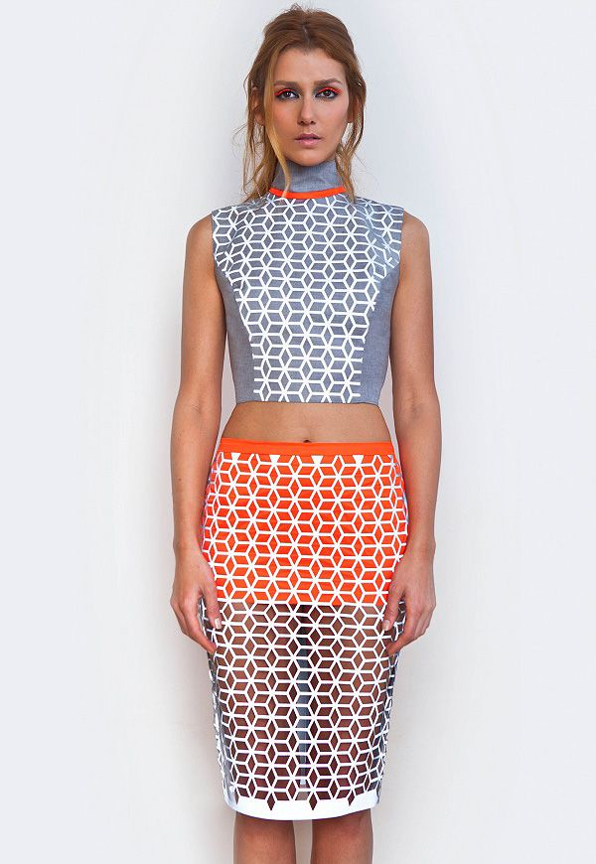

Slide 19
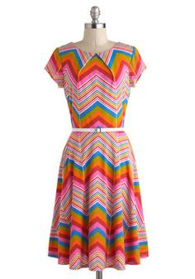
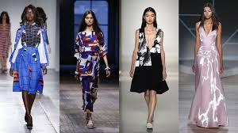

Slide 20
RHYTHM
Designing with Repetition, Pattern, and Rhythm. The use of repeated visual elements is a technique designers commonly employ in web design. You can repeat design elements, for example, to provide a consistent visual experience. ... You can also use repetition to draw attention to a particular area of content o rdesign
Rhythm is very important because it keeps the fun and good beat of song. It also makes a pattern in the song. You also can't make a good song without rhythm. ...Rhythm is basically what keeps the song together

Slide 21
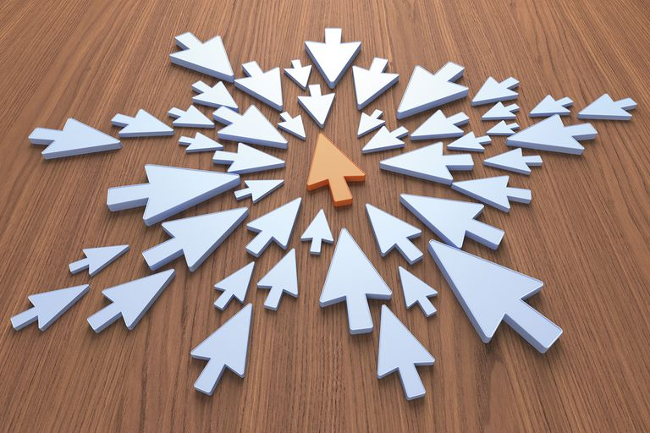
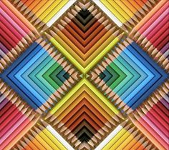
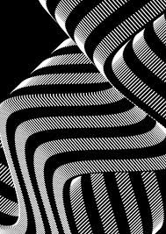

Slide 22
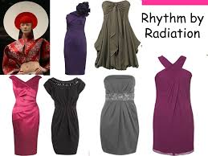
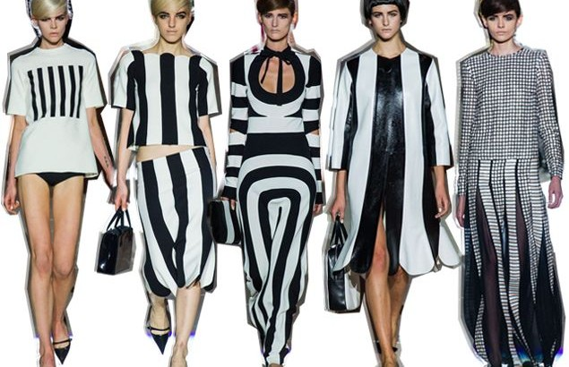

Slide 23
Emphasis
Emphasis is defined as an area or object within the artwork that draws attention and becomes a focal point. Subordination is defined as minimizing or toning down other compositional elements in order to bring attention to the focal point. ... Therefore, the red circle is the focal point.

Slide 24
focal point of the composition. The artist or designer uses emphasis to call attention to something, or to vary the composition in order to hold the viewers interest by providing visual "surprises."Emphasis can be achieved in a number of ways. ... One method used to attract attention in the design of a page or work of art is the use of a focal point.
The focal point. Emphasis can be achieved through size, placement, color and use of lines. T

Slide 25
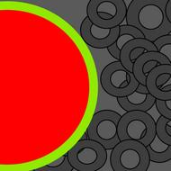
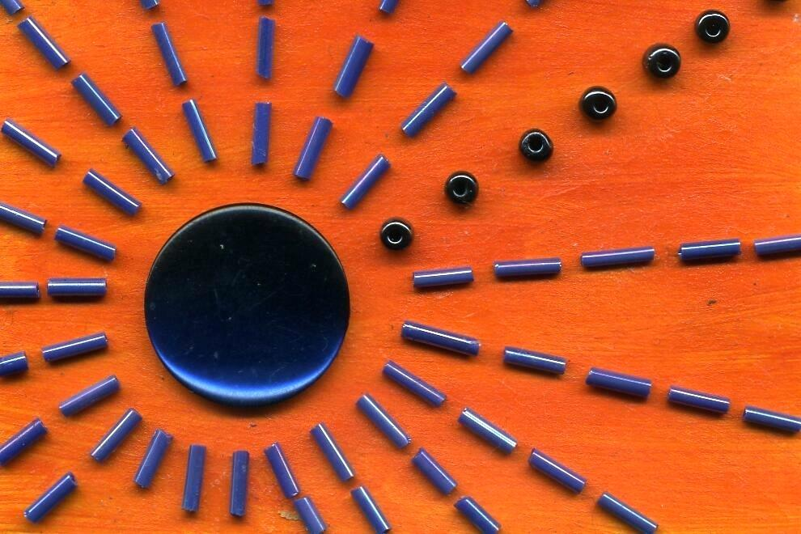

Slide 26
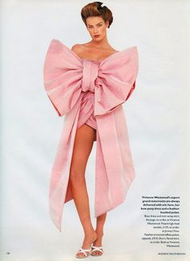
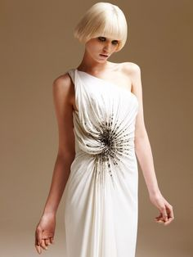

Slide 27
THANK YOU
Presented by
Prof. Suvarna Lavand

