Slide 1
Literature Review
Vrushali Rane
Deputy Librarian
BMK Knowledge Resource Centre
SNDT WU
January 9, 2023

Slide 2
What does Literature Review mean?
Literature
  A body of any written work in any form
Review
  “Re – View” or Look Again at what others have done in a particular area of study

Slide 3
Definitions
The documentation of a comprehensive review of the published and unpublished work from Primary and Secondary sources in the areas of research topic
Literature review is a comprehensive survey of the works published in a particular field of study or line of research.

Slide 4
Steps
Identify Relevant Resources
Analyze Resources
Critically Evaluate the Content
Summarize the Content
Write the Review
Organize

Slide 5
Target
Last 5 years
100 relevant resources

Slide 6
Identify Relevant Resources
  Scholarly Journals – Peer Reviewed / Non Peer Reviewed
  Books, research reports, dissertations etc
  Popular magazines, newspaper
  Online open access information
  E-books
  E-journals
  E-databases
  Websites

Slide 7
  Where to Identify Relevant Resources
Key = In your institute library as well as other libraries
start with what you know
Catalogue - book/journal/report
Databases - online resources, institutional repository
Grey Literature - Government documents, working papers
Course reading list; published bibliography; References at end of articles
Interlibrary loans (ILL)
Difficult to locate materials – ask a librarian!

Slide 8
Identify Relevant Resources What about the web?
Web documents – require particular care…
Critical assessment is vital – always
“double-check” facts before using these
Some online resources – evaluated, accurate, etc. – akin to library resources may look like scholarly resources,
but they are not…
Criteria = authority, objectivity, scope, accuracy, currency, stability, usability, etc.

Slide 9
Identify Relevant Resources Search Techniques
Know your Keywords, Concepts
Use Boolean Searching like ‘and’, ‘or’ and ‘not’
Use and Simple and Advance Search Features
Have a plan to track literature

Slide 10
Identify Relevant Resources
Expected Q
Core Journals
Core Authors
Research Articles

Slide 11
Analyze Resources
Keep Notes as you read
  Why is each item of interest to you?
  Where does the item “fit” in your research?
  Provides background/definitional information?
  Provides a good example to highlight your argument?

Slide 12
Critically Evaluate the Content
Previous knowledge and facts established on topic & their strength and weaknesses
Identify and clarify concepts, vocabulary and keywords related to the research topic
Justify the gap in research and how current research will fill that gap
Understand research methodology adopted by past researchers
Identify other scholars in the area of research
Contribution of present study to knowledge base
Ensure that no past research has been done on the current research topic selected

Slide 13
Summarize the Content
Title
Abstract
Research methods
Data collection tools
Analysis
Findings
Conclusions
Parallel work – review, references, citations, data collection tool, introduction

Slide 14
Summarize the Content
  Itemize everything
  Jot examples of great quotes – including page no
  Remember – paraphrases must be cited as well
  Be aware of copyright rules/restrictions!
  Document full citation as you find relevant information
  Difficult/time-consuming to go back

Slide 15
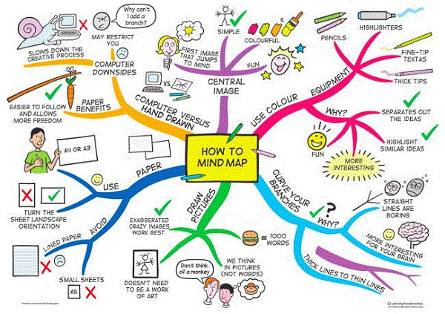
Write the Review
Prepare a mind map

Slide 16
Write the Review
Topic – Subtopics – Sub sub topics…
  Latest to oldest or vice versa
Use plural to singular words
Use thesaurus
Write in your own words
Continuity in writing
Academic writing

Slide 17
Organize
Old to new or New to old articles
Chronology
In text citations
References APA 6th ed – end of each chapter
Bibliography

Slide 18
Common Errors
Too Old References
General Articles not research based
Incomplete bibliographic details
Irrelevant Articles
Review organized alphabetically by author of the article
Monotonous style of writing

Slide 19
What we have
E-journals
  Proquest
  Science Direct – Elsevier
  Emerald
  IEEE
  Psyc Articles
  JSTOR
  JCCC
  ISID
World E-Book library
EPWRF
Indiastats
Law Databases
  AIR Online
Women’s studies archives

Slide 20
Good readers make
Good writers!
Thank You

Slide 21
Facilities
Open Access
Reading room : 9am to 6pm
Issue Return: 10am to 5pm
  10 books for 7 days
Renewals /Fine
Reservation
Taking pictures on mobile from books is allowed
Computer Lab
Wi-Fi
Remote Access
Plagiarism
JAWS

Slide 22

Library Membership
Fill up the form
Bring Fee Receipt
One Photograph
Rs. 10/- for lamination
Pick up library ID card after one week.
Refund of Library deposit.
    Claim deposit till end of year
    Produce Original Fee Receipt.
    Surrender ID card.
    Clearance Certificate
    RTGS

Slide 23
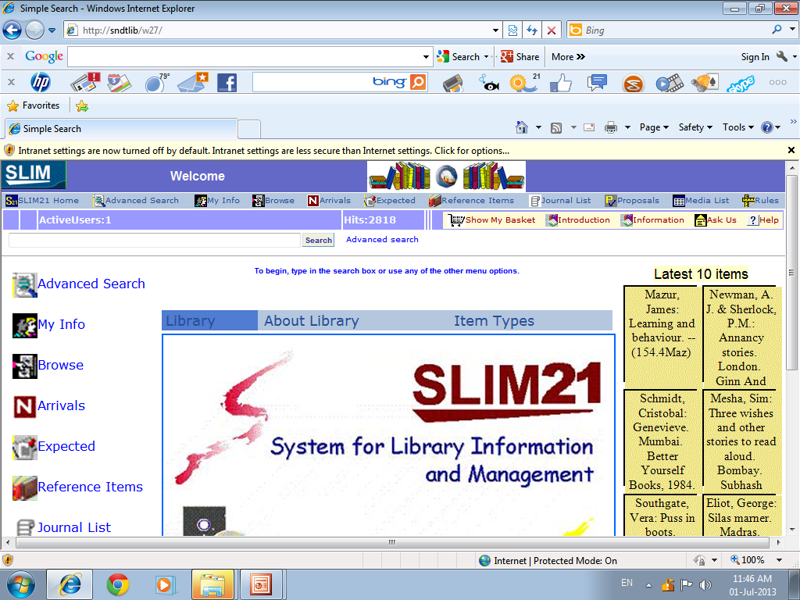
WEB OPAC

Slide 24
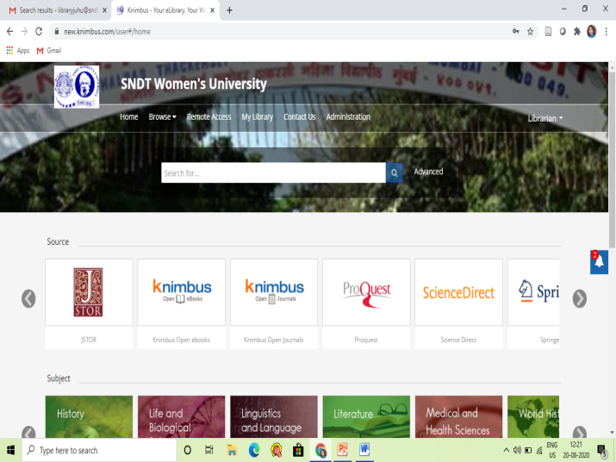
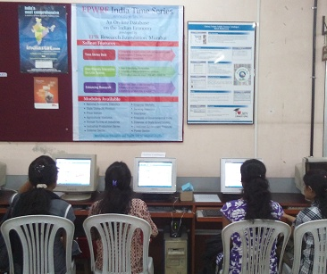
Databases
KRC has access to
  Above 1 lakh E-journals (full text + abstracts)
  3000+ e-books
  Dissertations and theses
  News clips
  Statistical / factual data
  Videos
  Women’s Archival collection
  Open resources from Knimbus

Slide 25

Source
Directly from Publishers like Emerald, Elsevier, Sage etc
From Aggregators like Proquest
Open E-resources :Discovery Tool – Knimbus

Slide 26

Access
IP (only from the university campus)
Username and Password (from anywhere)
Knimbus (remote access)

Slide 27
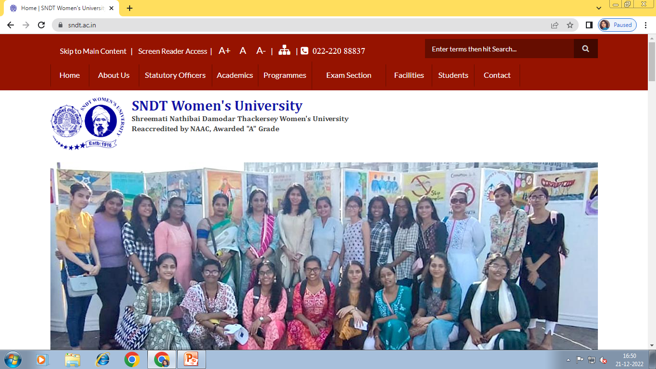
University Website
www.sndt.ac.in

Slide 28
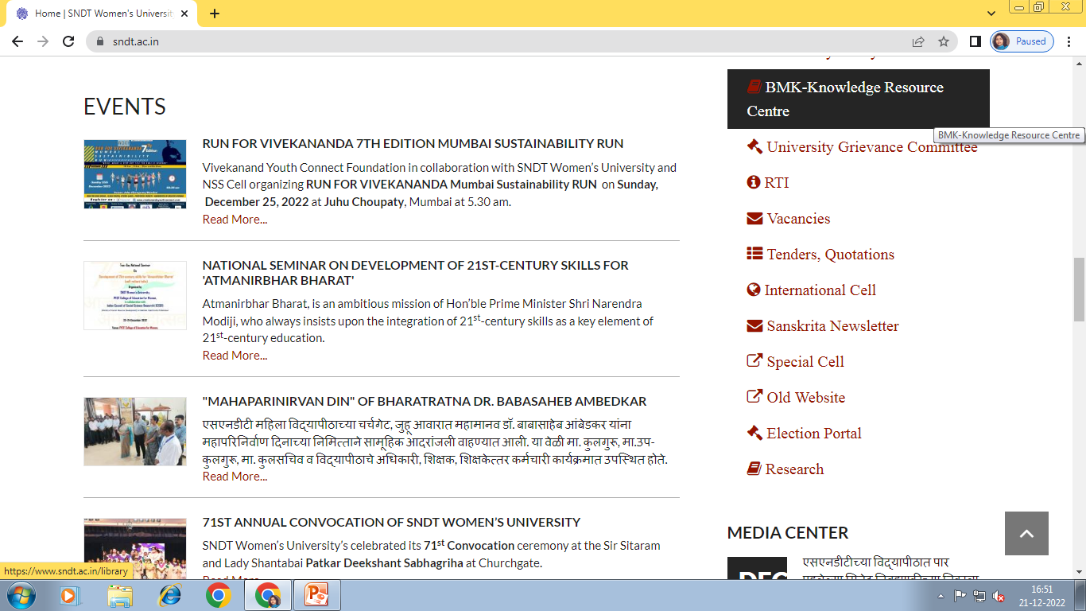
www.sndt.ac.in

Slide 29
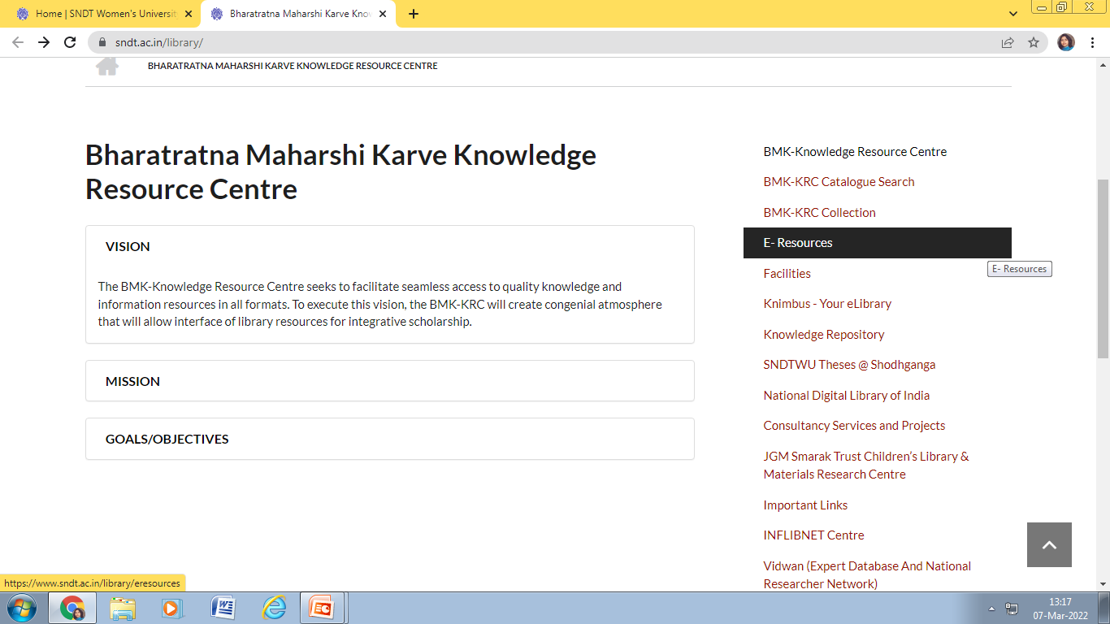

Slide 30
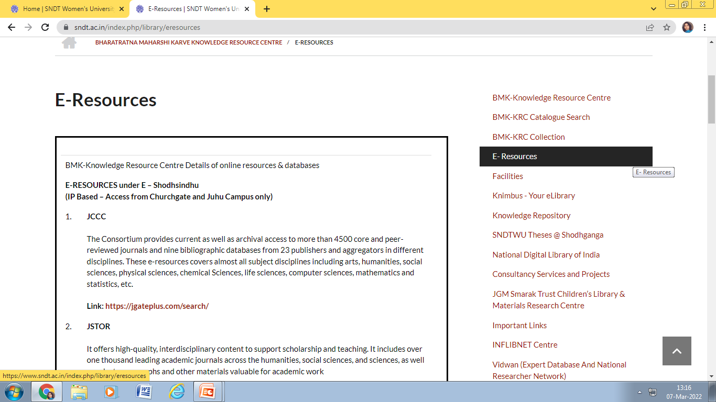

Slide 31
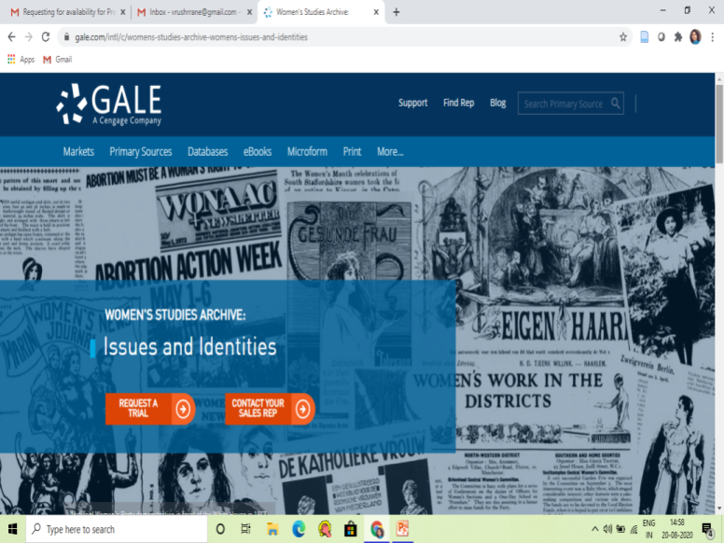
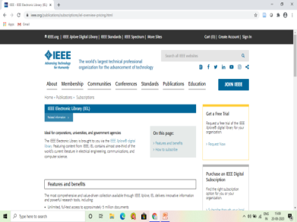
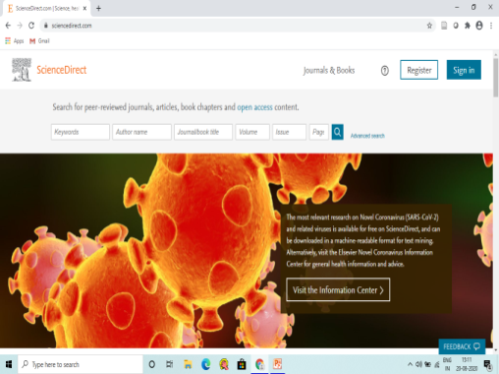
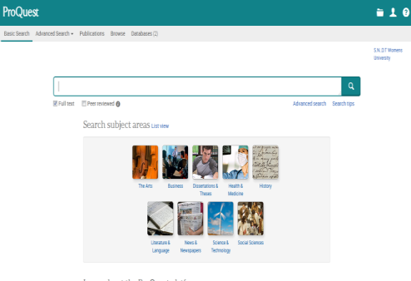

E-Resources
Proquest Central
PsycARTICLES
Emerald
IEEE Explore
Elsevier Pharmacy & Computer Science
Jgate
JSTOR
Institute of Studies in Industrial Development
IndiaStat
EPWRF
Women’s Studies Archives – Women’s Issues & Identities (Nineteenth Century Collection Online)

Slide 32
DATABASES: IP based
    JGate Plus (JCCC) :
    Website: https://jgateplus.com/search/
    Jstor database :
    Website: https://www.jstor.org/
APA PsycArticles (Access only from Churchgate)
Website: https://psycnet.apa.org/home
Emerald Insight (Access only from Churchgate)
    Science Direct (Access only from Juhu)
    Website: https://www.sciencedirect.com/
    IEEE - The Institute of Electrical and Electronics Engineers (Access only from Juhu)
    ASPP - All-Society Periodicals Package
    POP - Proceedings Order Plan (Conference Papers)
    Website: https://ieeexplore.ieee.org/Xplore/home.jsp

Slide 33
DATABASES : UN & PW
ProQuest Central
    Website: http://search.proquest.com
    User name - SNDT_LIB
Password – Welcome2PQ!
EPWRF India Time Series Statistical Database
Website: www.epwrfits.in
Username: sndtjuhu
Password: ti88ss
IndiaStat Database
Website: https://www.indiastat.com/
Username: sndtwomen
Password: library
Institute for Studies in Industrial Development (ISID):
    Website: http://isid.org.in/
    Username: sndtuniversity
    Password: sndt@123

Slide 34
DATABASES : UN & PW
Gale Women’s Studies Archive
URL: https://infotrac.gale.com/itweb/sndt
Access Code: galesndt
Access Type: Perpetual
Product Demo/Tutorial Link: https://support.gale.com/training/videos/gdc

Slide 35
E-books
World E-book library
Link : https://database.worldlibrary.org/ (Access with Login ID and PW)
Username : sndt@user
Password : reading
Pearson
Link: https://elibrary.in.pearson.com/ (Access with Login ID and PW)
Create own login password
Access Code : IBd-Z5X-5fC
S Chand
Link: ebooks.schandgroup.com (Access with Login ID and PW)
CBS :
Link : https://www.eduport-global.com/ (Access with Login ID and PW)
Username : SNDT
Password : sndt@123
Arts & Science Pub (Aadi Publications, Anmol Publications Pvt. Ltd., Edukeen Publisher, ABD Publisher..etc)
Link: www.asapglobe.com (Access with Login ID and PW)
Username : SNDTRemote
Password : SNDT2021

Slide 36
E-Books
Elib4u (New Age, PHI Learning, Laxmi Publications)
Link: https://digital.elib4u.com/ (Access with Login ID and PW)
Username-SNDTWU2022
Password- SNDTWU2022
Videeya
Link : Through Knimbus https://sndt.knimbus.com (Access with Login ID and PW)
User Name: libraryjuhu@sndt.ac.in
Password: knimbus@123
BSP Publication (Pharmacy 23 titles) on Wonderslate Platform
Link: https://www.wonderslate.com/institution/ (Access with Login ID and PW)
Login Id: acquisition@library.sndt.ac.in
Password: library2022.
New Age International Publishers (Electronics Engineering 7 titles)
Link: https://digital.elib4u.com/ (Access with Login ID and PW)
Login Id: acquisition@library.sndt.ac.in
Password: library2022.
Laxmi Publications (USP) and New Age International Publishers (Maths 2 titles)
Link : https://digital.elib4u.com/ (Access with Login ID and PW)
Login Id: acquisition@library.sndt.ac.in
Password: library2022.

Slide 37
Remote Access
Knimbus
Website : http://sndt.knimbus.com
Username : libraryjuhu@.sndt.ac.in
Password : knimbus@123
Default Password: user@knimbus

Slide 38
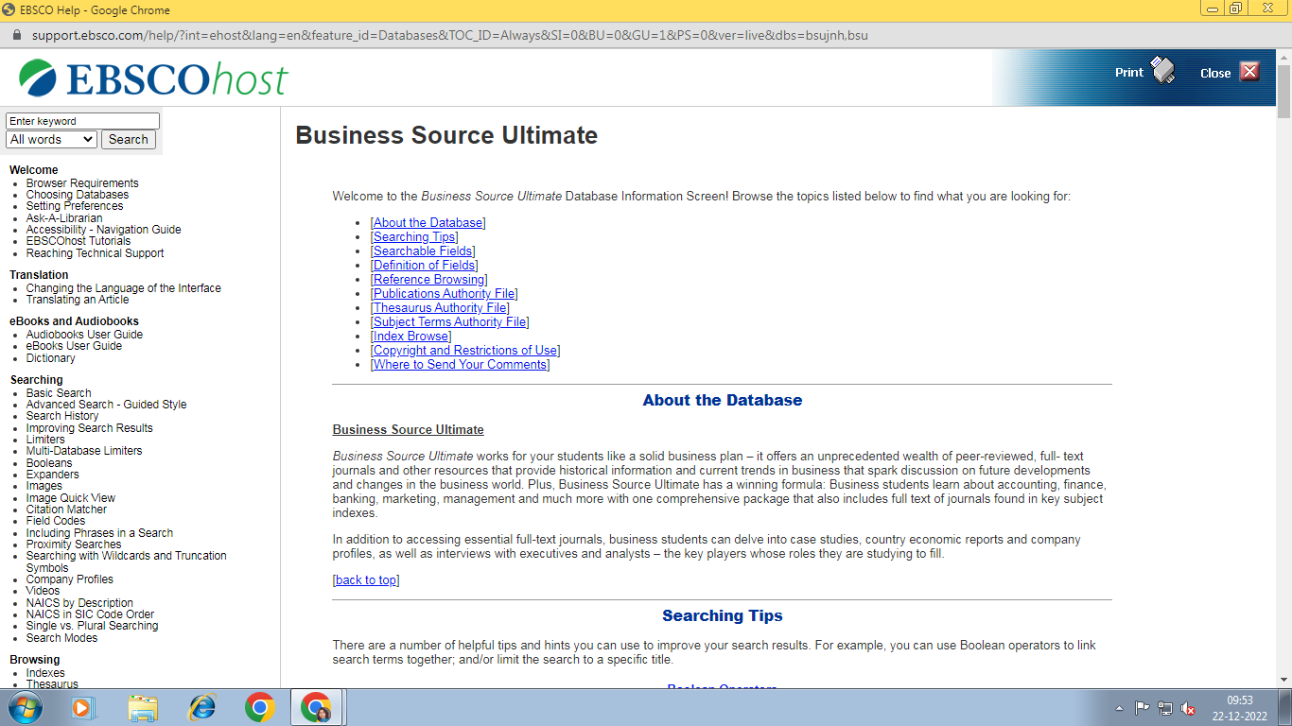
http://search.ebscohost.com
User Id:sndt
Password:swu@2022

Slide 39
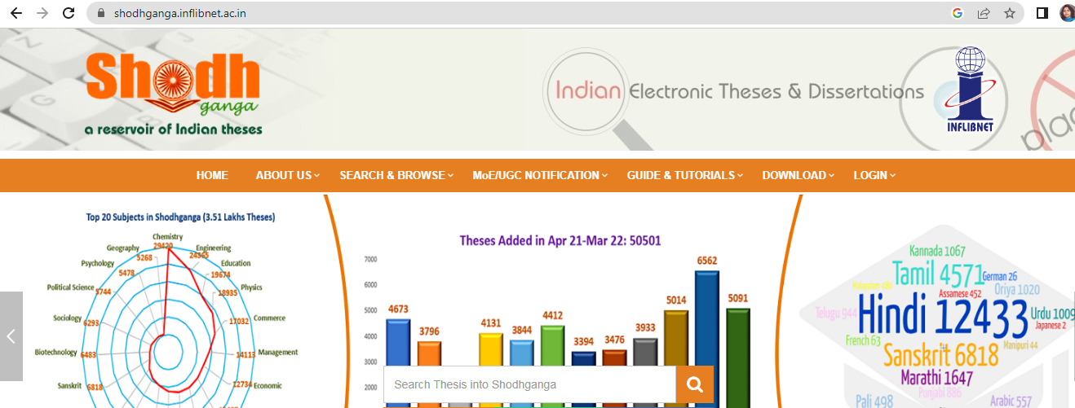
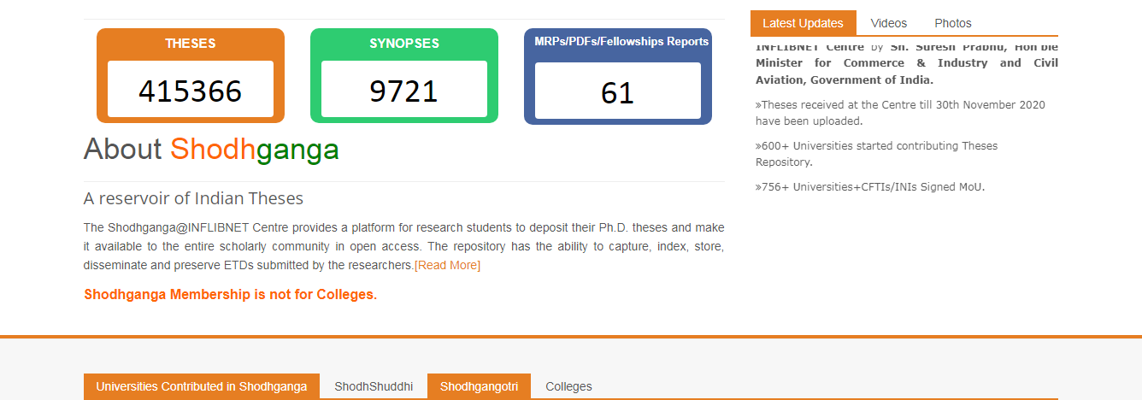

Slide 40
Contact Details
  E-mail : libraryjuhu@sndt.ac.in

