Slide 1
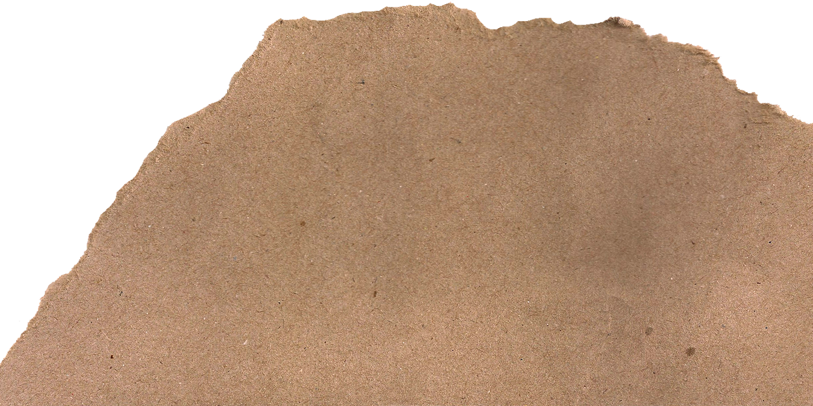

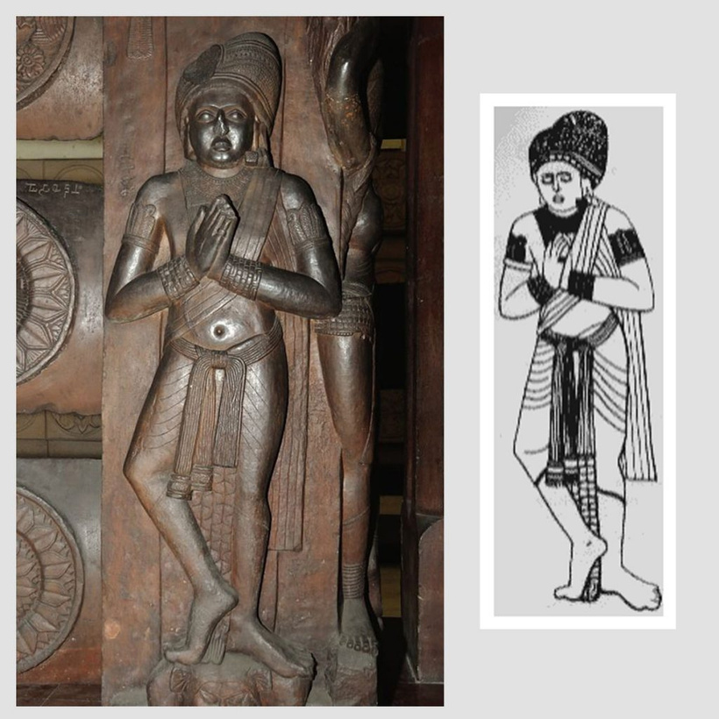
Mauryan and Sunga period period 321-72AD
Unit-II
Mauryan Period
Chandragupta Maurya founded the first large empire in Indian controlling Indus and Ganges plains and far North West. Cotton, Linen, silk, wool and Jute fabrics were readily available. Fur and better varieties of wool and silk like tasser called 'Kausheya' were used extensively used.
An insight into the clothing culture of ancient Indian is deepened further by the literature of the past-Vedic period. A study of the texts of that time suggests that level of refinement in textile, clothing and ornamental techniques had been achieved. With the evolution of the study by the end of Vedic period and the establishment of the Mauryan Empire, towns and villages became thriving centers of trade.
Sculptors carved during the Mauryan and Sunga period in the first century B.C in the north at Bharut and Sanchi gives us a feeling of super human power, the drapery hanged in heavy folds. The veils of women were voluminous. Long beaded aprons and closed scarf at the chest were in abundance.

Slide 2
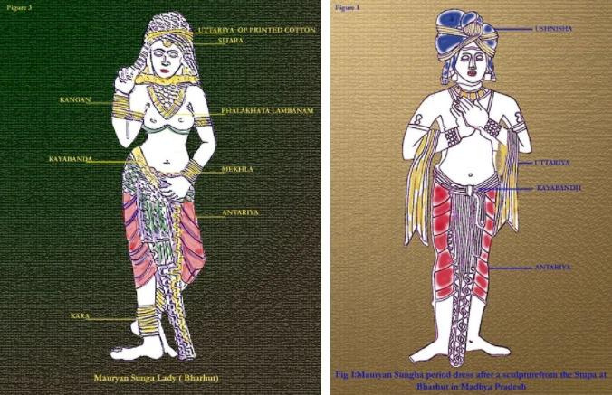
Mauryan and Sunga
Mens and Womens Costume
Men and Women wore three unstitched garments as in the Vedic times. The main garment was the 'Antariya' of white cotton and linen of flowered muslin, sometimes embroidered in gold and precious stones. For men's it was an unstitched length of cloth draped round the hips and drawn between the legs in ' Kachcha' style and extended from the waist to the calf or ankles or even shorter for the peasants and the common people. Even the 'uttariya' was used by them.
Women tied their 'Antariya' in different ways. Another version, the 'Lehnga' style was a length of cloth wrapped around the hips tightly to form a tubular type of skirt. This was not drawn between the legs like the 'Kachcha' style.
During the Mauryan and Sunga period lot of emphasis was given to the drapes but a lot of medallion designs full of flora and fauna was also found.

Slide 3


