Slide 1


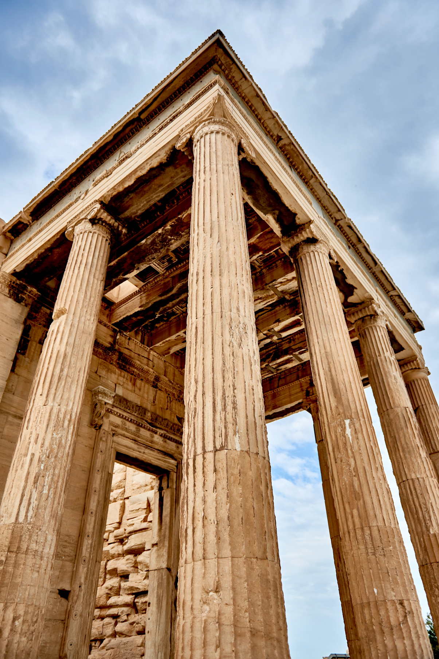
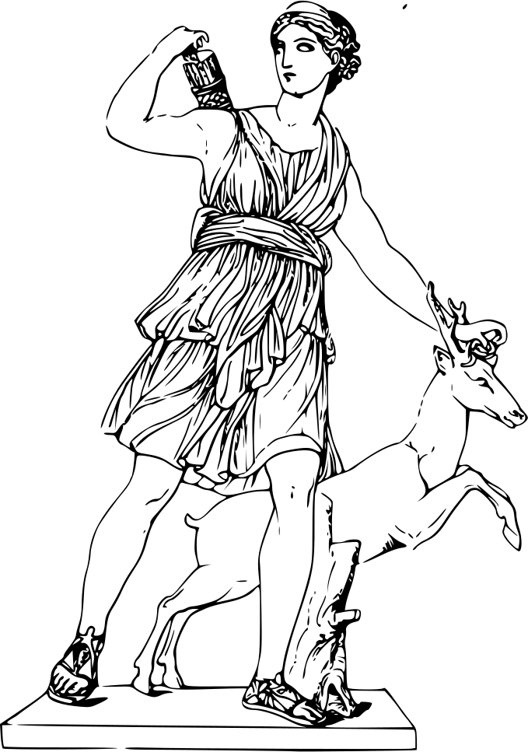
Fashion
History

Slide 2
Contents
Unit- I
Unit-II
Unit-III
Unit-IV
  Beginning of the clothing
  Origin of Costume
  Importance of Clothing
  Purpose of Clothing Protection Modesty Attraction
  Mauryan and Sungha period 321-72BC
  Satwahna 200BC-AD250
  Kushan period 130BC-AD-185
  History of Mughal Period costume
  Study of Indian Costume, Textiles, Traditional typical Jewelry other accessories of the following state of men & women
  Maharashtra
  Karnataka
  Kashmir
  Uttar Pradesh

Slide 3
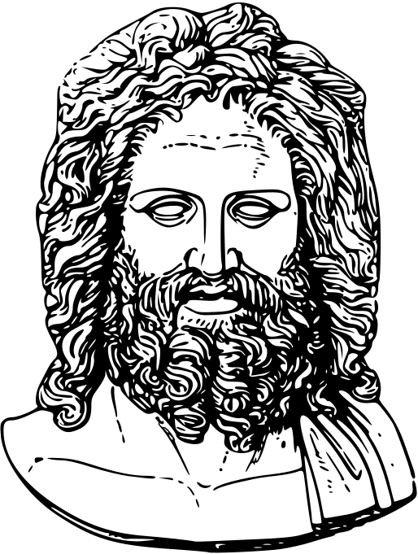
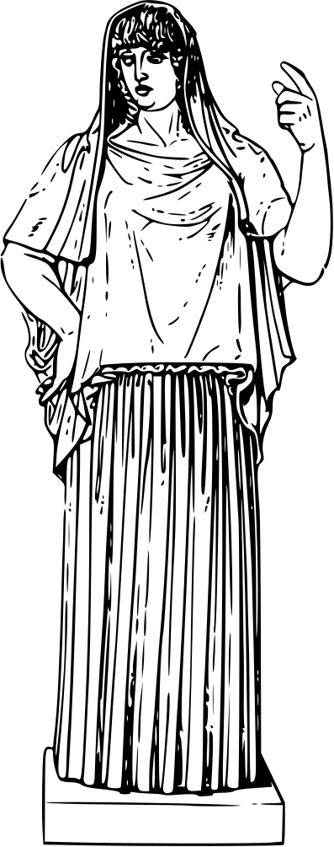
Introduction
Unit-I
Romans and Egyptians took great interest in their appearance and spend a lot of effort and currency on fashion and style. Wearing a particular type of clothing communicated status, wealth and occupation. During the 15th century, Burgundian Court of Philip the Good emerged as a center of fashion in Europe. During the Renaissance and Baroque periods, the fashion focus shifted from Burgundy to Italy and then to France.
In the western world, fashion was important all throughout history. The Dark Ages, the medieval period, the Tudor and Stuart times, the Renaissance era, the Georgian Period, the Victorian era, Edwardian age – The important periods in the history of Britain were also critical parts in the aisles of world fashion history. Britain and other European countries influenced world fashion – colonial rule brought their dressing styles to a global audience and made them popular all around the world.
During all these times, it was the royal courts that dictated fashion. Aristocratic people dressed elaborately and stylishly. Poor could not afford to change their clothes according to the whims of fashion.
Clothes made of natural fibers mostly in neutral colors were the costumes of choice of the masses while the rich flaunted their wealth in the form of clothes and accessories. Clothes were used to separate people into groups.

Slide 4
Origin and History of Clothing
The first known humans to make clothing, Neanderthal man, survived from about 200,000 B.C.E. to about 30,000 B.C.E. During this time the earth’s temperature rose and fell dramatically, creating a series of ice ages throughout the northern areas of Europe and Asia where the Neanderthal man lived. With their compact, muscular bodies that conserved body heat, Neanderthals were well adapted to the cold climate of their day. But it was their large brain that served them best.
Neanderthal man learned to make crude but effective tools from stone. Tools such as spears and axes made Neanderthals strong hunters, and they hunted the hairy mammoths, bears, deer, musk oxen, and other mammals that shared their environment. At some point, Neanderthals learned how to use the thick, furry hides from these animals to keep themselves warm and dry. With this discovery, clothing was born.
Prehistoric Period
The first known humans to make clothing, Neanderthal man, survived from about 200,000 B.C.E. to about 30,000 B.C.E. During this time the earth’s temperature rose and fell dramatically, creating a series of ice ages throughout the northern areas of Europe and Asia where the Neanderthal man lived.

Slide 5
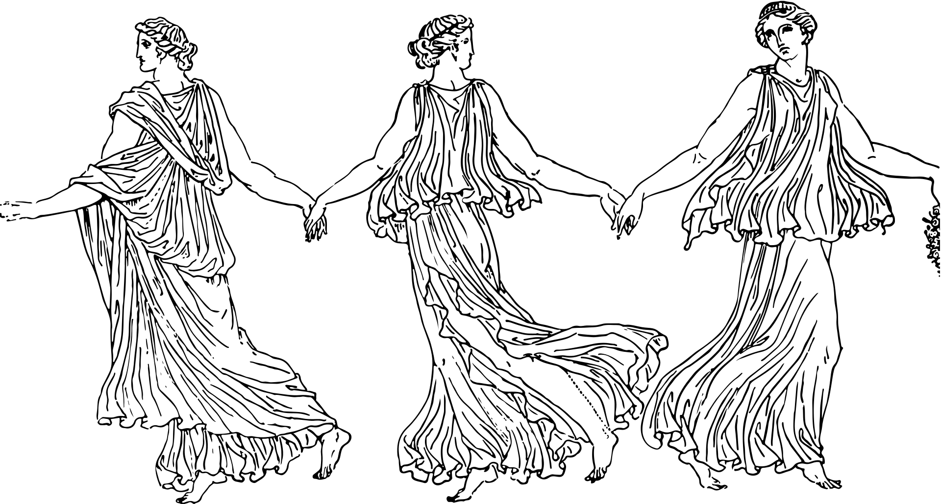
Origin of Costume
The Latin term "consuetude"—which meant a full set of outerwear—is where the word "costume" originates. with jewelry and hairstyle. In addition to serving as a means of covering and adorning the body, costumes also act as an important non-verbal channel of communication that helps to determine a person's cultural identity, including their community or country of conception, during any particular historical moment.
The costume is a person's or a group's distinctive way of dressing that expresses their - class, profession, and ethnicity.
epoch or nationalist activity.
The expression has also traditionally been used to refer to conventional attire suitable for particular hobbies, such as riding, swimming, dancing, and dressing up. Changes in fashion and regional cultural norms might affect what is considered proper and acceptable dress. “But sable is typically worn in carriages, layered over ivory satin with real lace, and over a sophisticated gown appropriate for an afternoon function.
This general usage has gradually been replaced by the terms “dress”, “attire” or “wear” and usage of “costume” has become more limited to unusual or out-of-date clothing and to attire intended to evoke a change in identities, such as theatrical, Halloween, and mascot costumes.

Slide 6
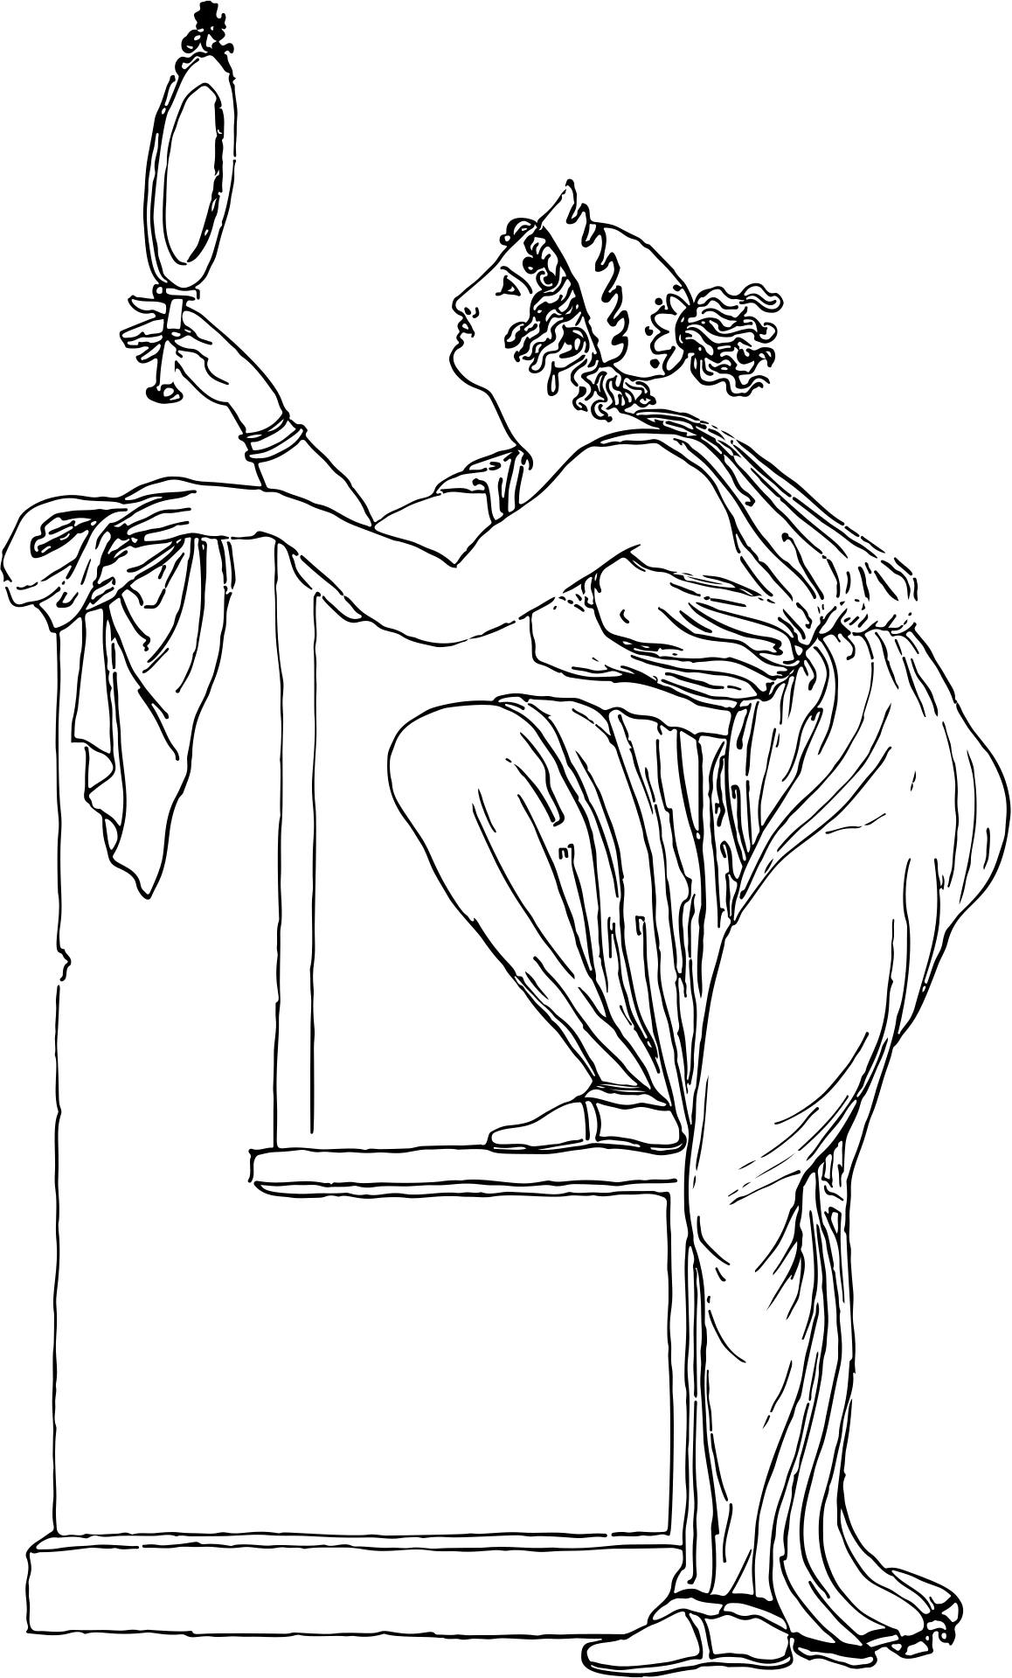
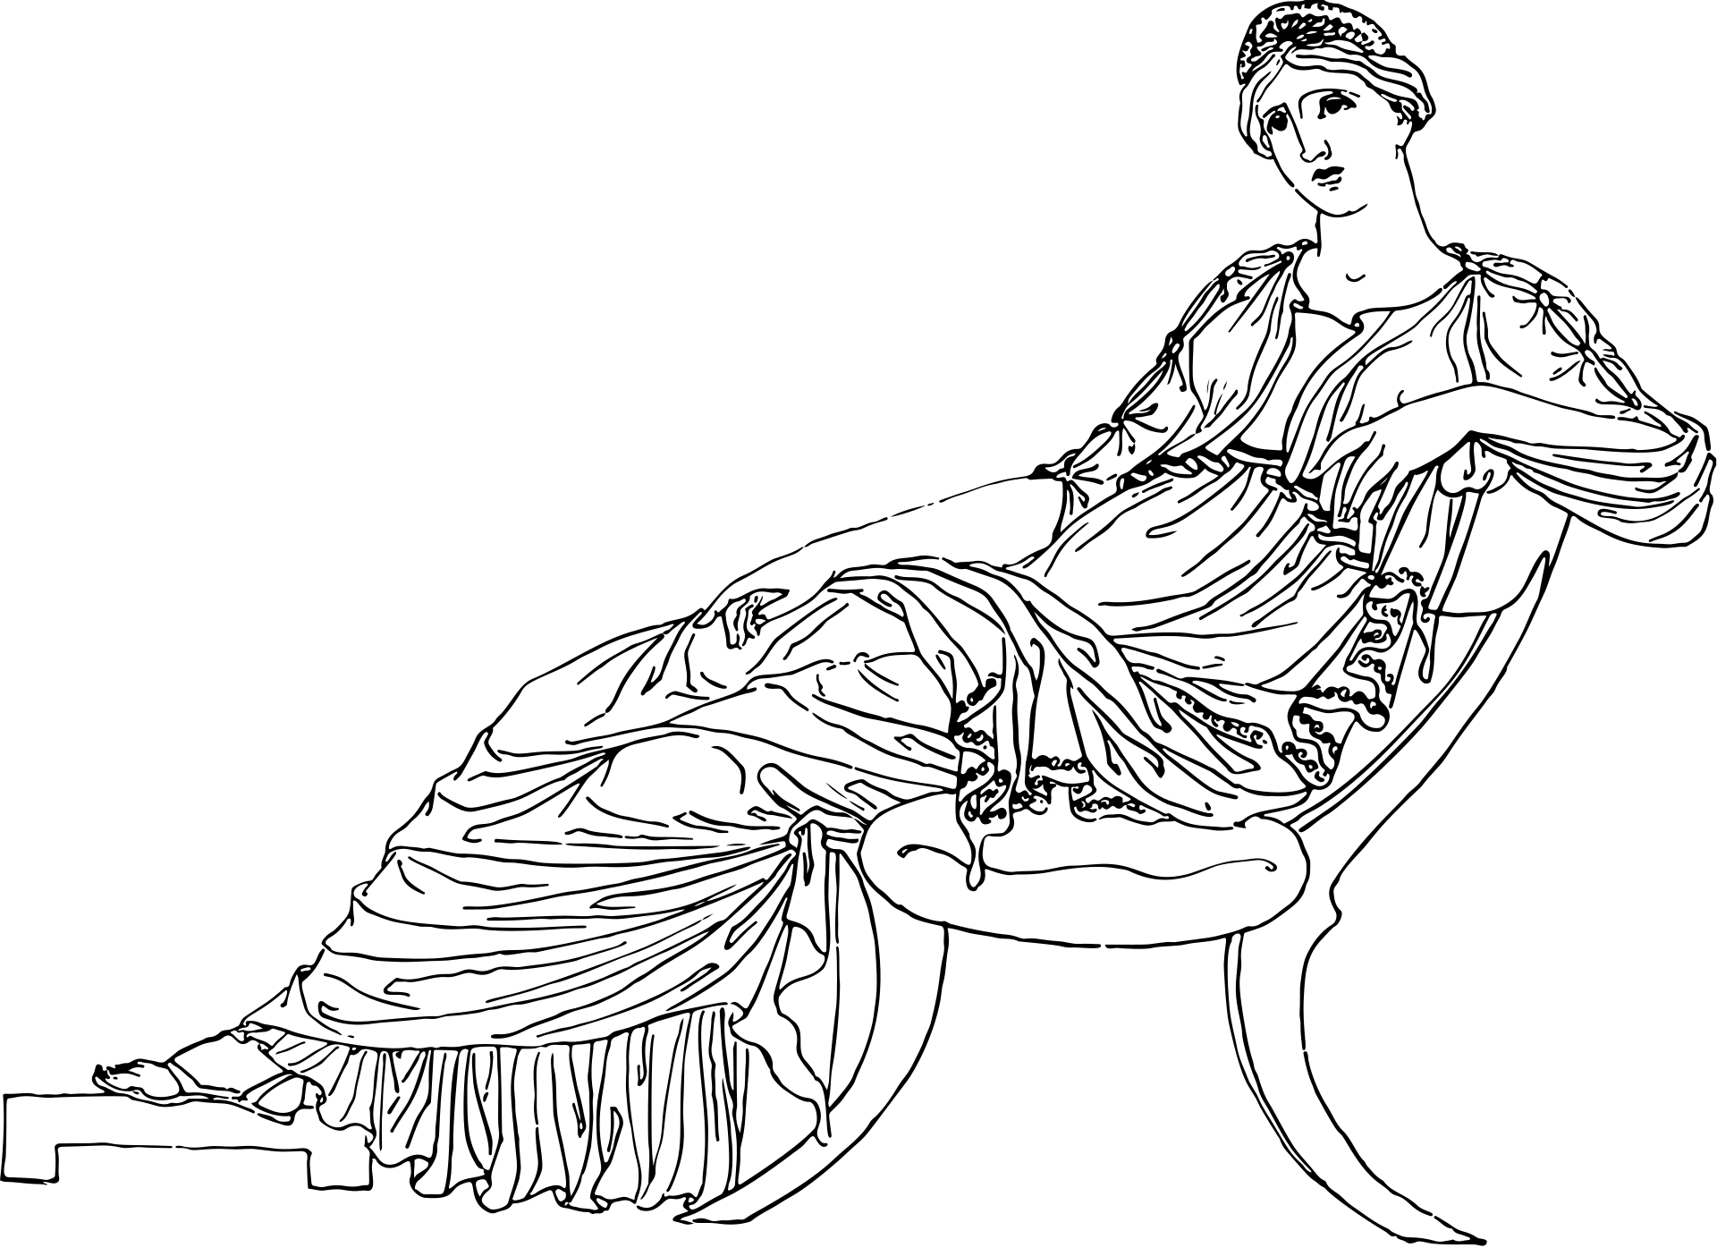
Importance of Clothing
  Every member of the human species covers their bodies with clothing, often referred to as a dress, a garment, or an article of garb, in order to protect them from the harsh weather conditions. The definition of clothes in its broadest sense includes coverings for the hands, feet, head, chest, and limbs. Typically, purses and other items that are carried rather than worn, such glasses or jewelry, are counted as accessories. On the other hand, body art such as tattoos, makeup, and hairstyles do not qualify as clothes as such even though they help convey the overall message that an individual wants to convey along with his or her choice of clothing.
  Most cultures developed clothing as a way of protecting the human body from harsh weather conditions such high winds, intense heat, cold, and precipitation. In particular, the weaving of clothing block air from flowing around the skin and, as a result, prevent the air that has been warmed by the skin from leaving, making individuals feel chilly and uncomfortable. Additionally, the clothing's transparent weaving protect the skin from the sun's ultraviolet rays and burns, shielding it from the heat. The human body is finally shielded from contact with water from rain or snow by more impenetrable weaves. Since water is a great thermal storage medium, when icy raindrops or snowflakes hit a person's skin, they immediately begin to warm up.[
  However, people dress for both social and functional purposes. In addition to serving practical purposes by being worn above the skin, clothing has distinct cultural and social connotations. For instance, it is considered offensive in many cultures to display the genitalia in particular to others.

Slide 7
Importance of Clothing
  Thus, clothes serve as a method to hide from the rest of the world the particular areas of a person's body. Religion, customs and of course, particular historically important circumstances have shaped the way different people in various times feel about clothing and exposure. Moreover, clothing has been regarded as one of the best ways to distinguish social classes, sexes, occupation, marital status and ethnic or religious affiliation. But in order to interpret correctly the messages a particular set of clothes may transmit to others, one has to be familiar with the translation of the specific code.
  In this way, clothing serves as a means of covering specific bodily parts from the public. The attitudes of different people in various historical periods about clothes and exposure have been influenced by religion, customs, and of course, particular historically significant circumstances. Additionally, it has long been believed that distinguishing social classes, sexes, occupations, marital status, and ethnic or religious affiliation may best be done through clothes. However, one must be familiar with the translation of the particular code in order to appropriately decipher any messages that a specific outfit may be sending to other people.
  For instance, it would be very unacceptable to wear white to a funeral in the west yet doing so is accepted in eastern cultures.
  Clothes are created from a variety of materials today. A person has the option of buying clothing manufactured from natural materials like silk, wool, and leather or from man-made fibers like nylon, polyester, Lycra, and Gore-Tex, which are widely utilized in the production of clothing. There is a lot of speculation about the route that future clothing may take in light of recent technology advancements; in truth, the clothing electronics sector is only getting started.

Slide 8
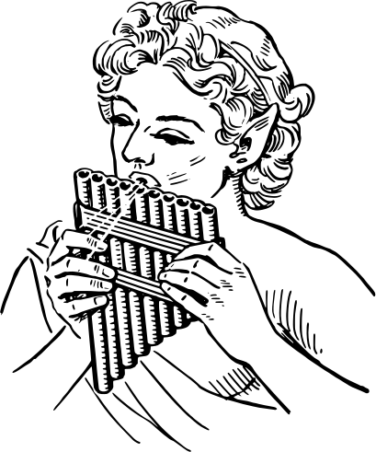

Purpose of Clothing Protection modesty Attraction
Our clothes has three main functions: to hide our bodies, to improve our look, and to express our intentions. Sportswear, formal wear, party wear, and casual clothing are a few examples. There are several reasons why humans wear clothing, including comfort and protection. We dress a certain way due to societal or psychological causes. In that it somewhat displays a person's personality, clothing can disclose a lot about that person. We also have attire that reflects a variety of nations, classes, creeds, and faiths. Clothing, food, and shelter are some of humanity's most basic and important needs. Clothing has a complex yet intriguing role in everyone's life.
1. Protection
First and most important reason for our clothing is it provides protection from heat cold, wind, and rain. We all know extreme weathers can affect our skin and body. Since our skin is open and uncovered these extreme weathers can easily affect our skin for eg. Too much cold can make our skin itchy and cracked; too much sun can tan our skin. Therefore there is a need for us to protect ourselves from such conditions. It absorbs perspiration, prevents sudden chills, and acts as a buffer between your body and accidental burns, scratches, and rough surfaces.
The right garments can insulate your body against extremely hot or extremely cold temperatures. People who live in extreme cold weathers dress in heavy coats made of fur so that they can keep their body and thus survive the harsh weather; whereas in deserts, nomads protect themselves from the hot sun from dehydrating their bodies by covering up with long flowing robes and headdresses.

Slide 9
2.Safety
Second most important reason for us to wear clothes is to protect ourselves from any possible injury. For eg some jobs like firefighters, some sportsmen like cycling etc. Wear particular clothing for safety reasons. In today’s world, some of our jobs are really very hazardous which requires safety measures like wearing proper clothing. Thus clothes offer safety, in fact, some of the clothing is specially termed as “safety” to identify them from regular clothing.
Fire-fighters wear asbestos clothing in hazardous situations. Police officers wear bulletproof vests. Road workers wear fluorescent orange vests so that drivers can see them easily and prevent accidents.
3. Uniforms
Uniform is a specific cloth worn by all the people of an organization thereby making it easy to identify which organization one belongs to. Uniforms provide an instant image for the group. For example, Workers of textile industry have a specific uniform, students of a school have their special uniform differentiating them from the students of the other schools, people working in government organizations has a particular uniform in sports like football, cricket each team has a specific uniform for their members.
In certain occupation specific has to be worn like, members of the police, restaurant workers, airline personnel, and hotel staff also wear a special uniform. These uniforms help to identify the worker to their customers, as well as create an image for the company.
4. Style and Color
Some occupation or schools require a preset style and color of clothing that means the same style with a different color is not allowed. E.g. the police uniform, the Navy or Army uniforms etc. These color and style has been followed since long years and is still continuing. Many people wear special styles and colors of clothing for special occasions in their lives like in a Catholic wedding the brides always wear white gowns.
5. Status
Clothes are one of the important factors that represent the status symbol of an individual. In olden days the kings and queens had a specific style of dressing which was very unique from the other people, which made it easier to identify them and understand their status. In today’s world in an official meeting, the official wears like suits and coat that too of a reputed company or brand represents the status of every individual.Some of the things representing high-status today are designer clothes, designer jewelry, fur coats, pure leather item, cost of classy fabrics etc. because these items tend to be more expensive than others.

Slide 10
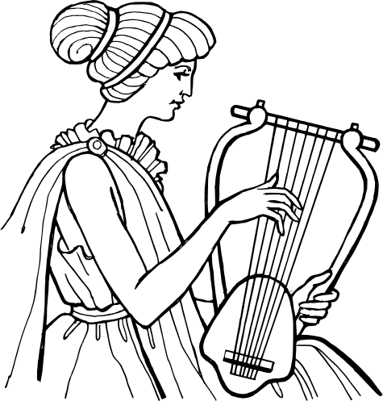
6. Sanitation
Clothes made of a particular quality is used by people working in some special jobs like chefs who work in the kitchen have to wear an apron, a hat and a mask while cooking so that the food they make remains hygienic and is not contaminated. Also, people working in a food factory have to follow similar dressing code. Surgeons to have to follow a dressing code and use disposable gloves, face mask, cap, and aprons in order to avoid contamination.
7. Decoration
Every individual loves to look good therefore each one of try to decorate ourselves with a certain style of clothing, jewelry, and cosmetics which help in enhancing our appearance and personality. We decorate ourselves based on the situations. This kind of dressing tells a lot about the individual. Adornment, or decoration, also helps people to express their uniqueness and creativity.
8. Modesty
We all live in a society which has preset unwritten rules as to how an individual should or should not dress and all of us invariably follow those rules. Like if you go for a morning or burial you wear black or white clothes but you will never wear a colored or fancy dress. Modesty refers to what people feel is the proper way for clothing to cover the body. A different group of people follows different standards of modesty.
9. Insignias
Insignias are badges or emblems that show membership in a group. Patches or emblems can be worn on jackets or blazer pockets. A school letter with a sports pin can be worn on a jacket or sweater to indicate participation in athletics.
10. Identification
Certain types of clothing, colors, and accessories have become representative of certain groups, activities, and occupations. This means that a specific style of dressing along with a specified accessory helps every individual to easily identify them in a big crowd as to what their occupation is. We teach our kids in kindergarten to identify people based on their clothing as to what is their occupation.

Slide 11


