Slide 1
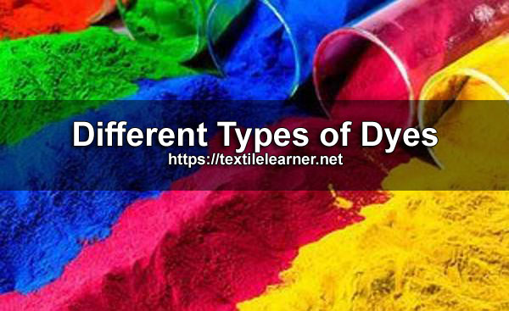

Slide 2
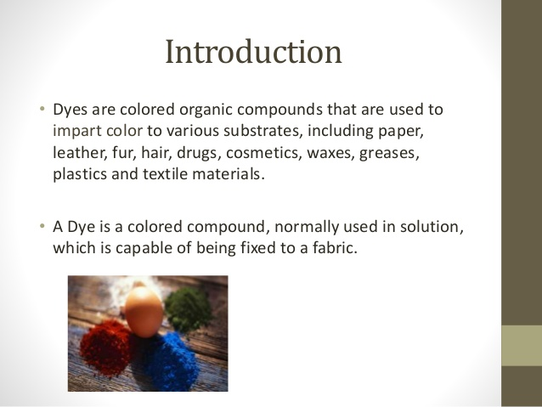

Slide 3
Definition of Dye
A dye is a coloring substance, either from natural or synthetic that imparts its color throughout material by penetration

Slide 4
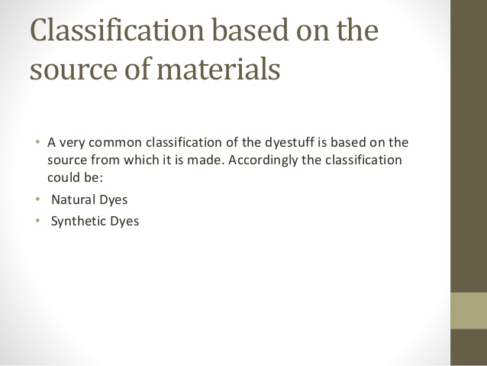
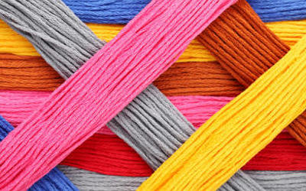

Slide 5
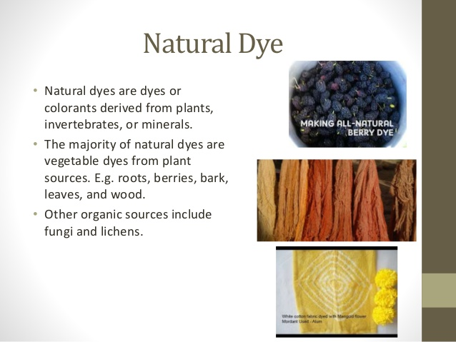

Slide 6
For vegetable origin of natural dyes, the best source of natural dyes are the different parts of plants and trees. Most natural dyes are extracted from different parts of plants and trees. Natural dyes and pigments are taken from the following parts of plants/trees:
Seed
Root
Stem
Barks
Leaves
Flowers

Slide 7
Jack fruits
It is a very popular fruit of south India and other parts of India. The wood of the tree is cut into small chips and crushed into dust powder and then subsequently boiled in water to extract the dye. After mordanting treatment of dyed fabrics, yellow to brown shades are obtained. The cotton and jute fabrics are dyed by this dye.

Slide 8
Turmeric
The dye is obtained from the root of the plant. The turmeric root is dried, crushed in powder form and boiled with water to extract the dye. It can be used in the dyeing of cotton, wool, and silk. Proper mordanting treatment improves colour fastness to wash. The brilliant yellow shade is obtained after dyeing with turmeric natural dye.

Slide 9
Onion
The papery skin of onion is the main source of the dye. Onion skin is boiled to extract the colour and subsequently can be dyed with or without mordanting the fabric. The resulting colour is from orange to brown.

Slide 10
Indigo
It is the seed of the plant. The full matured plant has 0.4% colour on weight of the plant. The shade of natural indigo is difficult to reproduce exactly. The variety of blue shade on cotton can be obtained by the application of natural Indigo.

Slide 11
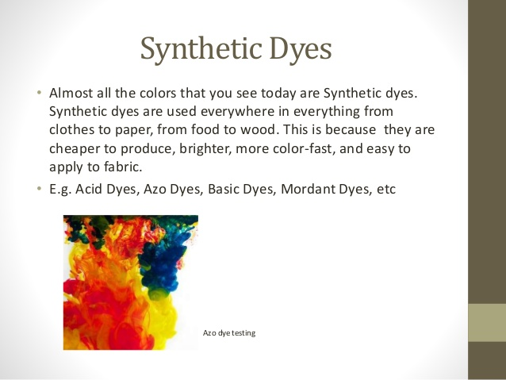

Slide 12
Basic dyes
Basic dye are water-soluble cationic dyes that are mainly applied to acrylic fibres, but find some use for wool and silk. Basic dyes are also used in the colouration of paper.

Slide 13
What fibers can be dyed with basic dye?
Basic dyes can be used to dye many different fibers, including natural fibers such as wool, silk, and cotton, but, when used on natural fibers, they are very poorly lightfast: they tend to fade very quickly when exposed to light.
Since the introduction of many superior dyes for natural fibers, basic dyes are no longer much used for dyeing them because of the light fastness problem. However, basic dyes continue to be very important in the textile industry for dyeing acrylic fibers. Their light fastness on acrylic fiber is far better than on natural fibers.

Slide 14
Advantages of Basic Dyes
•Relatively economical
•Wide shade range
•Shows good brightness
•Includes some of the most brilliant synthetic dyes

Slide 15
Limitations of Basic Dye
•High acid content
•Poor shade stability
•Preferential dyeing
•Very poor light fastness

Slide 16
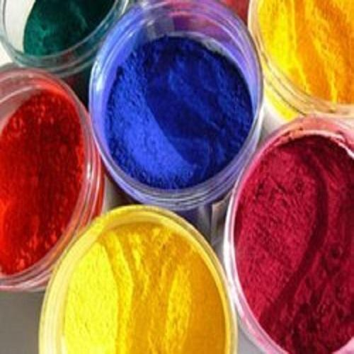
Direct Dyes
• Direct dyes are cheap and easy to apply, but of poor fastness quality.
• These dyes are also known as ‘salt dyes’ or cotton colours, which dye cotton, other vegetable fibres and
viscose rayon.

Slide 17
Properties Of Direct Dye
● It is soluble in water.
● It has sodium salt of sulphuric acid or carboxylic acid.
● It has strong affinity to cellulose fibre.
● Protein fibre can be dyed with this dye.
● Comparatively cheap.
● Easily diffusible into fibre.
● Wash fastness is not so good.
● The tinctorial power of this dye is very good.

Slide 18
Acid dye
These are soluble in water and are applied under acidic conditions.
• The acid dyestuff is mostly used for wool and silk and to a less extent nylon and acrylic fibres.
• The maximum quantity of dye absorbed depends on the amount of H2SO4 present in the bath.
• Acid dyes are inexpensive dyes.
• They are fast to light, but they are not fast to washing.

Slide 19
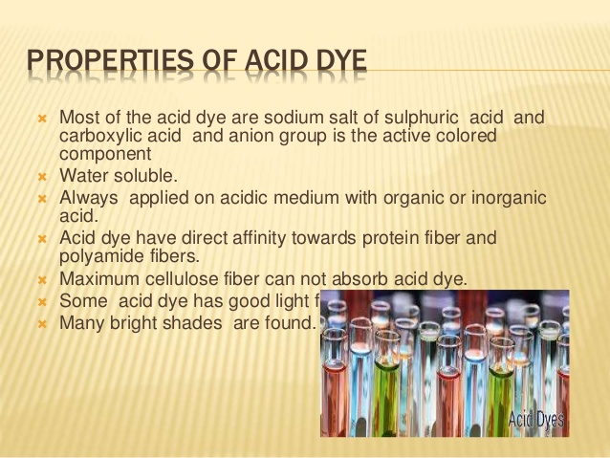

Slide 20
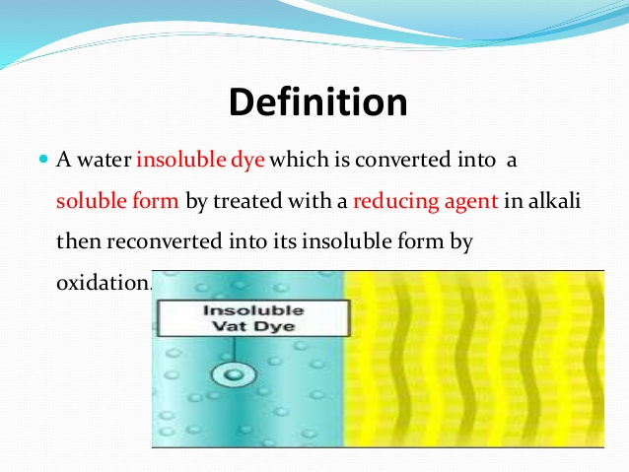
VAT DYE

Slide 21
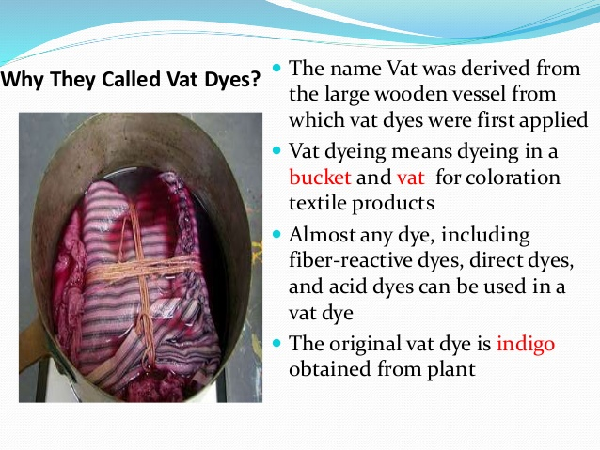

Slide 22
Vat dyes
• They are insoluble in water, but they are made soluble by the use of a strong reducing agent, such as Sodium hydrosulphite dissolved in sodium hydroxide.
• These are the fastest dyes for cotton, linen and rayon.
• They also may be applied to wool, nylon, polyester etc.
• Vat dyes are hot water dyes.
• Hot water dyes are available in both powder and liquid form.
• The first synthetic Vat dye was an Indigo created in 1879.
• Vat dyes are expensive because of the initial cost as well as the method of application.

Slide 23
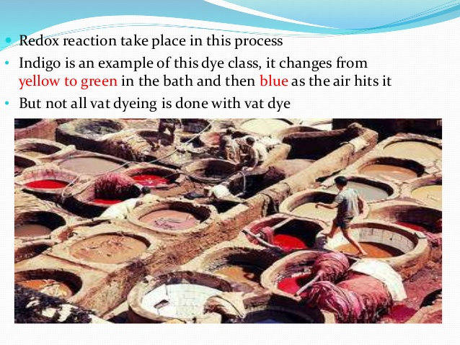

Slide 24
Reactive dyes
• They were first developed in 1956 by U.K.
• The dye is retained by means of a chemical reaction
between the dye and the fibre. As such their fastness
properties are excellent.
• The fibres most readily coloured with reactive dyes are
natural and man made cellulosic fibres, natural protein
fibres and polyamide fibres.
• With some reactive dyes, the dyeing can be carried out at room temperature.
However with most reactive dyes, the dyeing is carried out at high temperatures

Slide 25


