Slide 1
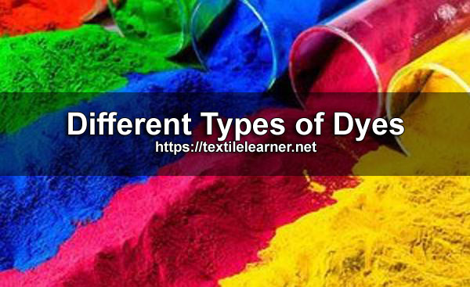

Slide 2
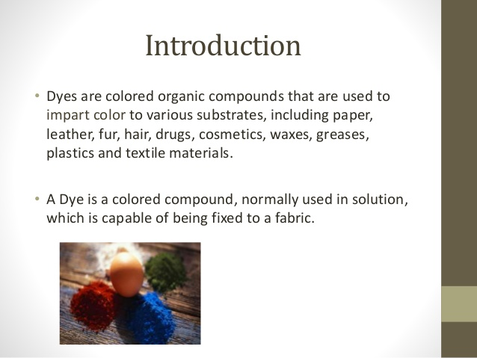

Slide 3
Definition of Dye
A dye is a coloring substance, either from natural or synthetic that imparts its color throughout material by penetration

Slide 4
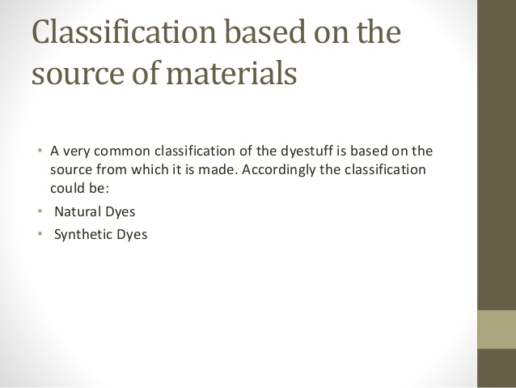
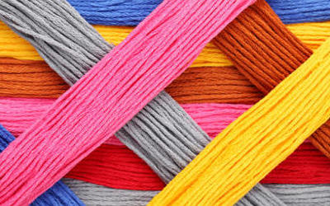

Slide 5
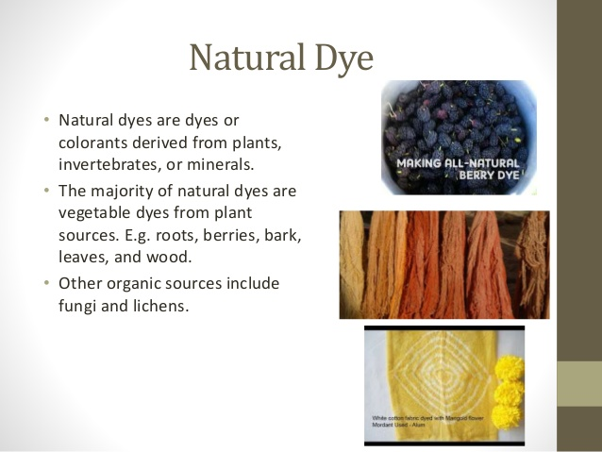

Slide 6
For vegetable origin of natural dyes, the best source of natural dyes are the different parts of plants and trees. Most natural dyes are extracted from different parts of plants and trees. Natural dyes and pigments are taken from the following parts of plants/trees:
Seed
Root
Stem
Barks
Leaves
Flowers

Slide 7
Jack fruits
It is a very popular fruit of south India and other parts of India. The wood of the tree is cut into small chips and crushed into dust powder and then subsequently boiled in water to extract the dye. After mordanting treatment of dyed fabrics, yellow to brown shades are obtained. The cotton and jute fabrics are dyed by this dye.

Slide 8
Turmeric
The dye is obtained from the root of the plant. The turmeric root is dried, crushed in powder form and boiled with water to extract the dye. It can be used in the dyeing of cotton, wool, and silk. Proper mordanting treatment improves colour fastness to wash. The brilliant yellow shade is obtained after dyeing with turmeric natural dye.

Slide 9
Onion
The papery skin of onion is the main source of the dye. Onion skin is boiled to extract the colour and subsequently can be dyed with or without mordanting the fabric. The resulting colour is from orange to brown.

Slide 10
Indigo
It is the seed of the plant. The full matured plant has 0.4% colour on weight of the plant. The shade of natural indigo is difficult to reproduce exactly. The variety of blue shade on cotton can be obtained by the application of natural Indigo.

Slide 11
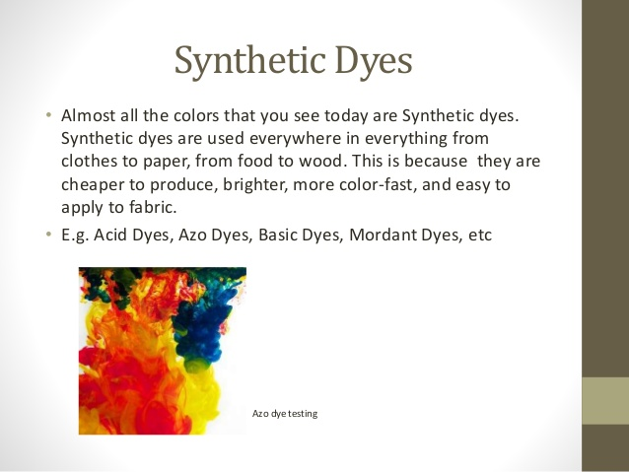

Slide 12
1. Physical form
:
2. On the Basis of Application Method
:DyePowder formGrain formFine powderformMicro or ultrafine powderformLump formSolution formPaste form
DYEReadymadeDyeWaterSulibleAcid dyeBasic dyeReactive dyeDirect dyeWaterinsolubleVat dyeSulpher dyeDispersedyeMordantdyeIngrain DyeAzoic dyeOxidationcolorMineralcolor
1. Physical form
:
2. On the Basis of Application Method
:DyePowder formGrain formFine powderformMicro or ultrafine powderformLump formSolution formPaste form
DYEReadymadeDyeWaterSulibleAcid dyeBasic dyeReactive dyeDirect dyeWaterinsolubleVat dyeSulpher dyeDispersedyeMordantdyeIngrain DyeAzoic dyeOxidationcolorMineralcolor
Basic dyes
Basic dye are water-soluble cationic dyes that are mainly applied to acrylic fibres, but find some use for wool and silk. Basic dyes are also used in the colouration of paper.

Slide 13
There are two ways of obtaining perfectly even distribution of dyestuff in a fibre:-1.
The migration properties of the dyestuff can be utilised toget the desired effect, provided the dyestuff is notimmediately fixed during adsorption on the fibre surfaceitself and the fibre sites having affinity for the dyestuffs aredistributed evenly in the fibre . In this case any initial poormigration and unevenness can be corrected subsequently byinducing the dyestuff molecules to migrate. However , in thecase of dyeing of cationic dyes on acrylic fibres, theconditions are not conducive at 100c or below since the dye-fibre bond (electrostatic bonds) is very stable from themoment it is formed.2.
The build-up of the dyestuff during the first phase of dyeing(adsorption on the fiber surface) can be controlledwhen migration subsequent to adsorption is not possible.Dyeing of acrylic fibres with cationic dyes falls this category.
What fibers can be dyed with basicdye?
Basic dyes can be used to dye many different fibers, including naturalfibers such as wool, silk, and cotton, but, when used on naturalfibers, they are very poorlylightfast:they tend to fade very quicklywhen exposed to light. Since the introduction of many superior dyesfor natural fibers, basic dyes are no longer much used for dyeingthem because of the light fastness problem.However, basic dyes continue to be very important in the textileindustry for dyeing acrylic fibers. Their light fastness on acrylic fiber isfar better than on natural fibers. Acrylic yarn and fabric cannot be
dyed with most dyes that work on natural fibers; they can be dyedonly with basic dyes or disperse dyes (the same disperse dyes thatare used for acetate and polyester). Basic dyes are needed toproduce bright or dark hues on acrylic fiber, because disperse dyesproduce only pale to medium colors on acrylic
There are two ways of obtaining perfectly even distribution of dyestuff in a fibre:-1.
The migration properties of the dyestuff can be utilised toget the desired effect, provided the dyestuff is notimmediately fixed during adsorption on the fibre surfaceitself and the fibre sites having affinity for the dyestuffs aredistributed evenly in the fibre . In this case any initial poormigration and unevenness can be corrected subsequently byinducing the dyestuff molecules to migrate. However , in thecase of dyeing of cationic dyes on acrylic fibres, theconditions are not conducive at 100c or below since the dye-fibre bond (electrostatic bonds) is very stable from themoment it is formed.2.
The build-up of the dyestuff during the first phase of dyeing(adsorption on the fiber surface) can be controlledwhen migration subsequent to adsorption is not possible.Dyeing of acrylic fibres with cationic dyes falls this category.
What fibers can be dyed with basicdye?
Basic dyes can be used to dye many different fibers, including naturalfibers such as wool, silk, and cotton, but, when used on naturalfibers, they are very poorlylightfast:they tend to fade very quicklywhen exposed to light. Since the introduction of many superior dyesfor natural fibers, basic dyes are no longer much used for dyeingthem because of the light fastness problem.However, basic dyes continue to be very important in the textileindustry for dyeing acrylic fibers. Their light fastness on acrylic fiber isfar better than on natural fibers. Acrylic yarn and fabric cannot be
dyed with most dyes that work on natural fibers; they can be dyedonly with basic dyes or disperse dyes (the same disperse dyes thatare used for acetate and polyester). Basic dyes are needed toproduce bright or dark hues on acrylic fiber, because disperse dyesproduce only pale to medium colors on acrylic
What fibers can be dyed with basic dye?
Basic dyes can be used to dye many different fibers, including natural fibers such as wool, silk, and cotton, but, when used on natural fibers, they are very poorly lightfast: they tend to fade very quickly when exposed to light.
Since the introduction of many superior dyes for natural fibers, basic dyes are no longer much used for dyeing them because of the light fastness problem. However, basic dyes continue to be very important in the textile industry for dyeing acrylic fibers. Their light fastness on acrylic fiber is far better than on natural fibers.

Slide 14
Advantages of Basic Dyes
•Relatively economical
•Wide shade range
•Shows good brightness
•Includes some of the most brilliant synthetic dyes

Slide 15
Limitations of Basic Dye
•High acid content
•Poor shade stability
•Preferential dyeing
•Very poor light fastness

Slide 16
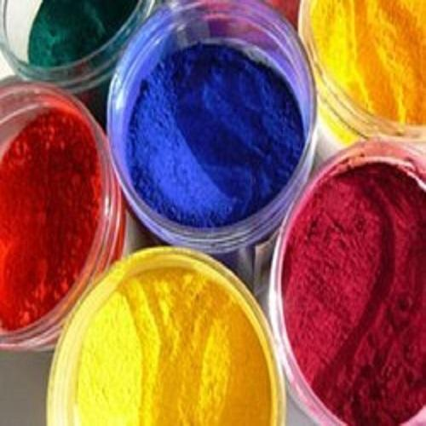
Direct Dyes
• Direct dyes are cheap and easy to apply, but of poor fastness quality.
• These dyes are also known as ‘salt dyes’ or cotton colours, which dye cotton, other vegetable fibres and
viscose rayon.

Slide 17
Properties Of Direct Dye
● It is soluble in water.
● It has sodium salt of sulphuric acid or carboxylic acid.
● It has strong affinity to cellulose fibre.
● Protein fibre can be dyed with this dye.
● Comparatively cheap.
● Easily diffusible into fibre.
● Wash fastness is not so good.
● The tinctorial power of this dye is very good.

Slide 18
Acid dye
These are soluble in water and are applied under acidic conditions.
• The acid dyestuff is mostly used for wool and silk and to a less extent nylon and acrylic fibres.
• The maximum quantity of dye absorbed depends on the amount of H2SO4 present in the bath.
• Acid dyes are inexpensive dyes.
• They are fast to light, but they are not fast to washing.

Slide 19
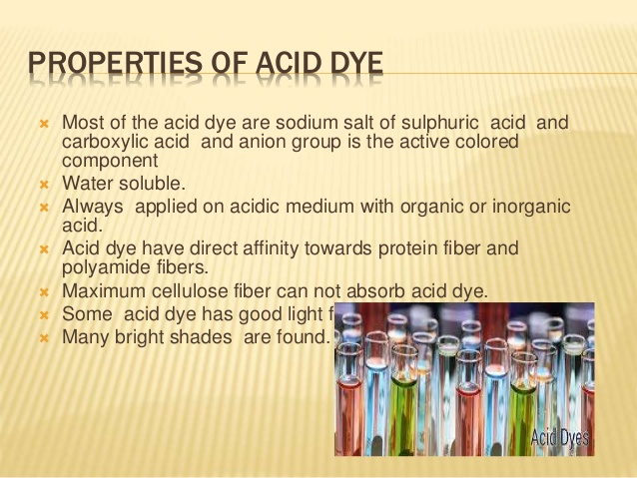

Slide 20
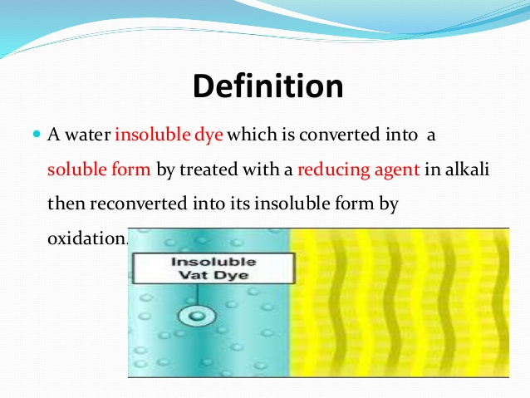
VAT DYE

Slide 21
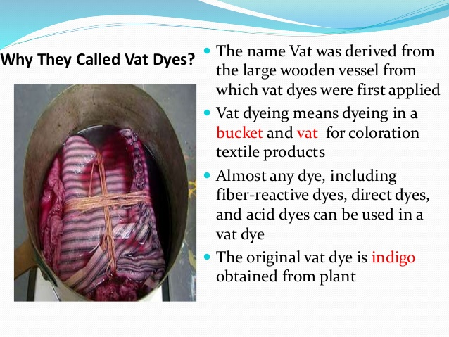

Slide 22
Vat dyes
• They are insoluble in water, but they are made soluble by the use of a strong reducing agent, such as Sodium hydrosulphite dissolved in sodium hydroxide.
• These are the fastest dyes for cotton, linen and rayon.
• They also may be applied to wool, nylon, polyester etc.
• Vat dyes are hot water dyes.
• Hot water dyes are available in both powder and liquid form.
• The first synthetic Vat dye was an Indigo created in 1879.
• Vat dyes are expensive because of the initial cost as well as the method of application.

Slide 23
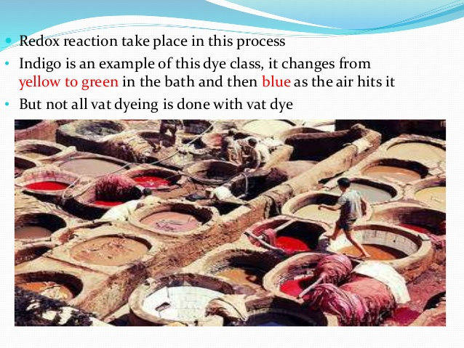

Slide 24
Reactive dyes
• They were first developed in 1956 by U.K.
• The dye is retained by means of a chemical reaction
between the dye and the fibre. As such their fastness
properties are excellent.
• The fibres most readily coloured with reactive dyes are
natural and man made cellulosic fibres, natural protein
fibres and polyamide fibres.
• With some reactive dyes, the dyeing can be carried out at room temperature.
However with most reactive dyes, the dyeing is carried out at high temperatures

Slide 25


