Slide 1

Functional finishes

Slide 2
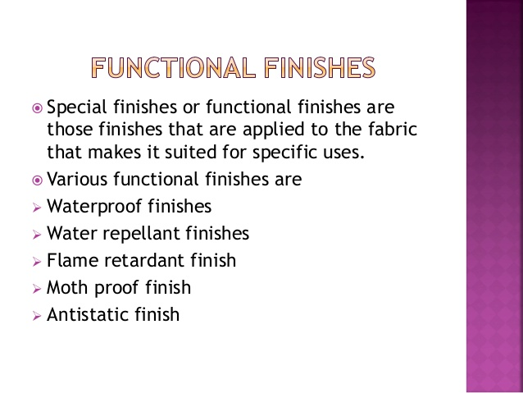

Slide 3


Slide 4
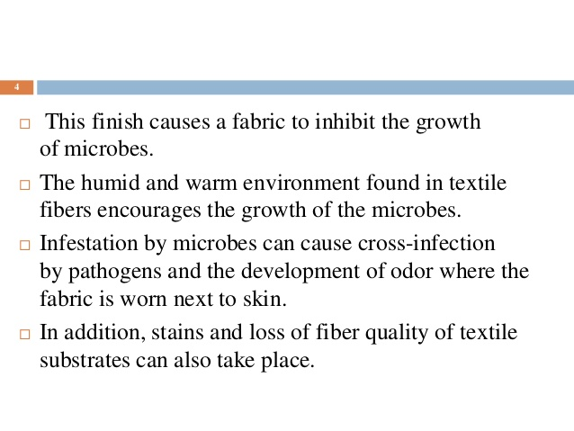

Slide 5
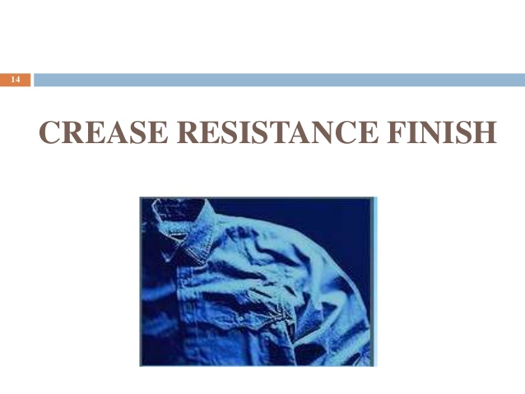

Slide 6
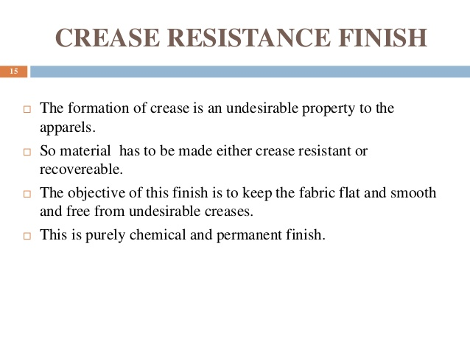

Slide 7

Durable press finish

Slide 8
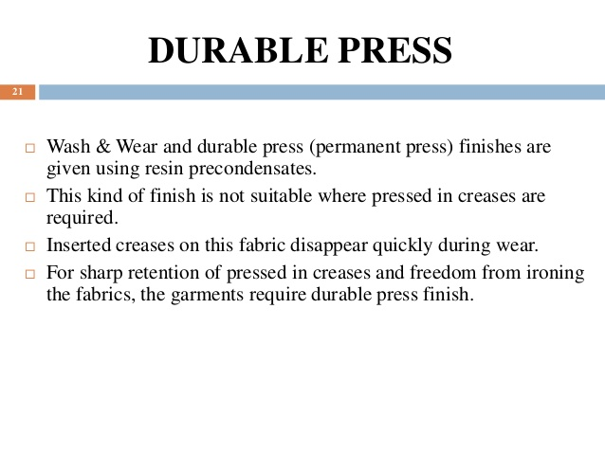

Slide 9
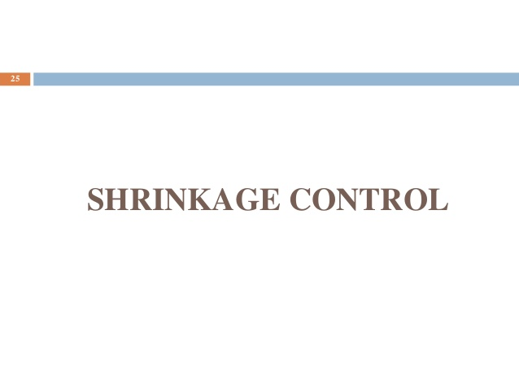

Slide 10
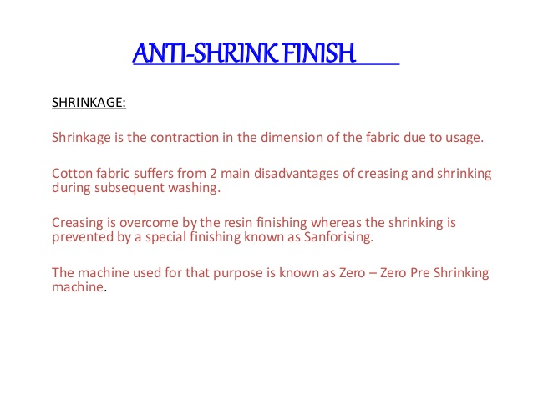

Slide 11

Flame retardant finish

Slide 12
Flame Retardant Finish
Flame retardants are chemicals, which are added to combustible materials to render them more resistant to ignition. They are designed to minimize the risk of a fire starting in case of contact with a small heat source such as cigarette, candle or an electrical fault.

Slide 13

Water repellent finish
Water repellent finish
Water repellent finish

Slide 14
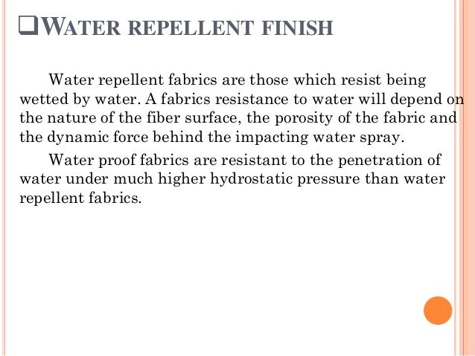

Slide 15
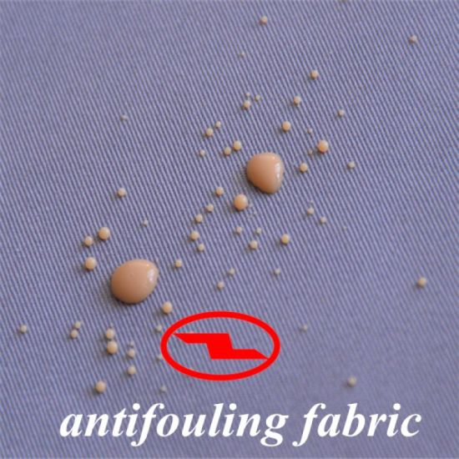

Slide 16
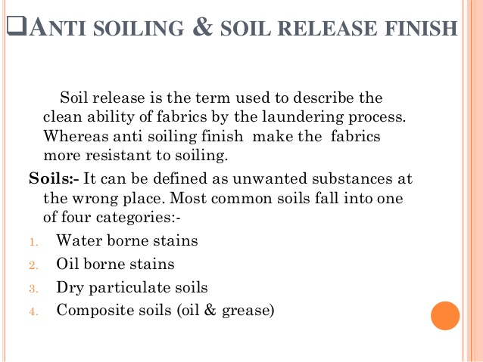

Slide 17

Preented by
Deepa nilawar

