Slide 1
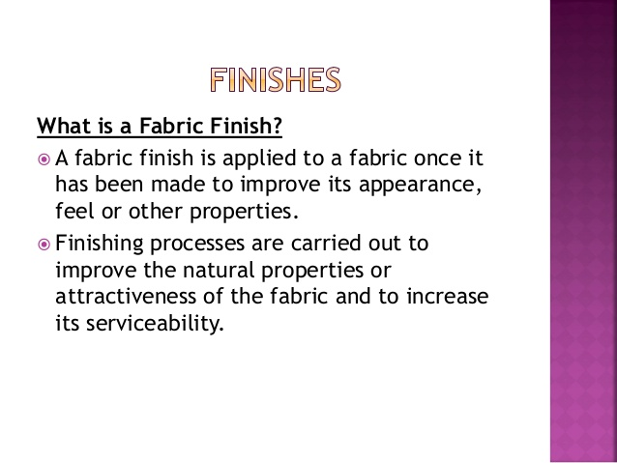

Slide 2
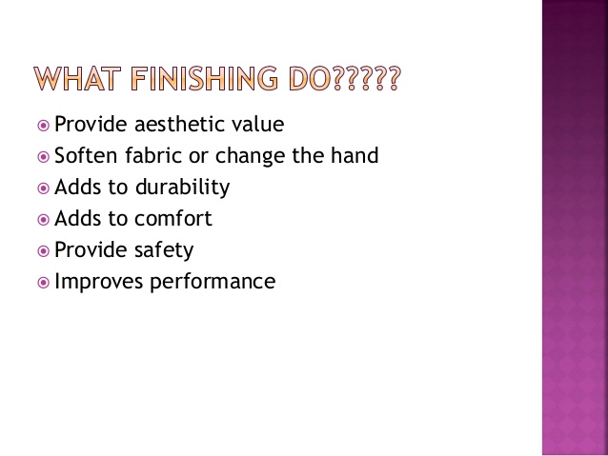

Slide 3
Singeing
Singeing is designed to burn off the surface fibres from the fabric to produce smoothness. The fabric passes over brushes to raise the fibres, then passes over a plate heated by gas flames.

Slide 4
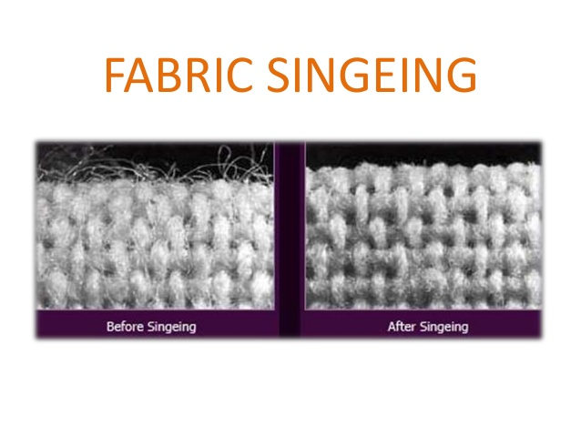

Slide 5
Desizing
Depending on the size that has been used, the cloth may be steeped in a dilute acid and then rinsed, or enzymes may be used to break down the size.

Slide 6
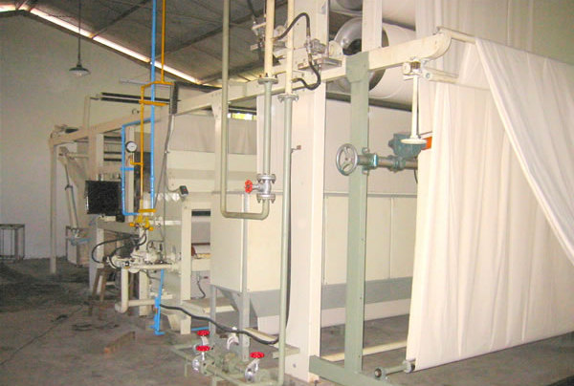

Slide 7
Scouring
Scouring is a chemical washing process carried out on cotton fabric to remove natural wax and non-fibrous impurities (e.g. the remains of seed fragments) from the fibres and any adventitious oil, soiling or dirt.

Slide 8
Bleaching
Bleaching improves whiteness by removing natural coloration and remaining trace impurities from the cotton; the degree of bleaching necessary is determined by the required whiteness and absorbency. However, for white bed sheetings and medical applications, the highest levels of whiteness and absorbency are essential.^{[8]}

Slide 9
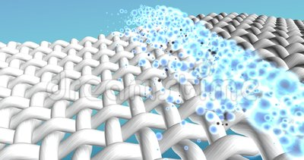

Slide 10
Mercerising
A further possibility is mercerizing, during which the fabric is treated with a caustic soda solution to cause swelling of the fibres. This results in improved luster, strength, and dye affinity. Cotton is mercerized under tension, and all alkali must be washed out before the tension .

Slide 11
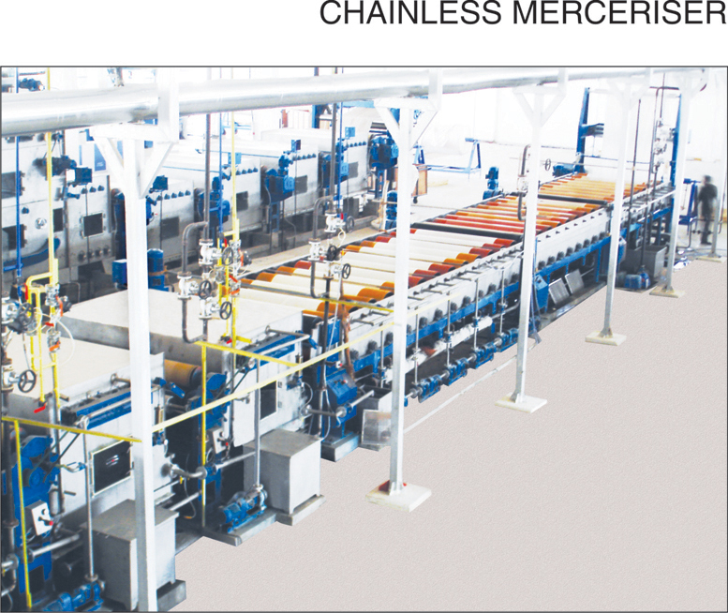

Slide 12
Dyeing
Cotton is an absorbent fibre which responds readily to colouration processes. Dyeing is commonly carried out with an anionic direct dye by completely immersing the fabric (or yarn) in an aqueous dyebath according to a prescribed procedure. For improved fastness to washing, rubbing, and light, other dyes such as vats and reactives are commonly used.

Slide 13
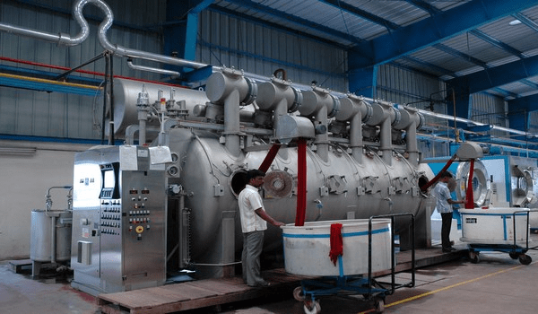

Slide 14
Printing
Printing is the application of colour in the form of a paste or ink to the surface of a fabric, in a predetermined pattern. It may be considered as localised dyeing. Printing designs on to already dyed fabric is also possible. The common processes are block printing, roller printing and screen printing

Slide 15
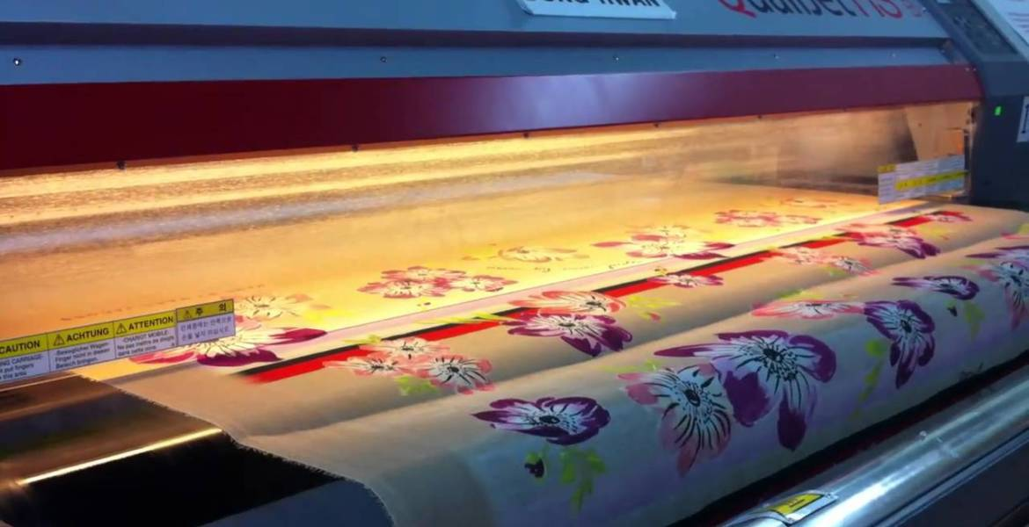

Slide 16
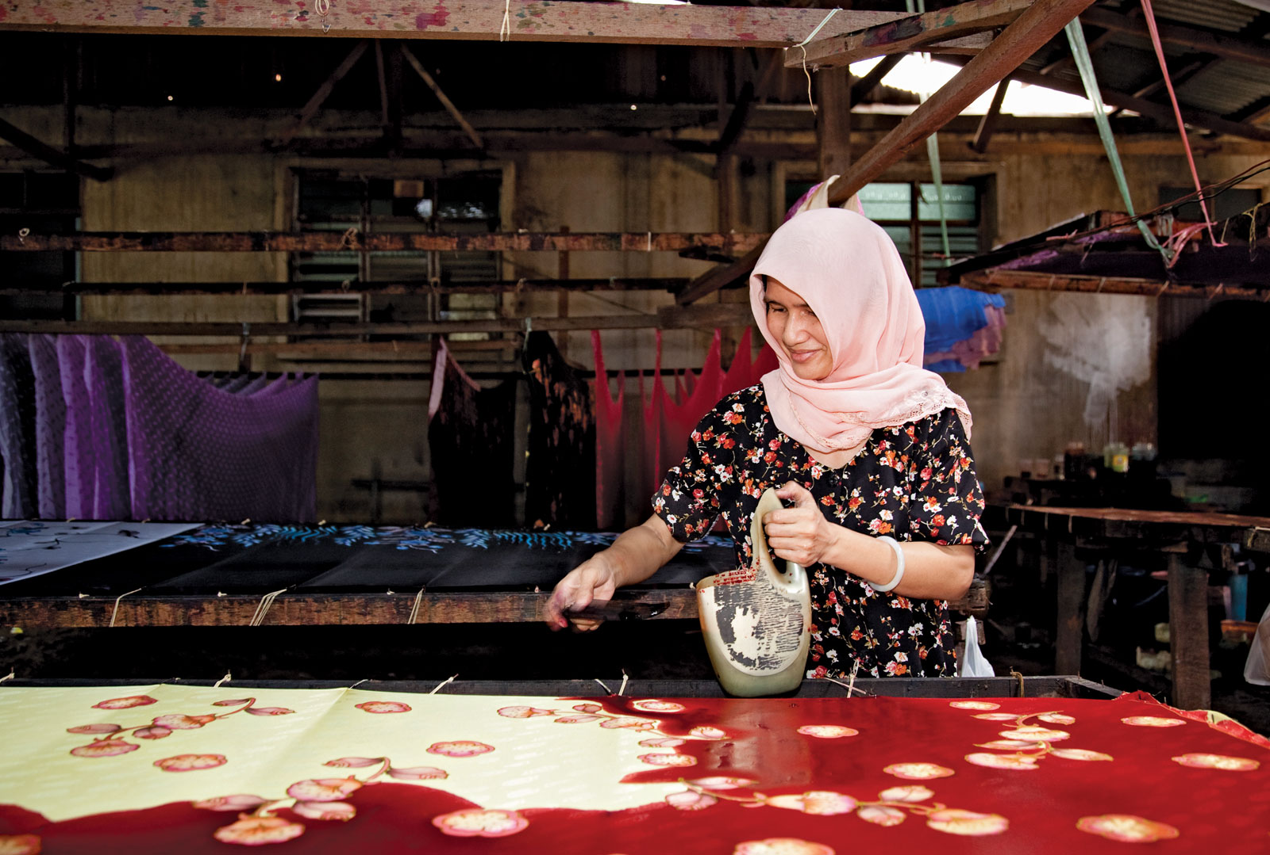

Slide 17

Presented by
Deepa Nilawar

