Slide 1
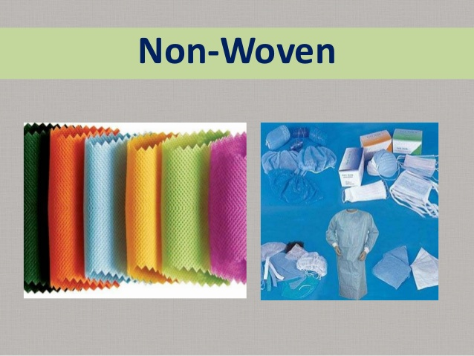

Slide 2
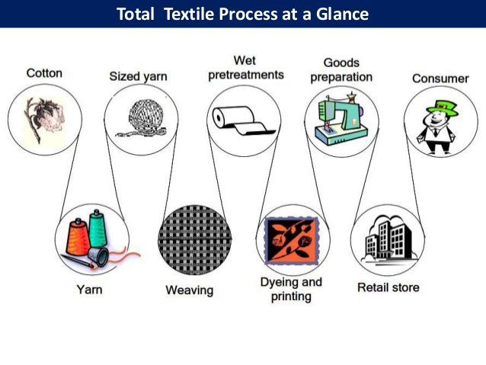

Slide 3
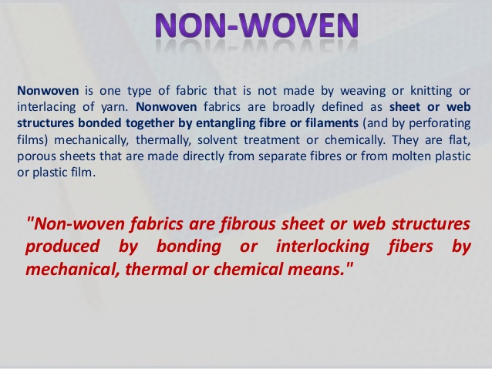

Slide 4
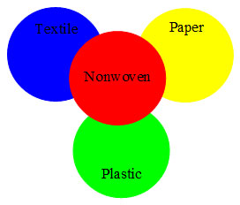
Nonwoven fabrics are broadly defined as sheet or web structures bonded together by entangling fiber or filaments mechanically, thermally or chemically.
They are flat , porous sheets that are made directly from separate fibres, molten plastic or plastic film.
They are not made by weaving or knitting and do not require converting the fibres to yarn.

Slide 5
Nonwoven fabrics are engineered fabrics that may be single-use, have a limited life, or be very durable.
Nonwoven fabrics provide specific functions such as absorbency, liquid repellence, resilience, stretch, softness, strength, flame retardancy, washability, cushioning, thermal insulation, acoustic insulation, filtration, use as a bacterial barrier and sterility.
These properties are often combined to create fabrics suited for specific jobs, while achieving a good balance between product use-life and cost.

Slide 6
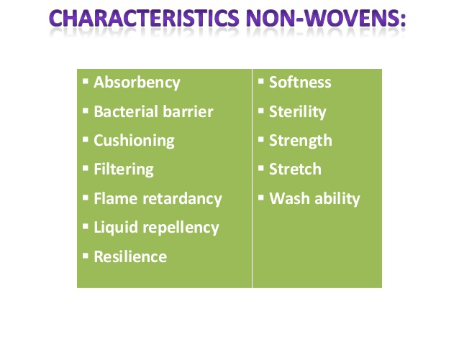

Slide 7
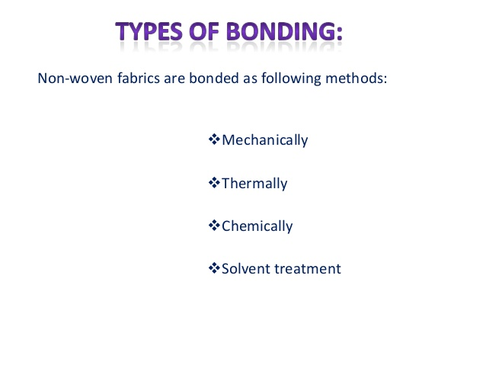

Slide 8
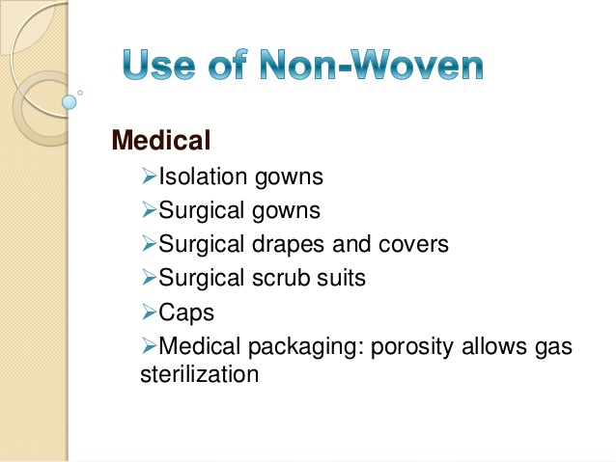
Gloves
Shoe covers
Bath wipes
Wound dressings
Drug delivery
Plasters

Slide 9
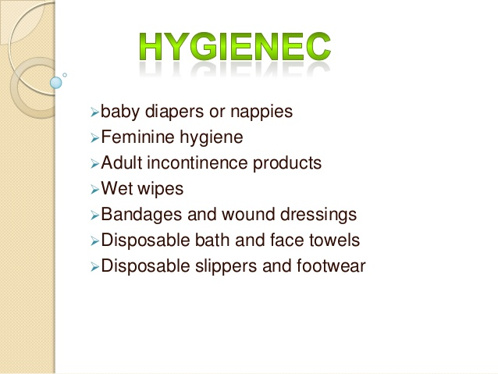

Slide 10
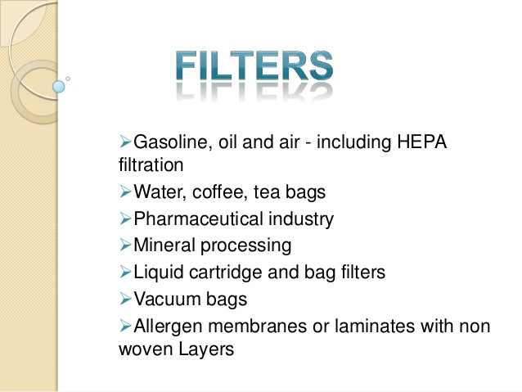

Slide 11
Geotextils
Nonwoven geotextile bags are much more robust than woven bags of the same thickness.^{[1]}
Nonwoven geotextile containers (sand bags) are used for
soil stabilizers and roadway underlayment
foundation stabilizers
erosion control
canals construction
drainage systems
frost protection
pond and canal water barriers
sand infiltration barrier for drainage tile
landfill liners

Slide 12
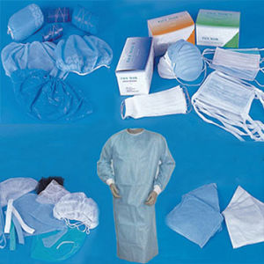

Slide 13
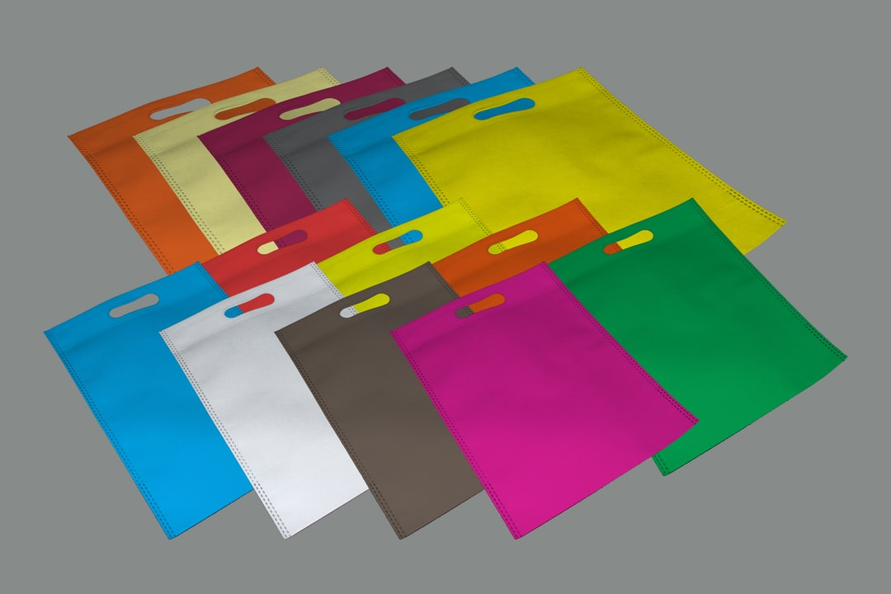

Slide 14
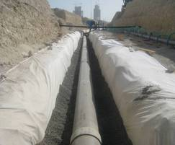

Slide 15
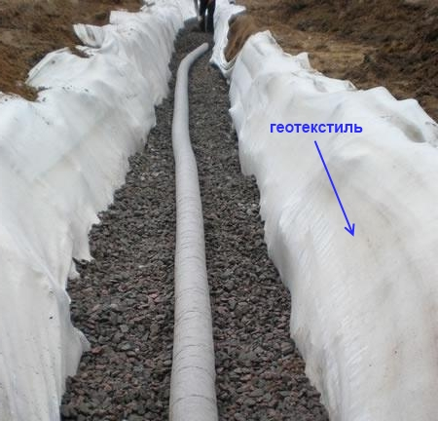

Slide 16
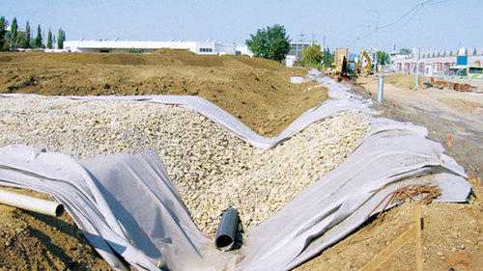

Slide 17
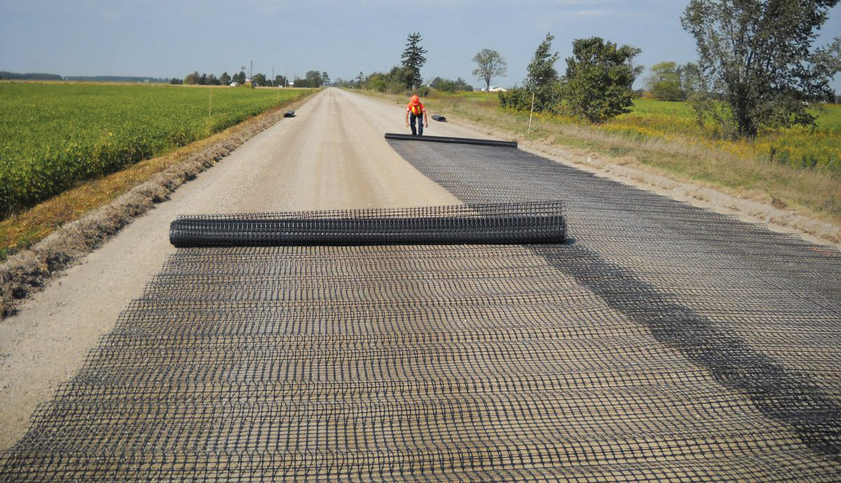

Slide 18
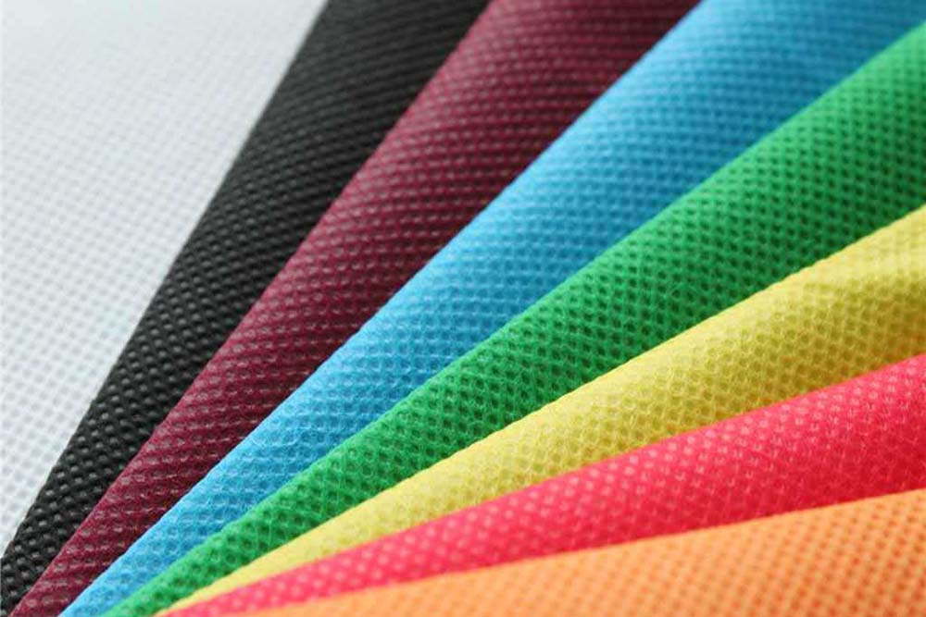

Slide 19

PRESENTED BY
DEEPA NILAWAR

