Slide 1


Slide 2


Slide 3
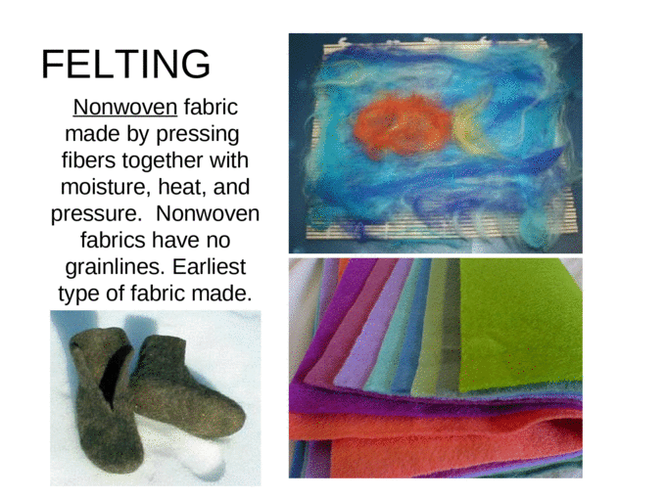

Slide 4
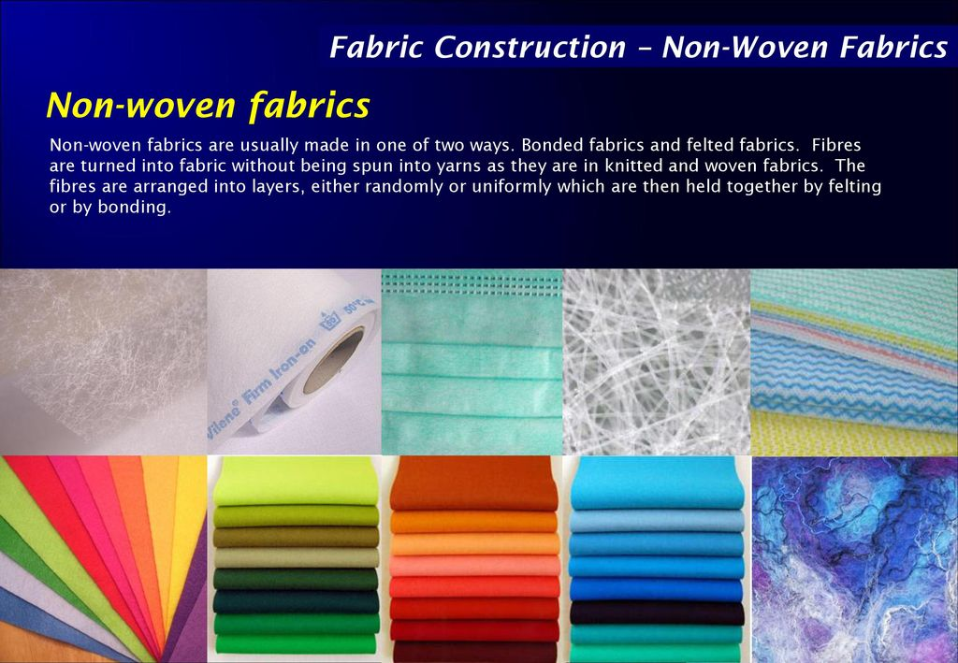

Slide 5
Raw Materials
Felt is produced from wool, which grips and mats easily, and a synthetic fiber that gives the felt some resilience and longevity. Typical fiber combinations for felt include wool and polyester or wool and nylon. Synthetics cannot be turned into felt by themselves but can be felted if they combine with wool.

Slide 6
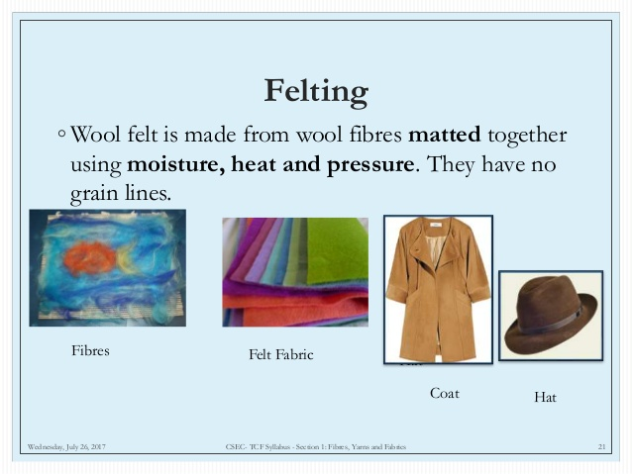

Slide 7
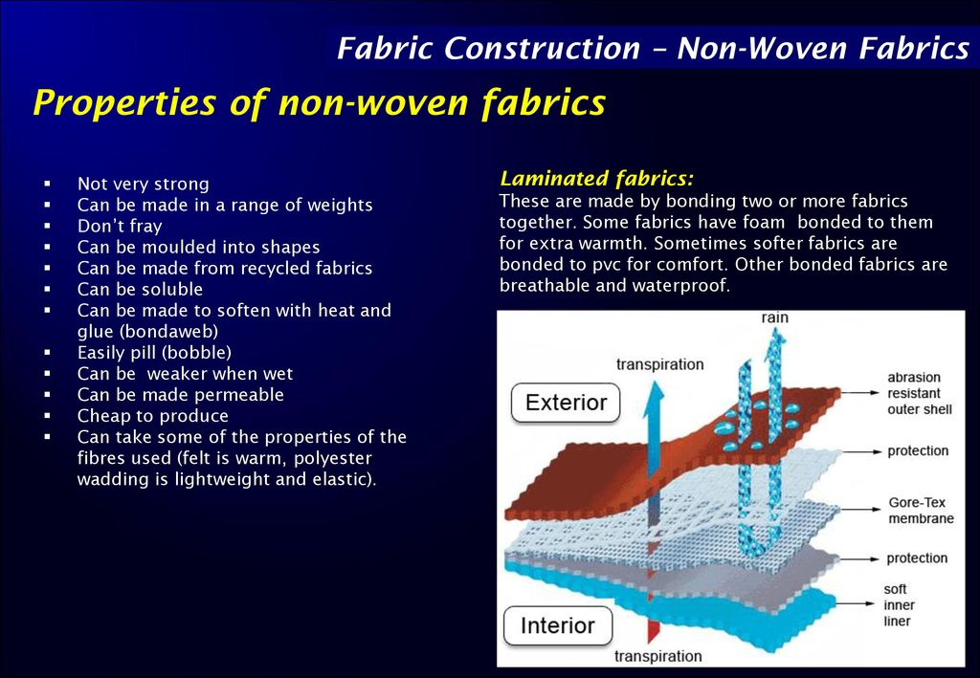

Slide 8
Wool felt
Still one of the most common types of felt, textile artisans made felt using wool from sheep or other wool-bearing animals for the majority of this fabric’s history. In addition to being aesthetically pleasing, wool felt shares the beneficial attributes of its base fiber, including absorbency, fire resistance, and impressive insulative properties.

Slide 9
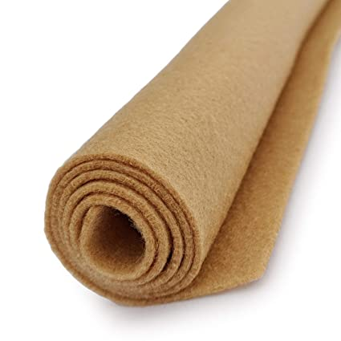

Slide 10
Fur felt
To this day, some textile manufacturers use beaver pelts to make felt hats and other accessories. While not as in vogue in the era of animal rights, fur felt is useful due to its impressive durability and high malleability. It’s also possible to make fur felt with types of fur other than beaver, but in every case, fur felt production involves the killing of fur-bearing animals.

Slide 11
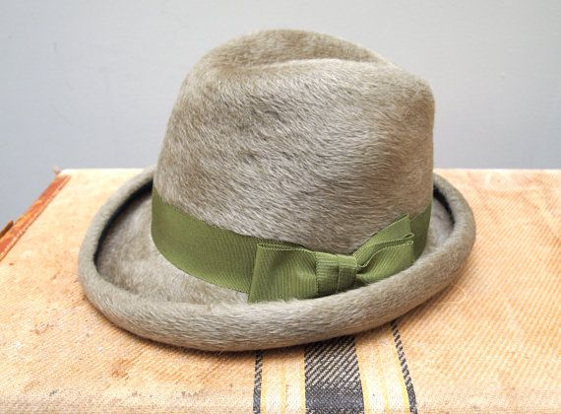

Slide 12
Acrylic felt
Acrylic felt has become increasingly popular over the last century. Cheaper to produce than wool, acrylic felt offers some of the same benefits as conventional felt. Unlike wool or fur felt, however, acrylic felt is highly flammable, and it is uncomfortable when worn against the skin.

Slide 13
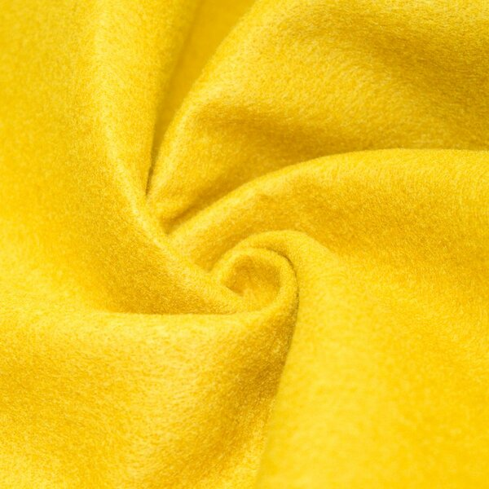

Slide 14
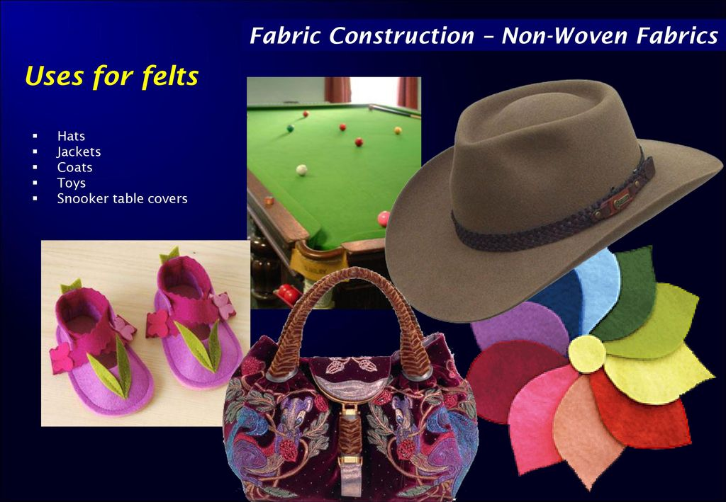

Slide 15

PRESENTED BY
DEEPA NILAWAR

