Slide 1
Dayanand college of arts, latur department of political science
INDIA & THE UNITED NATIONS

Slide 2
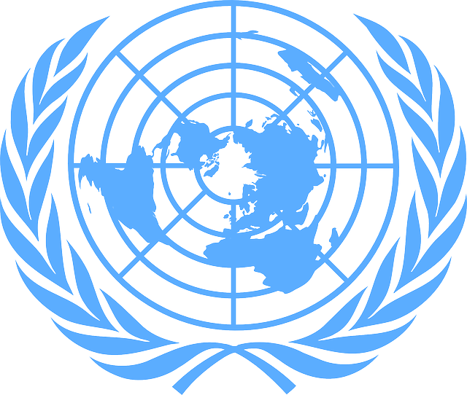
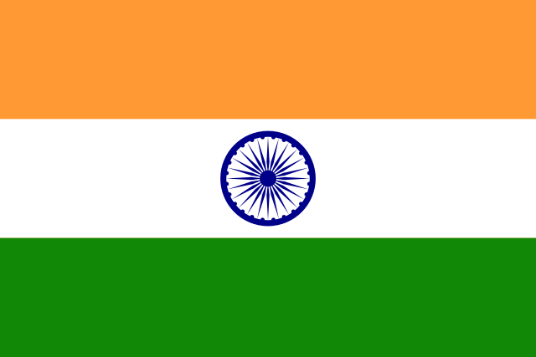
INDIA’s Flag
UNO’s Flag

Slide 3
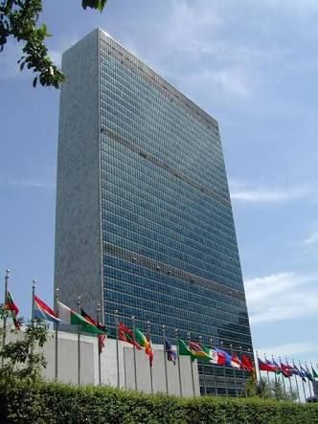
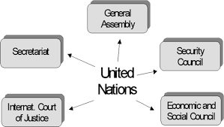
Structure Of UN
Headquarter @ New York

Slide 4
UNO
UNO – United Nations Organization
Came into existence – 24 Oct, 1945
Headquarter – New York, USA
Flag – is a circular world map as seen from the North Pole surrounded by a wreath of olive branches symbolizing peace, centered in white on a light blue background
United Nations is not a state, for sovereignty lies with the states which are its members. It is not compulsive in its nature, for its decision are not binding on those who compose the UN.

Slide 5
OBJECTIVES – (preamble of the charter)
To save the succeeding generations from the scourge of war
To reaffirm faith in fundamental human rights in the work & dignity of human person & equal rights of men, women & nation’s large & small
To establish conditions under which justice & respect for the obligations from treaties & other sources of international law can be maintained &
To promote social progress & better standard of life in larger freedom
PURPOSE – (Article 1 of the charter)
Maintenance of international peace & security
Development of friendly relations among nation’s
International cooperation in solving problems of economic, social, cultural & humanitarian nature; promotion & encouragement of respect for human rights & fundamental freedom &
To be a centre of harmonizing the actions of the nations to achieve the above ends

Slide 6
PRINCIPLES- (Article 2 of the charter)
The organization is based on the principle of sovereign equality of all it’s members
All member shall fulfill in good faith, the obligations they have assumed under the charter
The members shall settle their international disputes by peacefull means
They (members) shall refrain in their international relations from the threat or force in any manner inconsistent with the purposes of the UN
They shall give the UN every assistance in every action it takes in accordance with charter, and to refrain from giving assistance to any state against which the organization is taking preventive or enforcement action
The UN is to ensure that non-members act in accordance with this principles so far as necessary for maintaining international peace & security
The organization shall not intervene in matters essentially within the domestic jurisdiction of any state. This provision shall not however, prejudice the application of enforcement action with respect to threat’s to peace, breaches of peace & acts of aggression

Slide 7
“UNO RESPECTS INDIA”
India signed UN charter on 26 June, 1945 at San Franscisco Conference & became one of the original 51 members of the organization.
INDIAS APPROACH (Jawaharlal Nehru):-
“India’s approach towards the UN shall be one of consideration & support without reservations & that India would undertake to carry out it’s due responsibilities towards the international community.”
INDIAN CONSTITUTION & UN:-
The constitution of India reaffirmed, under Article 51, India's commitment to "promote international peace and security; to maintain just and honorable relations among nations; to foster respect for International Law and treaty obligations in the dealings of organised peoples with one another; and to encourage settlement

Slide 8
of international disputes by arbitration and other peaceful means (Art.51)".
In carrying out this commitment, India regards the UN as an invaluable platform for global deliberations, negotiations and diplomacy.
INDIA FAVOURED UNIVERSALISATION & DEMOCRATIZATION of UN :-
India always supported it’s expansion by supporting membership of new states. (pro-Soviet, pro-American & Red China)
Also involving them in the decision making process on matters of common & collective interests.
SUPPORT to UN RESOLUTIONS & PROGRAMMES :-
India has extended wholehearted support to the various UN resolutions & tried to implement them.
India has also helped in the implementation of the various programs sponsored by different international bodies like the WHO, UNESCO, FAO, UNICEF, etc.

Slide 9
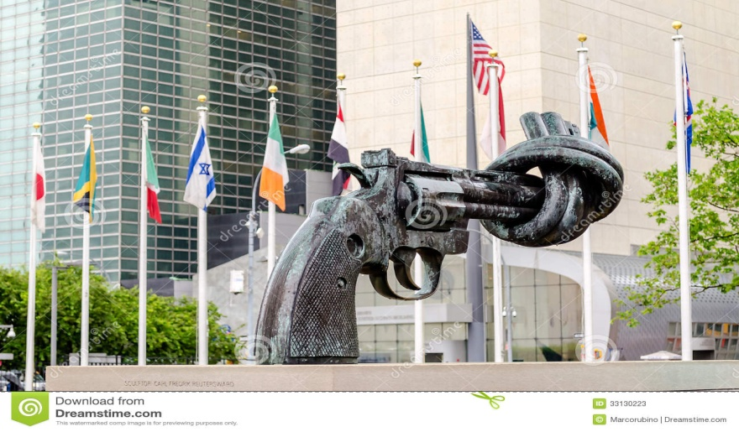
INDIA’s SUPPORT to ARMS CONTROL & DISARMAMENT :-
India has played a consistently positive and energetic role in UN efforts for disarmament and arms control.
India stands committed to total nuclear disarmament. India pleaded for the cause of disarmament and arms control in Eighteen Nations Disarmament Committee, special sessions of the UN General Assembly and finally in Conference on Disarmament (CD). India had signed the Partial Test Ban Treaty (1963) and Chemical Weapons Convention (1993), but firmly resisted all pressures to sign the Non Proliferation Treaty and blocked the Comprehensive Test Ban Treaty in 1996.

Slide 10
FINANCIAL SUPPORT to UN :-
Though India is quite a poor country it has extended full financial support to the United Nations & discharged its responsibilities faithfully.
International Yoga Day :-
On 11 December 2014, the United Nations General Assembly adopted without a vote a resolution commemorating 21 June as the International Yoga Day, recognizing the holistic benefits of this timeless practice and its inherent compatibility with the principles and values of the United Nations.

Slide 11
KEEN INTEREST in IMPROVEMENT of UN :-
India has strongly pleaded for the expansion of the Security Council to give representation to African & Latin American countries. (leads to 200 members)
India has favoured the inclusion of countries like Germany, India, Japan, Egypt, Brazil & Nigeria as permanent members of the security council.
India has demanded replacement of the existing economic system by a New International Economic Order which shall be able to take better care of the interests of the developing countries.
India is in favour of expanding the role of the UN. (beside of international peace, justice & cooperation; UN also make efforts to

Slide 12
bring about qualitative changes in the present world by undertaking international developments plans & programmes)
India wants the UN to be freed from the control of some big powers which at present are dominating its proceedings & decisions.
UN should work on the principle off transparency, non-discrimination & equal respect for the dignity of all individuals, societies & nations. Hence it is desirable that the Veto power in the Security Council should be done away with.
There is an imperative need that the UN should pay greater attention to present global problems like terrorism, proliferation of weapons of mass destruction & economic globalization.

Slide 13
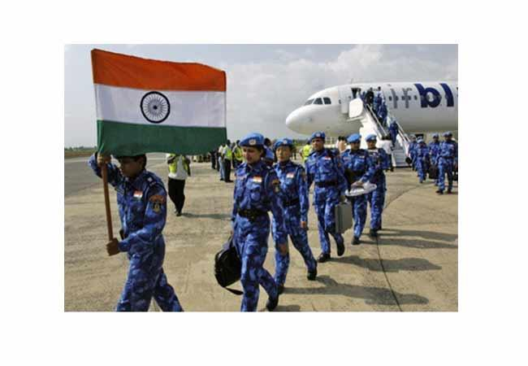
INDIA’s ROLE in PEACE KEEPING :-
India plays important role in Peace Keeping Operations in following countries – Korea, Congo, Gaza, Combodia, Somalia, Namibia, Sierra Leone, Lebanon, Kosvo, Ethiopia & Eritrea

Slide 14
India has from time time risked the lives of its soldiers in peacekeeping efforts of the UN not for any strategic gain, but for the service of peace & order in the world.
India – largest troops contributors to the UN.
India has contributed over 1,60,000 troops to 43 of 64 UN peacekeeping operations
India’s participation comes into effect only after:
All means of peaceful settlement of disputes are exhausted
It is assured that peace-keeping operations will adhere to the principles of the UN charter
The affected stake makes a request for such operation & that too under the command of the UN
It is assured that peace-keepings operations would not violate the humanitarian activities going on in the concerned state
The anticipated duration of the peace-keeping missions is tied down to the clear objectives
India has currently (Jan 2008) over 9300 personnel in 11 out of 17 ongoing UN peace-keeping operations in various trouble-spots around the world

Slide 15
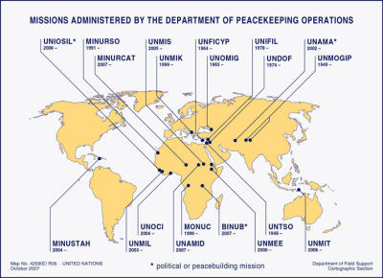
Present Day Peace Keeping Operations :

Slide 16
SERVICES OF INDIA’S to UN :-
India has been a non-permanent member of the UNSC seven times - 1950-51, 1967-68, 1972-73, 1977-78, 1984-85, 1991-92, and 2011-2012
India is one of the founding members of the UN
India attended the San Francisco Conference of 1945, its delegation led by Sir C.P. Ramaswamy Mudaliar
India is the largest contributor to the UN peacekeeping operations
India has contributed over 1,60,000 troops to 43 of 64 UN peacekeeping operations
More than 160 Indian defence and police personnel have laid down their lives serving under the UN's blue flag
Indian armed forces are part of seven of the 14 ongoing UN peacekeeping missions (2015)
India co-sponsored the landmark 1960 Declaration on Granting of Independence to Colonial Countries and Peoples
C.S. Jha headed the Special Committee to look into implementation of the declaration
India was one of the first countries to raise the issue of apartheid in South Africa at the UN in 1946

Slide 17
India was one of the earliest signatories to the Convention on Elimination of all forms of Racial Discrimination adopted in 1965
India has pushed for total nuclear disarmament and non-proliferation at the UN
it is the only nuclear weapons state to demand total elimination of nuclear weapons
In 1996, India along with 20 other countries submitted an action plan for phased elimination of nuclear weapons (1996 - 2020)
India played a pivotal role in UN's ascertaining of ODA estimates for developed countries
India long with Brazil, Japan and Germany formed the G4 in 2005 to demand UNSC reforms
In 1996, India piloted a draft Comprehensive Convention on International Terrorism (CCIT)
India founded in 2005 and is a major contributor to the UN Democracy Fund
India has used the General Assembly platform for voicing strongest opposition to imperialism, colonialism and apartheid. In 1954, India took a leading part in securing political sanctions against the racialist regime of South Africa.

Slide 18
In 1965, it supported fully the UN sponsored economic boycott of Rhodesia. It gave full support to the Angolan liberation movement and to the cause of Independence of Namibia.
India also played an active role in setting up of the United Nations Conference on Trade and Development (UNCTAD) and calling for the creation of a New International Economic Order(NIEO).
India led a group of developing countries whose support proved valuable in getting 16 countries admitted in 1955.
India forcefully pleaded for representation of Communist China in the United Nations.
India is a member of almost all international agencies like UNESCO, WHO,FAO, UNICEF etc.

Slide 19
Some of the prominent personalities who rendered great service to the international organisation include Mrs. Vijay Lakshmi Pandit as President of the UN General Assembly; Maulana Abul Kalam Azad and Dr. Radhakrishnan as Chairman of UNESCO;Mrs. Rajkumari Amrit Kaur as Chairperson ofWHO; Sri V.R. Sen as President of FAO; H.J. Bhaba as Chairman of Atoms for peace Commission; B.N. Rau and Nagendra Singh as Judges of International Court of Justice. Over 55,000 Indian Military and Police personnel have served under the UN flag in 35 UN peace keeping operations in all the continents of the globe. General Thimmaya, Prem Chand, Rikliye and Satish Nambiar being chosen by the UN Secretary Generals to Command UN peacekeeping forces at different points of time. Recently an Indian, Major General Randhir Kumar Mehta has been appointed as the world body's Military Adviser for peace keeping. This is the first time that a nominee from a developing country has occupied this highly prestigious post.

Slide 20
INDIA’s DEMAND for UN SECURITY COUNCIL’s PERMANENT SEAT :-
Why Should India Be a Permanent Member?
* India constitutes 16% of the world's population and has emerged as a major power of South Asia.
* India has played a proactive role in restoration of peace in the world. It has been a great exponent in the non-alignment concept. Out of 112 NAM countries none has the permanent seat. Therefore, a major section of the world is deprived of being represented in the SC as its permanent member.
* Now India is a nuclear power, and it has committed itself towards making Indian Ocean as Zone of Peace by adhering to the doctrine of 'no first use'.
* India is among the founding nations of the UN and has been very instrumental in helping the UN in the process of peace keeping in the world.
* India is the biggest democracy in the world and cherishes the values enshrined in the UN Charter more than any other nation of the world.
* In the economic arena, within fifty-seven years of independence, India has displayed

Slide 21
substantial dynamism. In the 1990s, our rate ofgrowth averaged 6% per annum. India is likely to become one of the largest markets in the world, with a middle class estimated to be in the region of 500 million by the year of 2025. The emergence of India as a major player in the software and IT enabled services sectors has raised India's economic profile, and it is now beingseen as an economic superpower in the making.
Merits of India's Getting the Permanent Seat in the UNSC
* To maintain international peace and security in accordance with the principles and purposes of the UN.
* To investigate any dispute or situation which might lead to international friction.
* To recommend methods of adjusting such disputes or the terms of settlement.
* To formulate plans for establishing a system to regulate armaments.

Slide 22
* To determine the existence of a threat to the peace or act of aggression and to recommend what action should be taken.
* To call on members to apply economic sanctions and other measures not involving the use of force to prevent or stop aggression.
* To take military action against an aggressor.
* To exercise the adminission of new members.
* To recommend the General Assembly for the appointment of the Secretary General and,
together with the Assembly, to elect the judges of the international court of justice.
Kofi Annan Recommendations :-
Expansion of the Security Council is the most important and most politically difficult subject that the panel has to make recommendations on. The panel in its final report in December 2004 gave two options :

Slide 23
(1)Providing for increasing the numbers of permanent seats without veto powers by 6 and nonpermanent seats by 3, and
(2) The number of permanent members would be kept at five but there would be a new category of eight semi-permanent members without veto with renewable four-year terms, with 11 non-permanent members making up the balance.
For India :-
the chances of getting into the permanent membership of the UN Security Council are very high. But the chances of getting veto power are highly doubtful. Ideally one loves to have such a power, but a permanent position in the Security Council even without a veto is not a bad idea. A Security Council seat even without a veto can definitely change the course of India's destiny drastically.
India, in the first instance, should accept a berth on the Security Council and then lobby hard to achieve equal status in the Council with the permanent five veto-wielding nations.

Slide 24
RECENT INDO-UN Relations
Former narcotics Commissioner of India was elected to International Narcotics Control Board for the term 2015-2020.
India’s representative was re-elected to the Committee of Economics, Social & Cultural Rights for the term 2015-2017.
India was also successfully elected to the Executive Board of UNDP for the term 2015-2018 & the Commission on Science & Technology for Development of the term 2015-2018.
India’s candidate ; Dr. Rasik Ravindra, former Director, National Centre for Antarctic and Ocean Research (NCAOR) was elected to Commission on the Continental Shelf during the 24th Meeting of State Parties to the UN Convention on the Law of the Sea held on 12 June 2014. He will serve in the Commission till 2017.
India was elected for a four year team to the Inter-governmental Committee for Safeguarding the Intangible Cultural Heritage at UNESCO ,Paris on 4 June 2014, receiving the highest number of votes among the 10 contesting , Member States.

Slide 25
India was elected Vice President (representing the Asia-Pacific Group) in the Bureau of the Human Rights Council (HRC) for 2014.
The consideration of India’s combined 3rd & 4th periodic report on the Convention of the Rights of the Child as well as Initial Reports on the Optional Protocols ‘Involvement of Children in Armed Conflict’ & ‘Sale of Children, Child Prostitution & Child Pornography’ by the UN Committee on rights of the Child (CRC) took place on 2-3 June 2014 at Geneva. Secretary, Ministry of Women & Child Development led an inter-ministerial delegation for the interactive dialogue.
India was granted ‘OBSERVER’ status in the Artic Council during at Kiruna Ministered Meeting held in May 2013. In July 2013, Indi joined international anti-corruption Academy (IACA) based on Laxnburg, Austria. Another significant development was India’s accession to the Madrid Protocol on trademarks.
The UN Special Rapporteure on violence against women, its causes & consequences visited India in Apri 2013.
Prime Minister Shri Narendra Modi addressed the 69th session of the UN General Assembly on 27th Sept, 2014.

Slide 26
bibliography
Prakash Chandar & Prem Chopra, “Comparative Politics & International Relations”, Cosmos Bookhives Publ.
“INDIA 2015”, Publication Division, Ministry of Information & Broadcasting, GOI
www.mea.govt
Kalpana Rajaram, “International Orgnisations: Conference & Treaties”, Spectrum Publ.
N D Arora, “Political Science”, TMH Publ.
Shailendra Devalankar, “India’s Foreign policy (Bharatiy Parrashtra Dhoran)”, Pratima Publication
Archis Mohan, article- “India and the United Nations: the quest for equity”
Wikipedia.org

