Slide 1
Unit I: Introduction
A- What is research?
B- Qualities of a good researcher
C- Understanding key terms in Research writing
D- Research topic

Slide 2
A- What is research?
Humanities is the study of classical languages, literature, philosophy, art, music, culture, and history as distinguished from the natural science.
Classical languages are a language with a literature that is classical; usually ancient, it should be an independent tradition that arose mostly from its own; most classical languages are dead languages today.
Literature is the study of entire body of writings of a specific language, period of time, and people.
Philosophy is the rational investigation of the truths and principles of being, knowledge, or conduct.

Slide 3
Five Forms of Philosophy
Metaphysics
Epistemology
Logic
Ethics
Aesthetics

Slide 4
Metaphysics is the study of being. It is the fundamental nature of how and why things exist. Aristotle was a well known metaphysicist.
Epistemology is the study of how we know things. We use epistemology to decide the limits and boundaries of what can or cannot be known.
Ethics is the study of moral standards and how they affect conduct.
Logic is the means of which we come to know anything.
Aesthetics is the study of how and why something can be considered “beautiful” and what value we assign to that beauty.

Slide 5
What is Research? Definition
Research is defined as careful consideration of study regarding a particular concern or problem using scientific methods.
The American sociologist Earl Robert Babbie writes:
“research is a systematic inquiry to describe, explain, predict, and control the observed phenomenon. It involves inductive and deductive methods.”

Slide 6
The Word Research
Noun: systematic investigation to establish facts; a search for knowledge.
Verb: attempt to find out in a systematically and scientific manner; inquire into.
An etymologist might tell us that it comes from the Old French word cerchier, to search, with re- expressing intensive force.
Before 1400 in France, research meant to search really hard.

Slide 7
Definition
Research is defined as the creation of new knowledge or the use of existing knowledge in a new and creative way.
It should generate new concepts, methodologies and understandings.
This could include synthesis and analysis of previous research to the extent that it leads to new and creative outcomes.

Slide 8
Definition
This definition of research encompasses pure and strategic basic research, applied research and experimental development.
Applied research is original investigation undertaken to acquire new knowledge but directed towards a specific, practical aim or objective.
It includes a client-driven purpose.

Slide 9
Instead, you might talk about innovation, or about experimentation. You could describe the element of risk associated with discovery. Investigation might lead to analysis. There might be tests that you will undertake to prove your hypothesis. You could just say that this work is original and has never been done before. You could talk about what new knowledge your work will lead to.
You might describe a new method or a new data source that will lead to a breakthrough or an incremental improvement over current practice. You could make it clear that it is the precursor to development, in the sense of ‘research and development’.

Slide 10
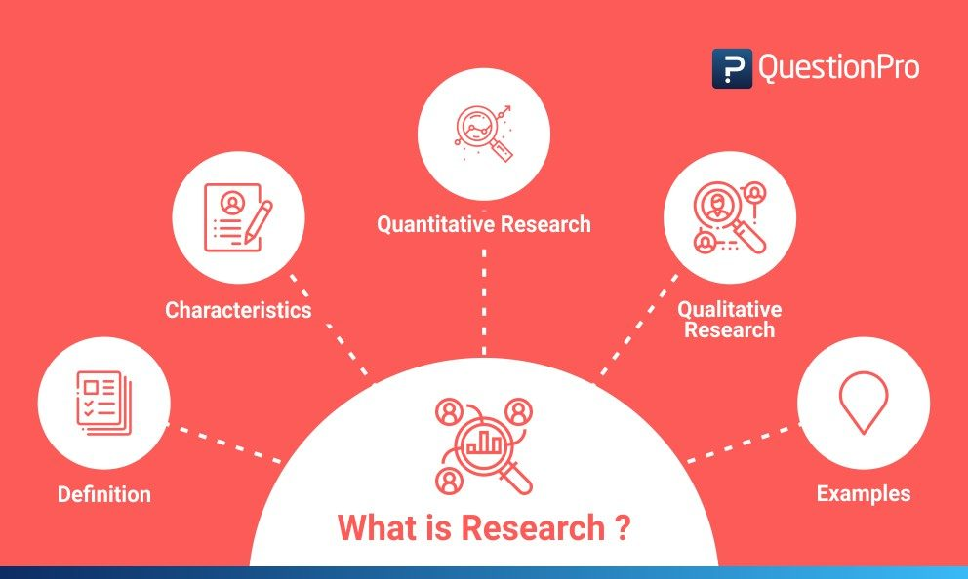

Slide 11
What is not Research?
Research isn’t teaching
Research isn’t scholarship
Research isn’t encyclopedic.
Research isn’t just data-gathering.
Research isn’t just about methodology.
Research isn’t repetition, except in some special circumstances.

Slide 12
Is Development Research?
Development (as in ‘research and development’) may or may not be classified as research, depending on the type of risk involved.
Sometimes, the two are inextricably linked: the research leads to the development and the development refines the research.
At other times, you are creating something new, but it is a new product or process, not new knowledge.
It is based on new knowledge, rather than creating new knowledge.
If the risk involved is a business risk, rather than intellectual risk, then the knowledge is already known.

Slide 13
B- Qualities of a
Good Researcher

Slide 14
a votary of truth, truth should be his goal.
dispel prejudice, should not conceive any pre-conceived notion, maintain objectivity while gathering information
gather accurate and in-depth information from the respondents
a keen observer of the phenomena and should not be complacent with approximates.
maintain precision and must try to avoid unnecessary details
analyze and interpret the collected information with a positive spirit and in the proper sense, notwithstanding his personal requirement or benefit

Slide 15
As a scientific genius, adequately sensitive to difficulties “Where less gifted people pass by untroubled by doubt.”
sufficient moral courage to face the difficult situation and should not be discouraged due to non-cooperation of the respondents or nature
utilize his time properly in a balanced manner.
no short cut to truth, so, wait to obtain complete data and always eschew hasty statement. As a scientific man, says Karl Pearson, strive at self-elimination in his judgment to provide an argument which is true for each individual mind
apathetic to the approval or disapproval of society and bold enough to present his findings of research to the society
conceptually clear, use the terms uniformly and appropriately.

Slide 16
The researcher should not only be careful in selecting the research tools but also properly trained so as to use these tools to procure reliable and valid data.
The researcher should also develop proper communicative skill and the ability to establish rapport with the respondents so as to elicit proper response.
Knowledge in the language of the respondents will be of immense help for the researcher. This will enable him not only to communicate the questions properly but also to cognize the responses properly.
Awareness of the possible drawbacks and shortcomings of research is very essential on the part of a good researcher. By knowing it before, the researcher may try to minimize such problems, although it is well high impossible to claim complete perfection of a research work.
A good researcher will always be well behaved and well clad. These qualities will attract the respondents towards him; sufficiently motivate them to produce necessary information required for the purpose of research.

Slide 17
C- Understanding key terms in Research writing

Slide 18
How to Understand key terms
Being cautious
Being critical
Classifying and listening
Compare and contrast
Defining terms
Describing terms
Describing trends
Describing quantities
Explaining causality
Giving Examples
Signaling Transition
Writing about past

Slide 19
look at the following research question/topic and determine the key concepts to use and also the words you won't use in your research:
"Special education is a field of contradictions. Historically rooted in the unease that disabilities evoke, special education has inherited both the charitable urge to accommodate the unfortunate among us and the opposite desire: to keep those who remind us of our human vulnerabilities safe from view. This tension between accepting and rejecting the individual with disabilities can be observed throughout the relatively short but eventful history of public special education in the United States” (Bursztyn xv).
After reading the above passage, a student has decided to research special education. S/he wants to determine if educational equality is preserved or hindered as a result of such programming.
First, identify a few major concepts to use as keywords and phrases for your initial searching in online databases and the library catalog.
EX: special education, equality, inclusion, exclusion

Slide 20
Unit I
Introduction
D) Research topic

Slide 21
Background research - Knowing more about your topic's background can help you to develop an effective topic that interests you.
Brainstorm concepts- brainstorm all of the words or concepts related to the topic.
Develop a research question- develop a research question you're going to answer in your topic by doing more, in-depth research.
Your general approach- think about general approaches, historical angle, a geographical angle, or a sociological angle
Start doing investigative research- scholarly articles, books, probably will modify or refine your topic
Research is a dynamic process- discover new things and modify or refine your topic. This process will help you to develop your thesis and that is essentially proposed answer to your research question.

Slide 22
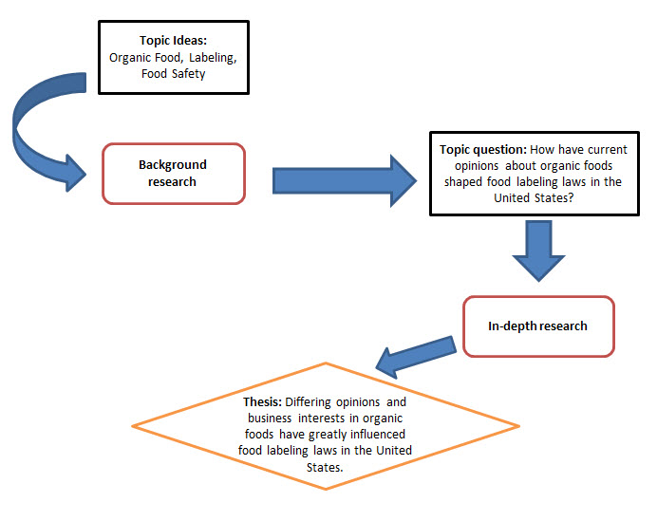

Slide 23
Focus on the following
Too Broad
Better
Too Narrow
Better
English Women Novelists of Victorian Age
George Eliot as a Feminist Novelist.(A special reference to Adam Bede)
English Women Novelists of 1760s
Feminism in George Eliot’s Novels

