Slide 1
Unit III:
Institutions, Culture, and Structures
I/ 15 Introduction:
Institutions, Cultures, and Structures

Slide 2
Difference and Structures of Power
Thus far, we have been concerned with feminist theories and perspectives that seek to understand how difference and inequalities are constructed through structures of power and binaries- race, class, gender, and sexuality intersect.
At this juncture, we can ask: where do these processes occur? How do they not only get produced, but how are they re-produced through daily activities in institutions?
We identify, historicize, and analyze several of the key institutions that structure our lives- the family, media, medicine, law and the prison system.
Struggle to end violence against women.
First, we provide a theoretical overview of institutions, culture, and structures.

Slide 3
Institutions as Primary Agents of socialization
the institutions- our lives interacting with others.
An institution is a “social order or pattern that has attained a certain state or property…and [owes] [its] survival to relatively self-activating social processes” (Jepperson 1991:145).
Institutions like the family, marriage, media, medicine, law, education, the state, and work structure thought and behavior,
In almost every facet of our day-to-day experience we operate within institutions without noticing their influence on our lives.
As a result, we can conceive of institutions as primary agents of socialization (Kimmel 2007).

Slide 4
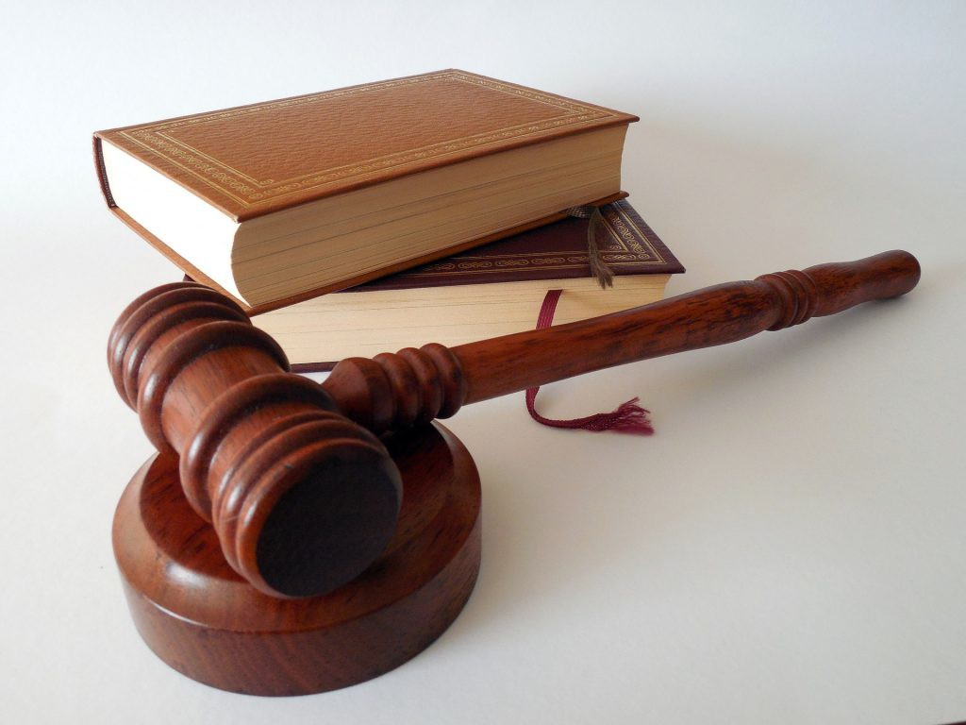
“Law Image” by Succo is in the Public Domain, CC0

Slide 5
Institutions & Inequalities
Institutions reproduce gendered, classed, racialized, ableized, and sexualized inequalities.
Everyone does not have access to the same institutions
Perhaps there was a school located in a predominantly white, middle-class neighborhood and another school located in a neighborhood of predominantly working-class people of color.
Schools - the tax - different neighborhoods - different amounts of resources—books, computers, the ability to pay teachers and staff, etc.
The middle-class students - a well-funded public school; the working-class students- disadvantaged from the lower amount of funding school.

Slide 6
The Dominant Culture
Institutions shape, and are shaped by, culture.
Culture is a system of symbols, values, practices, and interests of a group of people.1 Culture is shot through with ideology, which can be understood to be the ideas, attitudes, and values of the dominant culture.
It is important to note that “dominant culture” does not describe the most numerous group within society. “Dominant culture” typically describes a relatively small social group that has a disproportionate amount of power.
An example of a dominant culture would be the numerically small white minority in South Africa during apartheid.
More recently, the Occupy Movement has critiqued the ways in which the “1%” exerts a disproportionate amount of control and power as the dominant culture in the United States.

Slide 7
Mainstream Institutions- the Dominant Culture
Mainstream institutions often privilege and reward the dominant culture.
The sociologist Pierre Bourdieu (1984) argues that institutions value certain types of culture and reward people who have those types of culture.
As we discussed in the previous chapter, different social classes have different types of cultural capital—assets that are not necessarily economic, but promote social mobility.
For example, students who attend public schools in middle-class districts or private schools often have access to more language courses, arts courses, and extracurricular activities—skills, knowledge, and experiences that colleges value greatly in their admission decisions.
Schools in less economically privileged districts often have fewer of these options

Slide 8
Social Structures
The interaction between culture and institutions creates social structures.
Social structures are composed of
1) socially constructed ideas, principles, and categories
2) institutions distribute material resources to stratified groups
3) they shape experience, identity, and practice.
Social structures are relational that stratify groups allocating both symbolic and material benefits
“Symbolic resources” are the nonmaterial rewards that accrue to privileged groups. E.g. employers assume that employees- fathers are more responsible, mature, and hardworking, and deserve more pay as opposed to their childless peers or to working mothers (Hodges and Budig 2010).

Slide 9
Social Structures
In this example, the sex/gender/sexuality system is a structure through which employers—as gatekeepers of advancement through institutions of work—privilege heterosexual fatherhood.
The effect of this is the reproduction of the symbolic privileging of heterosexual masculinity, and the unequal allocation of material resources (salary and wage raises, advancement opportunities) to married men with children. Unmarried men without children do not receive the same symbolic and material rewards nor do married women with children.
In this sense, structures limit access to opportunities: educational opportunities, employment opportunities, and opportunities to move up in social class standing.

Slide 10
Structures as Unchangeable and Monolithic
A tendency to think of “structures” as unchangeable and monolithic entities, our definition of structure does not make such an assumption.
Social structures are made possible by their reliance on socially constructed categories that change through time and place.
Social structures structure experience and identity so people are not passive observers or dupes—as the history of labor struggles, struggles for self-determination in former colonies, the civil rights movement, and feminist movements have shown, people fight back against the institutions and dominant cultural ideas and categories that have been used to oppress them.
For instance, the phrases “Black power” and “gay power” were created by Black and gay liberationists in the late 1960s to claim and reframe identities
Therefore, structure and agency should not be viewed as two diametrically opposed forces, but as two constantly interacting forces that shape each other.

Slide 11
Thank You

